Slide 1
On Being a Woman Archivist: Fair Compensation and the Importance of Mentoring
LaNesha Gale DeBardelaben, Archivist
Charles H. Wright Museum of African American History
SAA Women’s Archivists Roundtable
August 24, 2011

Slide 2
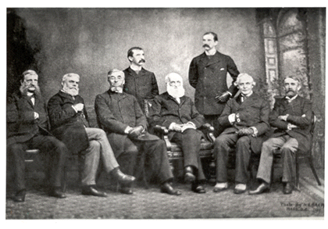
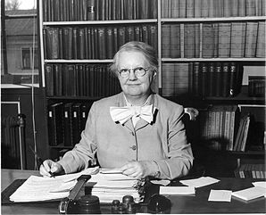
On Being a Woman Archivist
Old Boys’ Network
Founding Mothers
Officers of the American Historical Association during their annual meeting in 1889.
Margaret Cross Norton (state archivist of Illinois) who, along with Ruth Blair (state archivist of Georgia) were two of the founding members of the Society of American Archivists

Slide 3
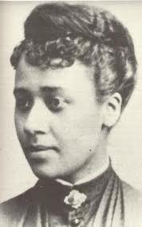
On Being a Woman Archivist
“Not the boys less, but the girls more.”
~ Dr. Anna Julia Cooper
Dr. Anna Julia Cooper (1858-1964) , Womanist scholar, author, and educator

Slide 4
On Being a Woman Archivist
The National Organization for Women (NOW) says…
“Women today are paid on average only 78 percent of what men are paid, and for women of color, the gap is significantly wider (68% for African American women and 59% for Chicano women).”
“Women’s median pay was less than men’s in each and every one of the 20 industries and 25 occupation groups surveyed by the U.S. Census Bureau in 2007. Even men working in female-dominated occupations tend to earn more than women working in those same occupations.”
Source: “Women Deserve Equal Pay.” National Organization for Women. 2011. http://www.now.org/issues/economic/factsheet.html

Slide 5
On Being a Woman Archivist
The National Organization for Women (NOW) says…
“When The WAGE Project looked exclusively at full-time workers, they estimated that women with a college degree lose $1.2 million and professional school graduates may lose up to $2 million. Not only are these inequities enormously detrimental to women and their families, wage inequities follow women into their retirement years, reducing their Social Security benefits, pensions, savings and other financial resources.”
Source: “Women Deserve Equal Pay.” National Organization for Women. 2011. http://www.now.org/issues/economic/factsheet.html

Slide 6
On Being a Woman Archivist
The National Organization for Women (NOW) says…
“Wage disparities kick in shortly after college graduation, when women and men should, absent discrimination, be on a level playing field. One year after graduating college, women are paid on average only 80 percent of their male counterparts' wages, and during the next 10 years, women's wages fall even further behind…Even after "[c]ontrolling for hours, occupation, parenthood, and other factors normally associated with pay, college-educated women still earn less than their male peers earn. . . . A large portion of the gender pay gap is not explained by women's choices or characteristics.”
Source: “Women Deserve Equal Pay.” National Organization for Women. 2011. http://www.now.org/issues/economic/factsheet.html

Slide 7
On Being a Woman Archivist
Professional and Related Occupations | Median Weekly Earnings
White women | $922
African American women | $764
Asian women | $1,132
Latino women | $782
White men | $1,221
African American men | $933
Asian men | $1,396
Latino men | $970
Institute for Women’s Research Policy
Table 1:
Median Weekly Earnings for Male and Female Workers, by broad occupational classification and Race and Ethnic Background (Full-Time Workers Only), 2010
Source: http://www.iwpr.org/initiatives/pay-equity-and-discrimination/#publications
IWPR compilation of data based on US Bureau of Labor Statistics, Annual Average 2010.

Slide 8
On Being a Woman Archivist
The National Committee on Pay Equity Research Reports
2011 State-by-State Equal Pay Fact Sheets
2011 Gender Wage Gap by Occupation Report
2011 Simple Truth about Gender Pay Gap Report
2011 Wage Disparities and Women of Color Report
Source: Research Reports. National Committee on Pay Equity. “http://www.pay-equity.org/info.html

Slide 9
On Being a Woman Archivist
PAY EQUITIES
Don’t be afraid to negotiate.
Know your worth, communicate your worth, and bank upon our worth.
Research the average and median salaries of your professional position at similar institutions in your locality, region, and nationally. The more you know, the greater your ability to advocate for yourself.

Slide 10
On Being a Woman Archivist
MENTORING
Mentoring is about connecting, communicating, and influencing others, reciprocally.
It is the altruistic act of actively supporting, assisting, and facilitating another in their professional development. Simply put, it is helping others help themselves.

Slide 11
On Being a Woman Archivist
Mentoring is for everyone, not just for new archivists.
Mentoring can assist you at different stages in your career. No matter where you are in your profession, you can gain to grow and connect with others. If you anticipate a career move or plan to consider running for an elected office in the profession, having a mentor would prove extremely helpful.

Slide 12
On Being a Woman Archivist
What I have gained from my mentors:
Wisdom
Sound professional habits and practices
A wider network
Knowledge of professional opportunities
A sounding board during times of frustration
A patient teacher who has traveled the road
A motivator/encourager/professional friend

Slide 13
On Being a Woman Archivist
Best Practices in Mentoring:
Set goals for the relationship (create structure and expectations).
Work at it. Take it seriously, but enjoy every moment.
Take the initiative, make the time, and protect the time.
Respect confidentiality.
Be responsible.
Be frank and direct. Encourage feedback.

Slide 14
On Being a Woman Archivist
Let’s Talk!

