Slide 1
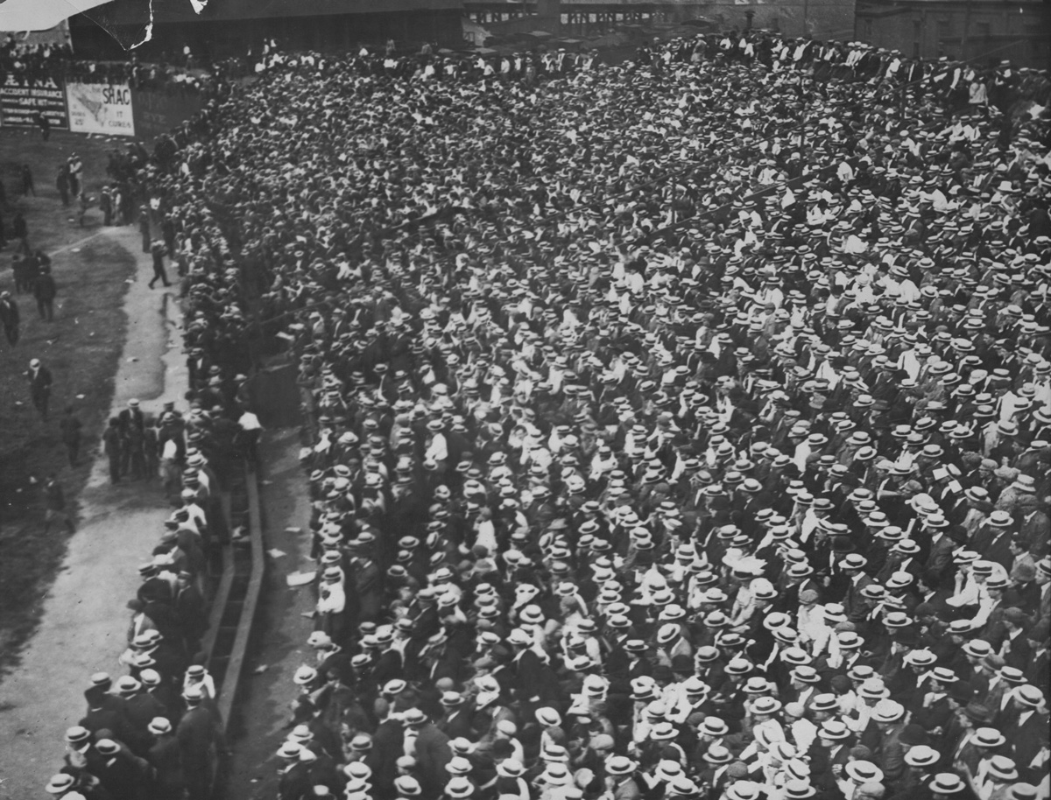
PLASC Member Survey:
Who’s our crowd?
Conducted by Stephanie Bennett and Adrienne Pruitt
Presented at the PLASC annual business meeting, Friday, August 16, 2013
Notes:
This member survey was conducted on behalf of the Public Library Archives/Special Collections Roundtable to help the Steering Committee better serve its nearly 960 members and list participants. The survey was created by Adrienne Pruitt and open from January 31 to February 28, 2013. Question responses were compiled by Stephanie Bennett.
The survey was completely anonymous and was open to all members of the PLASC roundtable. No direct quotations from the free text responses will be made publicly available. Summaries only have been provided where appropriate.
Raw survey data is stored in SAA's SurveyMonkey account, which is accessible to SAA leaders.
Image courtesy of the Boston Public Library. Image number: 05_02_010618
Bond, E.E. (Edmunds E.), 1871-1969 ; Roxbury, Massachusetts; 1904-1911

Slide 2
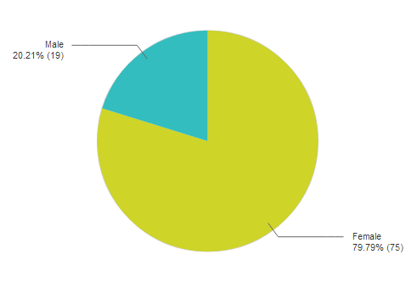
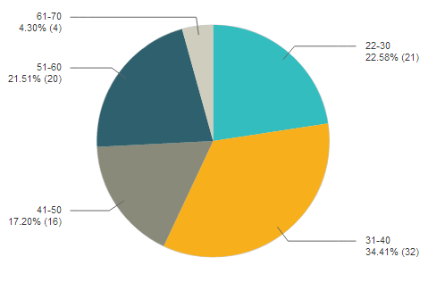
General Demographics
What is your gender?
What is your age?
Notes:
Seventy-five of the ninety-four respondents were women.
Fifty-three respondents were between the ages of 22 and 40. Thirty-six were between 41 and 70. No one was under 22 or over 70.

Slide 3
General Demographics
Answer Choices | Responses
Pacific (Alaska, California, Hawaii, Oregon, Washington) | 7.69% (7)
Mountain (Arizona, Colorado, Idaho, Montana, Nevada, New Mexico, Wyoming, Utah) | 13.19% (12)
West South Central (Arkansas, Louisiana, Oklahoma, Texas) | 7.69% (7)
East South Central (Alabama, Kentucky, Mississippi, Tennessee) | 3.30% (3)
South Atlantic (Delaware, District of Columbia, Florida, Georgia, Maryland, North Carolina, South Carolina, Virginia, West Virginia) | 13.19% (12)
West North Central (Iowa, Kansas, Minnesota, Missouri, Nebraska, North Dakota, South Dakota) | 3.30% (3)
East North Central (Illinois, Indiana, Michigan, Ohio, Wisconsin) | 6.59% (6)
Mid-Atlantic (Pennsylvania, New Jersey, New York) | 28.57% (26)
New England (Connecticut, Maine, Massachusetts, New Hampshire, Rhode Island, Vermont) | 16.48% (15)
 | n = 91
Notes:
The Mid-Atlantic had the largest number of respondents, nearly 29%. The Mountain, New England, and South Atlantic regions were home to approximately 15% of respondents. Every region had at least three respondents. One respondent called Europe home.
Regions based on census.

Slide 4
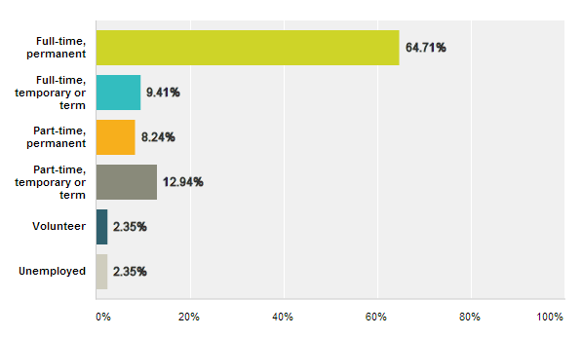
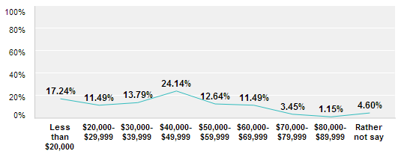
Job Demographics
What is your current employment status?
What is your total annual salary?
Notes:
The majority of respondents, fifty-five people, were in full-time, permanent positions. Nineteen respondents had a temporary or term position, either full- or part-time. No respondents indicated they were interns or retirees.
Most respondents earned $40,000 to $49,999, nearly 25%; around seventeen percent earned less than $20,000. Less than five percent reported earning more than $70,000.

Slide 5
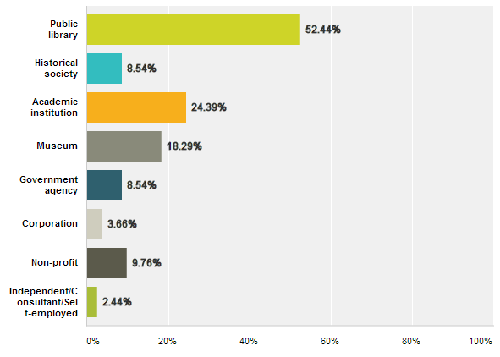
Job Demographics
In what kind of repository do you work?
Notes:
A majority of respondents indicated that they work at a public library. Academic institutions were home to nearly a quarter of the respondents. Museum employees were nearly twenty percent of respondents, and non-profit employees accounted for almost ten percent.

Slide 6
Job Demographics
What is your job title?
Title Word | Respondent Titles
Archive, Archives or Archivist | 40
Library or Librarian | 31
Assistant or Associate (as a noun) | 7
Collections | 6
Curator | 5
Manager | 5
Processing or Processor | 5
Volunteer | 4
Notes:
While we cannot provide exact titles, the following represent the most common words in the seventy-six respondents’ titles. More than one of the words below may be present in a single title, and some respondents provided multiple titles.

Slide 7
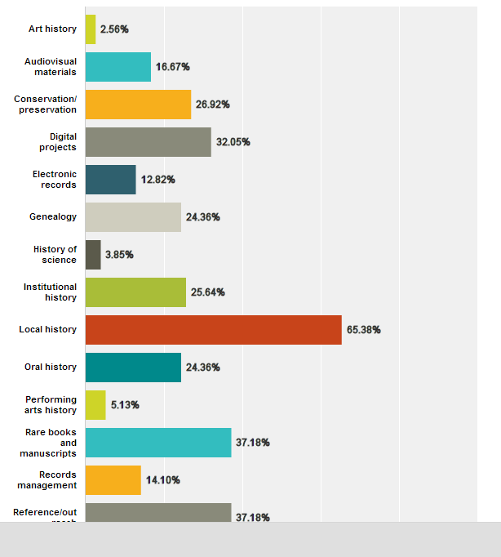
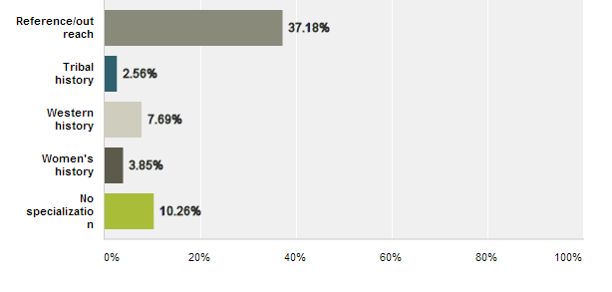
Job Demographics
Does your work specialize in a particular area?
Notes:
As seen in the table below, by far the most frequently chosen specialization, selected by 51 of 78 respondents, was local history. Rare books and manuscripts and reference/outreach were the next most popular, possibly reflecting common academic archives structure. In addition to the provided responses, twenty comments provided more details about individual roles. Commenting respondents indicated programming and instruction roles; governmental or military focus; or art, architecture, or artifacts/objects work.

Slide 8
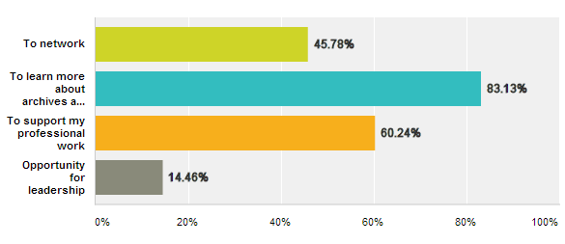
PLASC Membership
Why did you join PLASC?
Notes:
Eighty-three percent of respondents belong to PLASC to learn more about archives and special collections in public libraries; professional work support and networking were both important to respondents. Only a few, twelve people, joined for leadership opportunities. A small number of comments from respondents included past work in public library archives and recognition that public library challenges were frequently shared by other types of small repositories.

Slide 9
PLASC Membership
What do you most value about the PLASC roundtable?
Respondents’ comments, twenty-seven in all, indicated that those members valued the roundtable for three reasons:
Networking opportunities (11 responses)
Learning and information-sharing opportunities (10 responses)
Support and identification from like-minded librarians and institutions (12 responses)
In some responses, more than one reason was indicated; for example, several responses appreciated the opportunity to network with others and exchange ideas.

Slide 10
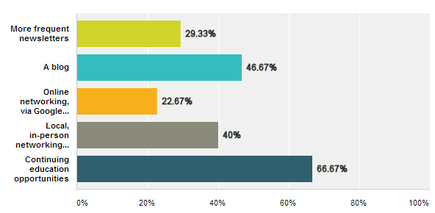
PLASC Membership
What would you be interested
in seeing PLASC offer?
Notes:
The most popular response was continuing education opportunities. Other popular responses included local, in-person networking events and online networking, via Google Hangouts or Skype.

Slide 11
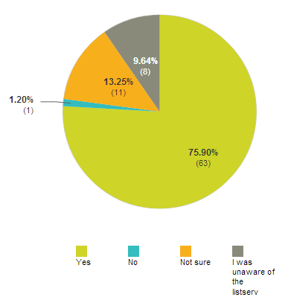
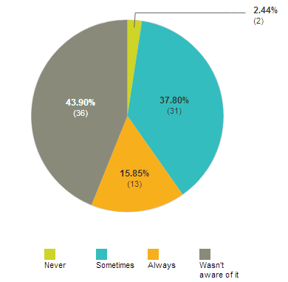
Are you subscribed to the PLASC listserv?
PLASC Membership
Do you read the PLASC newsletter?
Notes:
While a majority of respondents were on the listserv, nearly twenty-five percent were not sure or did not know about the listserv.
Approximately half of the respondents read the newsletter occasionally or regularly.

Slide 12
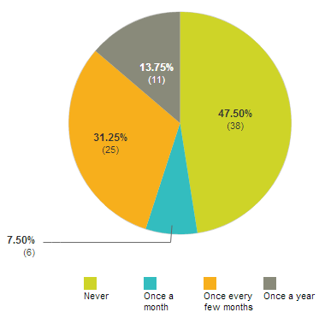
How often do you visit the roundtable web page? What information are you seeking?
Answer Choices | Responses
Annual reports | 25% (10)
By-laws | 2.5% (1)
Contact information | 30% (12)
Election information | 25% (10)
Newsletters | 72.5% (29)
 | n = 40
What else might you like to see on the web page?
Answer Choices | Responses
A guide to online resources | 79% (49)
FAQs | 53.2% (33)
Member news | 59.7% (37)
PLASC-related presentations from annual SAA meetings | 79% (49)
 | n = 62
Notes:
A little more than fifty percent of respondents visited the web page but most rarely do.
Respondents who did go to the roundtable web page were most often looking for newsletters. Other sought-after information included job postings and general information.
Respondents were interested in all provided options. Comments indicated interest in career and development resources, as well as new developments in archives overall.

Slide 13
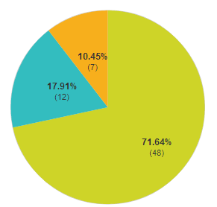
PLASC Membership
Do you attend the PLASC business meeting during the annual SAA conference?
Are there program topics you would like to see presented at future business meetings?
How to start an archives or special collections library (2)
Advocacy for small institutions
Programming ideas for small institutions
Resources for small or public institutions
Funding challenges and possible solutions
Central index or access points to local collections
Ideas on user inputs of national name authorities for local history and genealogy
Role of volunteers in public library archives
Security in public library collections
Networking with similar repositories
Members sharing what they’re working on
Notes:
Funnily enough, we also asked this question . .
A considerable majority of respondents, nearly two-thirds, had not attended PLASC’s business meeting at the annual SAA conference.
Comments indicated most respondents were not able to afford SAA annual meeting attendance regularly or at all;
others had roles in other roundtables that required attendance at other meetings. This is one reason we’re trying to video this meeting for posting on YouTube, so that our members who can’t be present can still be a part of the conversation.
If these are things you’re interested in presenting at next year’s meeting, please talk to us today or by email!

Slide 14
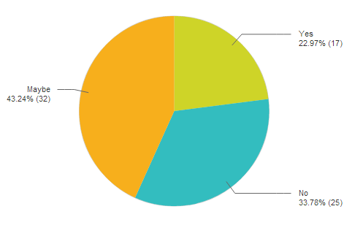
PLASC Membership
Would you be interested in participating
in SAA’s mentoring program?
Other comments or questions?
Notes:
Nearly a quarter of the respondents reported an interest in participating in SAA’s mentoring program. Nearly half of respondents were possibly interested in participating in the program, and thirty-four percent were not interested.
A handful of respondents had more feedback, including a request for more discussion on the listserv, starting with topic prompts; a stated desire to learn more from interactions with people working in the field; and two thank yous. We’re also interested in hearing from you in person, today!
Comments indicated that some respondents have mentored through the program before. Other respondents were early in their career or SAA memberships and did not feel comfortable guiding others. A small number did not qualify due to lack of SAA membership.

Slide 15
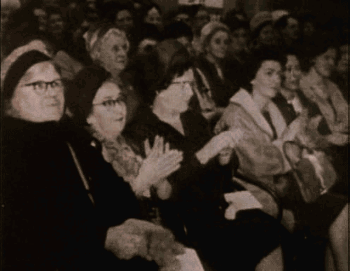
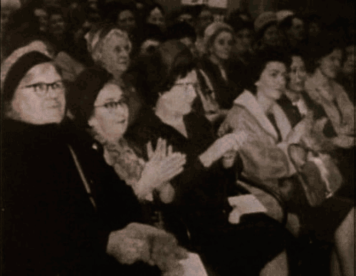
PLASC Member survey

Slide 16
Questions? Comments?
Adrienne Pruitt
Processing Archivist
Boston College
adrienne.pruitt@bc.edu
Stephanie Bennett
Project Archivist
Iowa State University
se.bennett@gmail.com

