Slide 1
Showcasing CNY
Promoting Local History Collections through Digital Collaboration
Deirdre Joyce, Assistant Director & Regional Archivist, CLRC

Slide 2
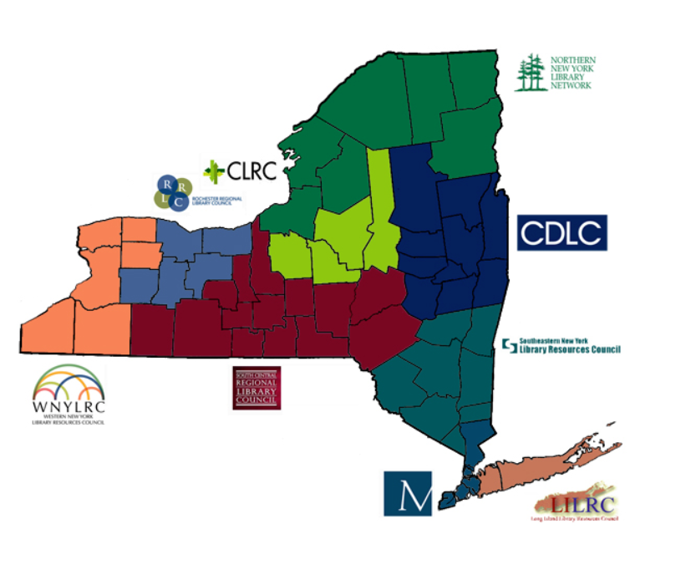
Who are we?
Central New York Library Resources Council (CLRC)
One of 9 regional library systems in NY
Serving a 4 county region in Upstate NY

Slide 3
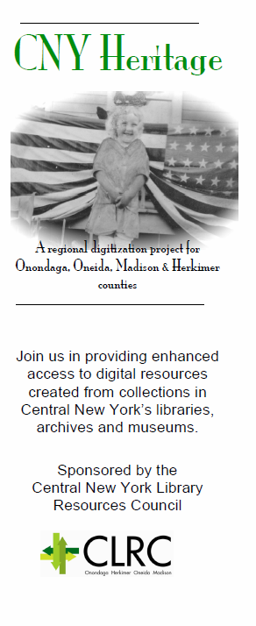
Timeline
2008: CNY History

Slide 4

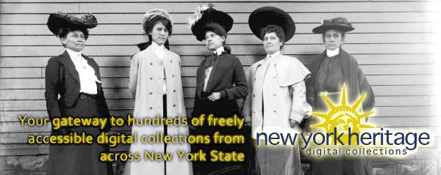
Timeline
2008: CNY History
2010/11: New York Heritage
http://nyheritage.org

Slide 5
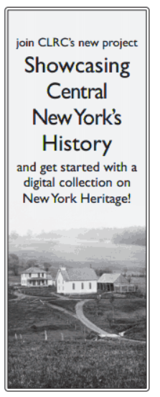
Timeline
2008: CNY History
2010/11: New York Heritage
2012/13: Showcasing CNY

Slide 6
Features
New membership category
Collaboration with public libraries encouraged
Full service digitization using interns from Syracuse University
Digitization “bootcamp”

Slide 7
Results
9 new institutions joining CLRC as Heritage members (room to grow)
17 new collections during grant period
6 public libraries
7 historical societies
16 additional collections being worked on now
11 public libraries
2 historical societies
6 interns and a renewed relationship with the SU iSchool

Slide 8
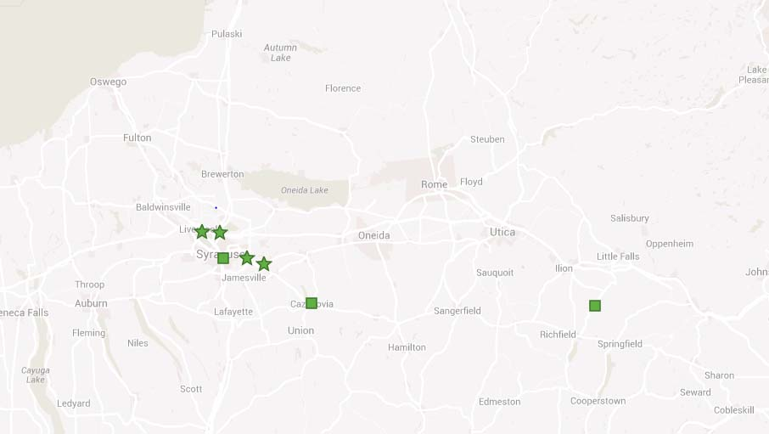
Before:

Slide 9
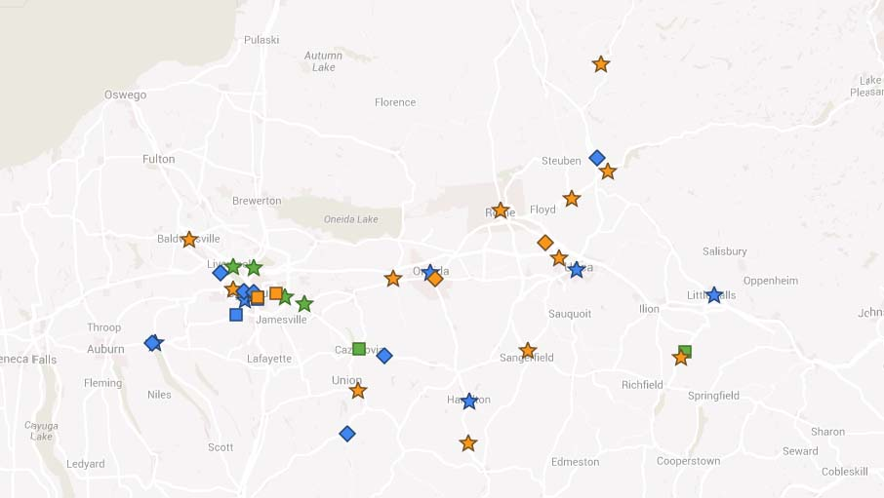
After:

Slide 10
Key Takeaways:
Focus on collections
Focus on users
Focus on relationships

Slide 11
Thank You.
Deirdre Joyce
Assistant Director & Regional Archivist
Central NY Library Resources Council
p: 315.446.5446 / email: djoyce@clrc.org

