Slide 1
G-L-O-R-I-A: the hidden archive of 16 magazine’s editor

Slide 2
Notes:
Website: library.rockhall.com

Slide 3
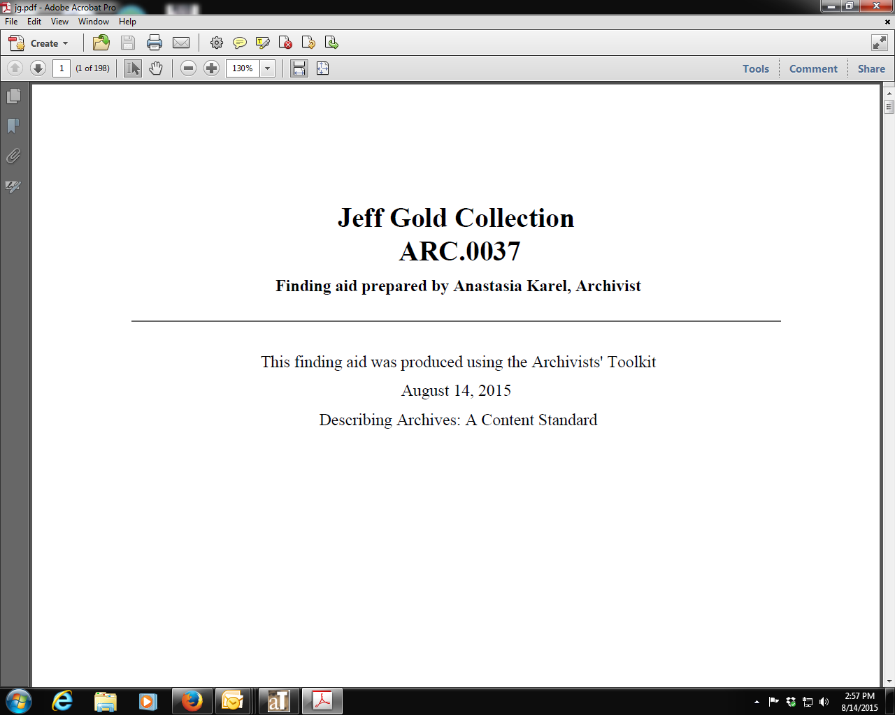
Notes:
This slide and next give finding aid details.

Slide 4
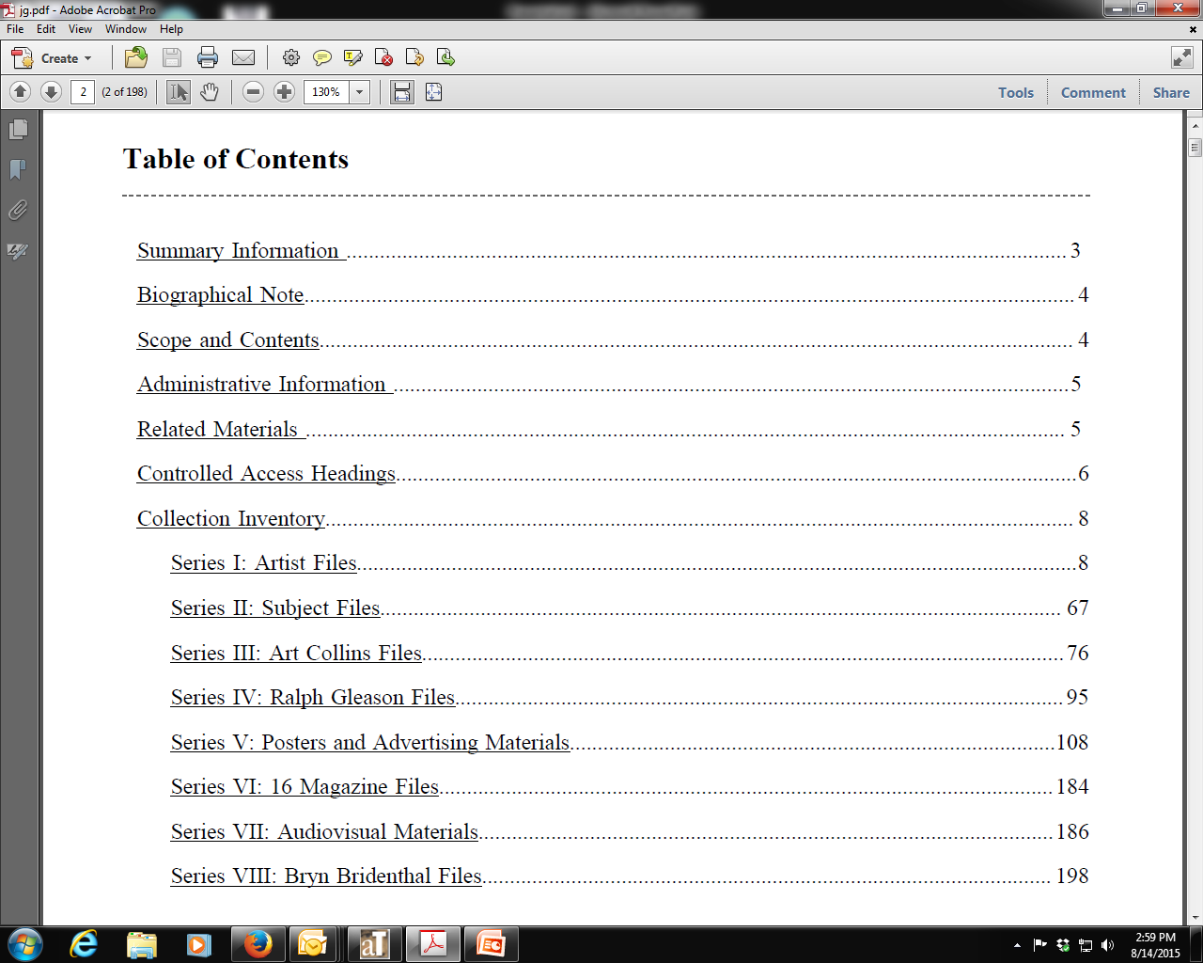

Slide 5
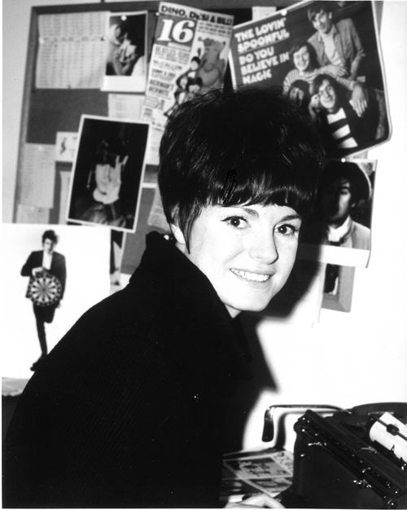
Notes:
Photo of Gloria Stavers in her office (from gloriastavers.com, not the collection)

Slide 6
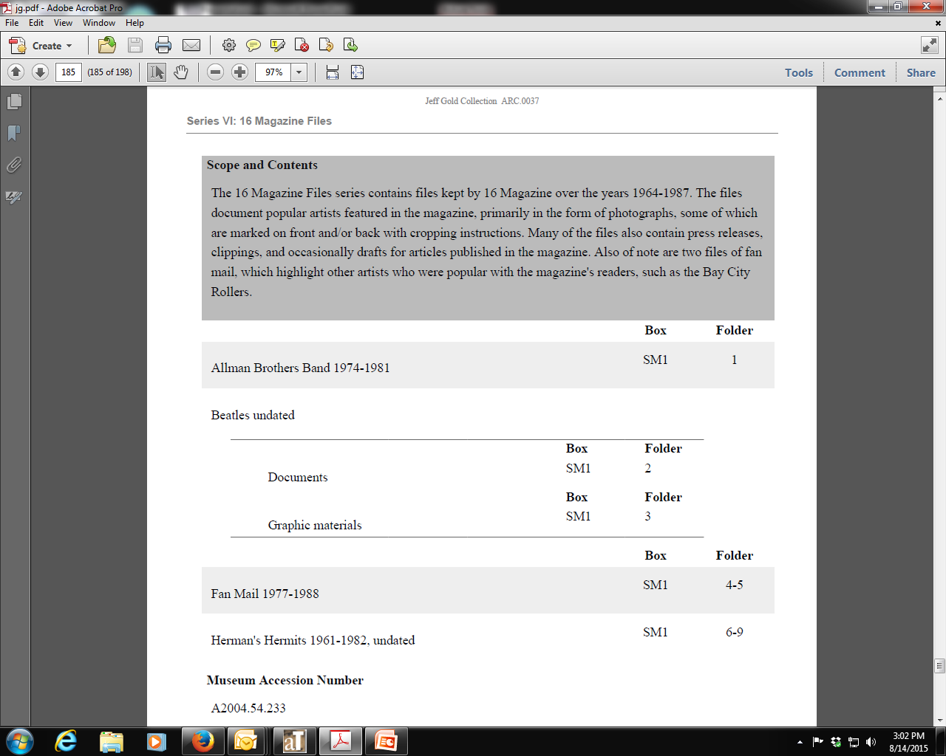
Notes:
Finding aid detail showing the Beatles’ files

Slide 7
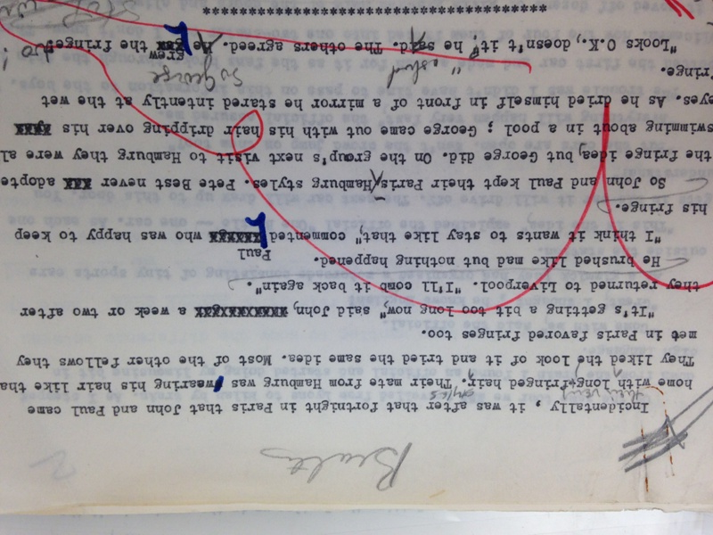
Notes:
Close-up scan of an original manuscript written by the Beatles’ road manager, Neil Aspinall

Slide 8
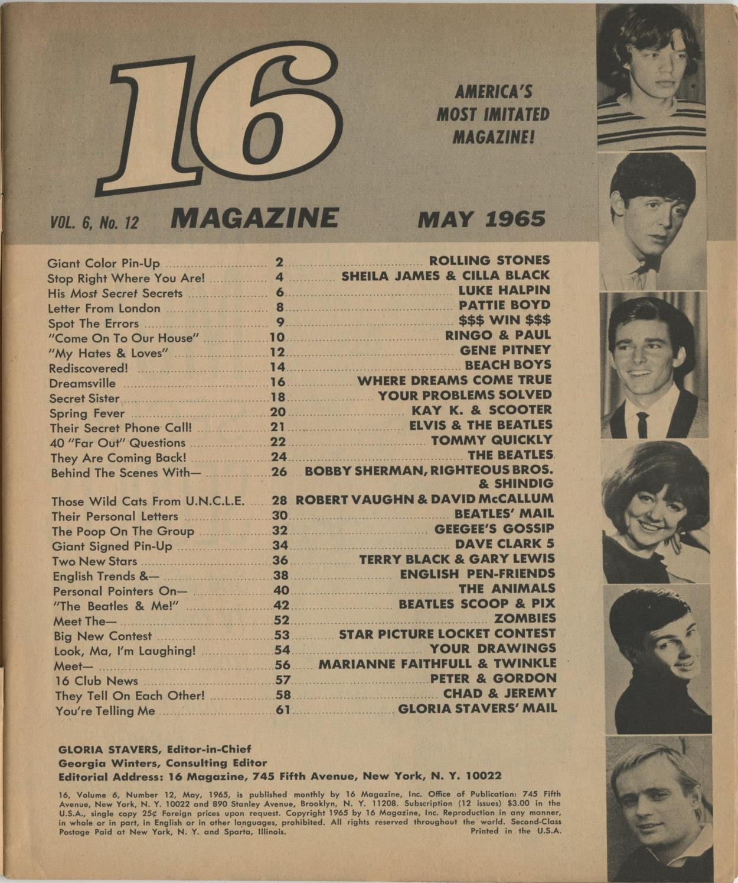
Notes:
Issue of 16 where the Neil Aspinall piece appeared

Slide 9
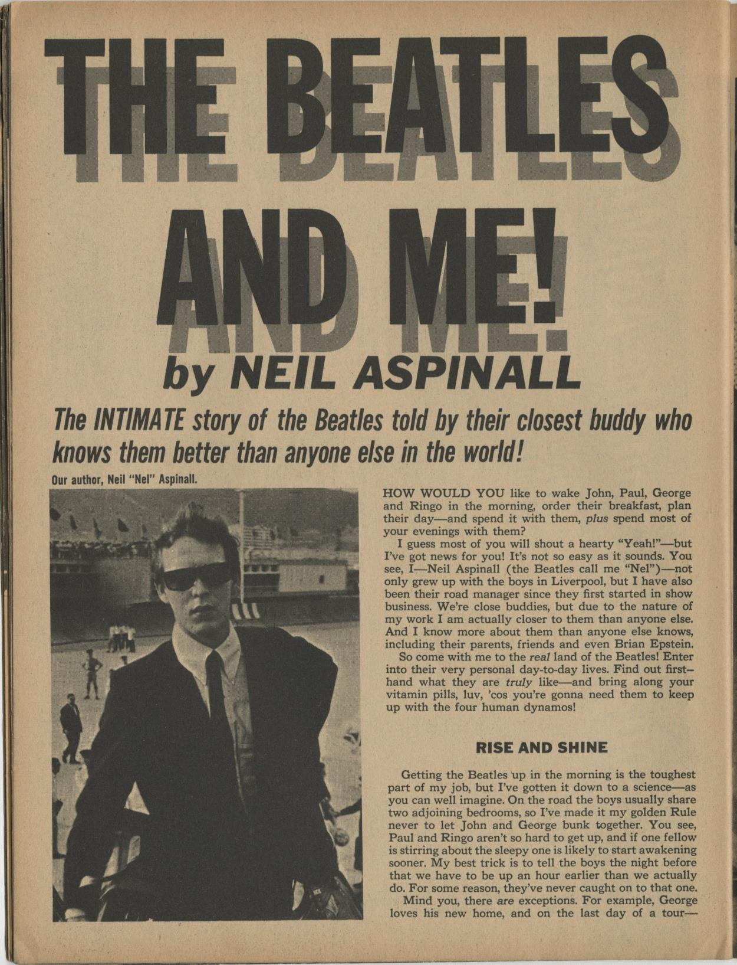

Slide 10
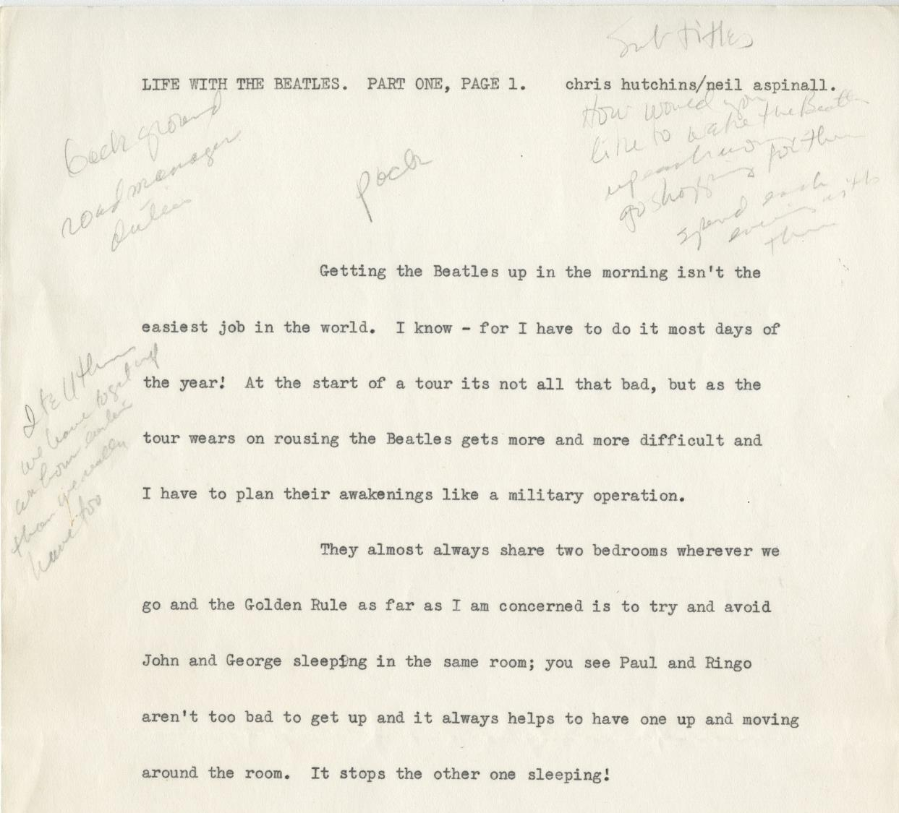
Notes:
Another draft of an article by Neil Aspinall (compare handwritten notes with what was published in previous slide)

Slide 11
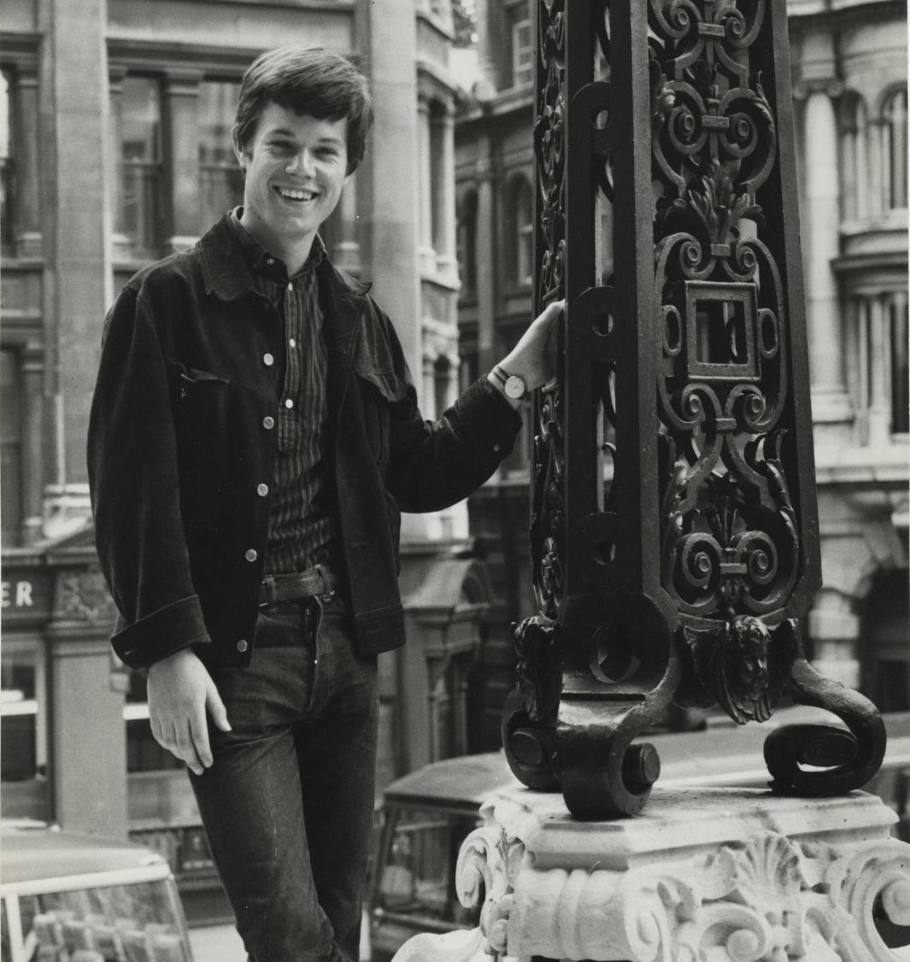
Notes:
Q: Do you know who this is?

Slide 12
Notes:
A: Mick Jagger’s brother, who is also a musician, but at the time was just a source for news

Slide 13
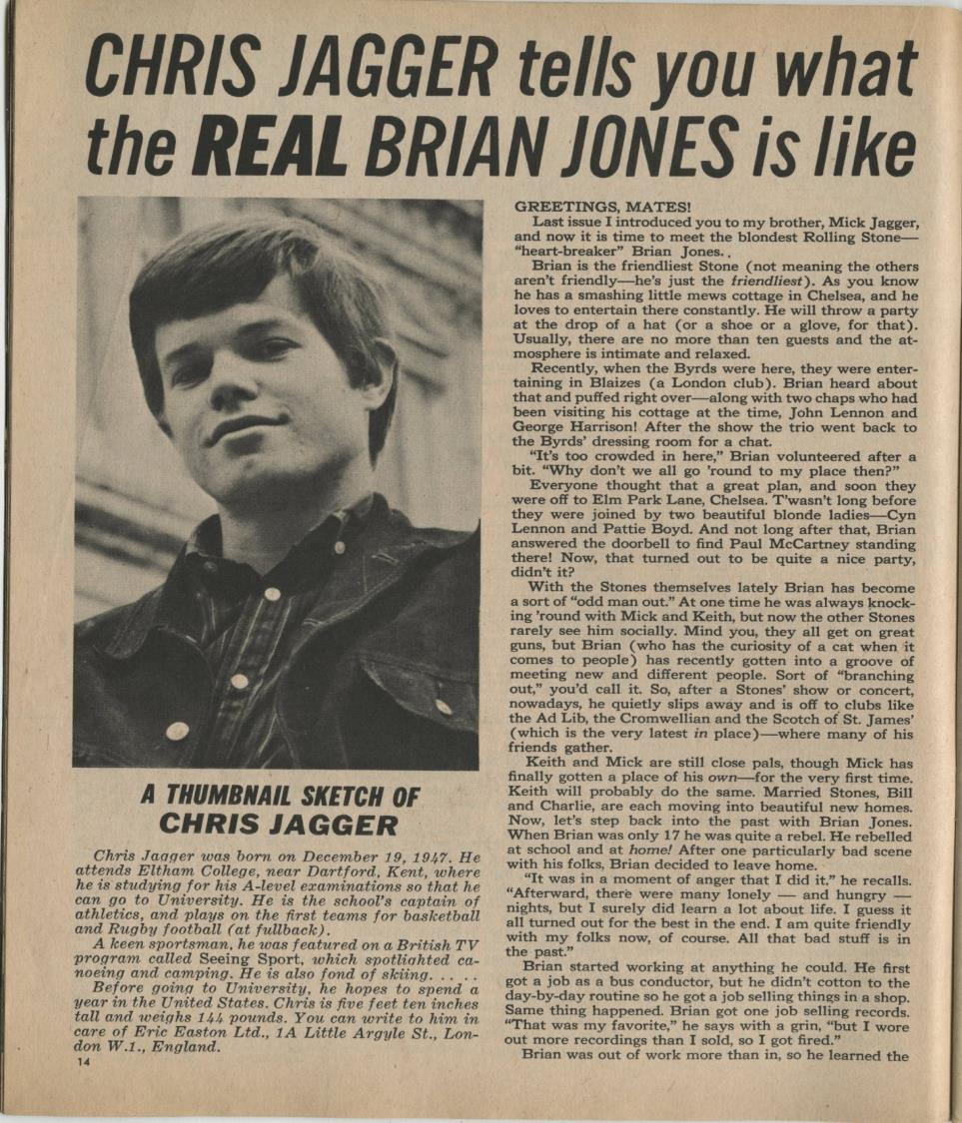

Slide 14
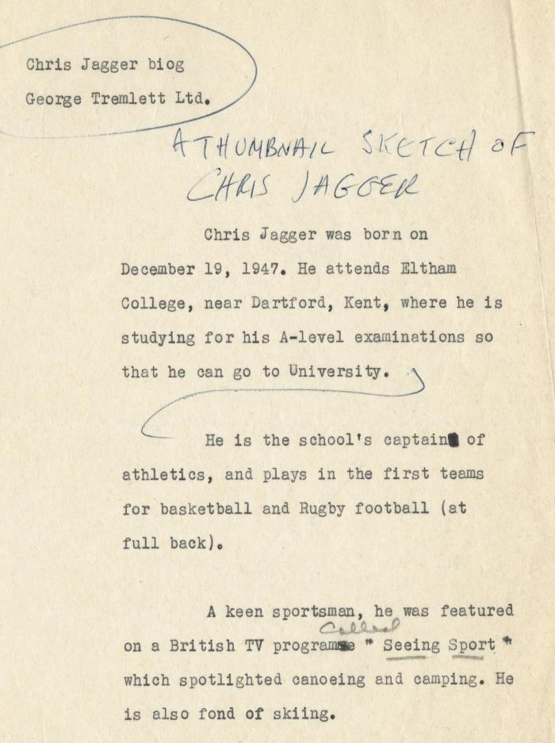
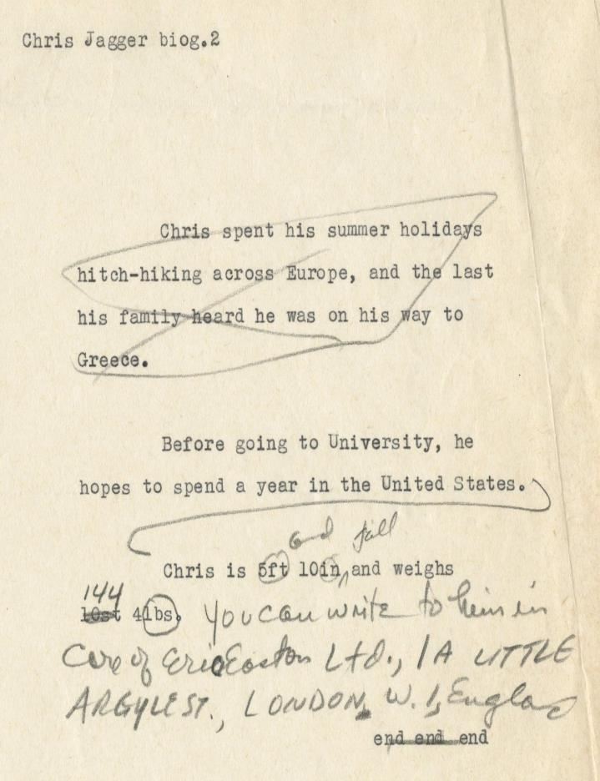
Notes:
See previous slide to see the published version of this thumbnail sketch

Slide 15
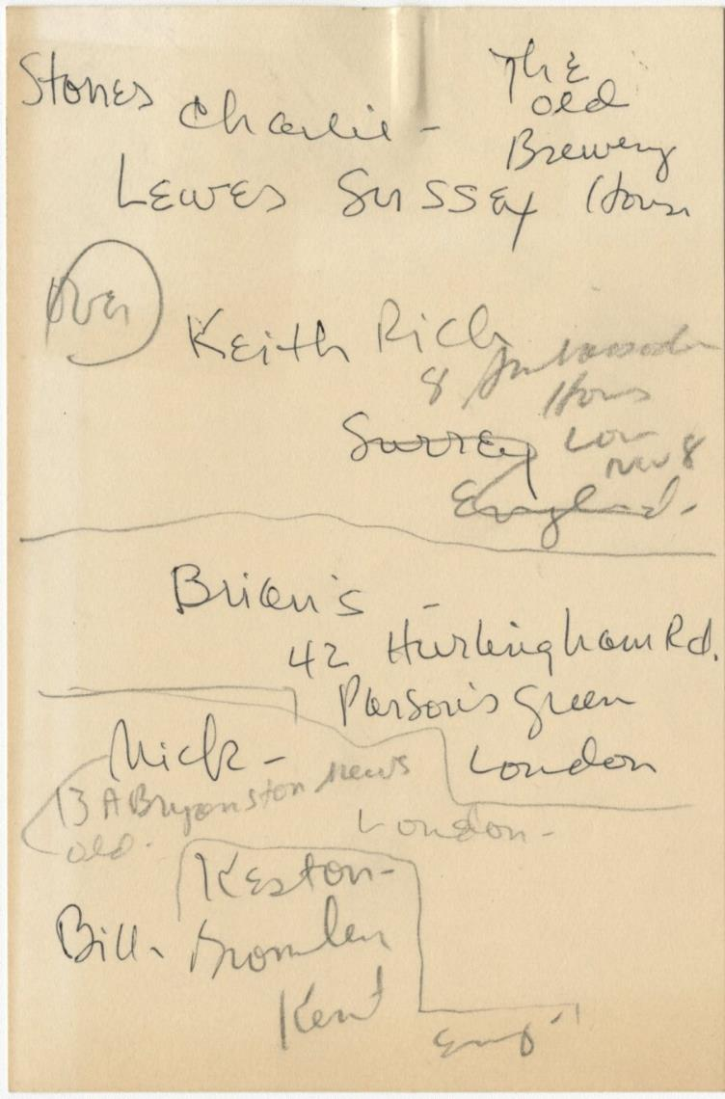
Notes:
Addresses for the Rolling Stones

Slide 16
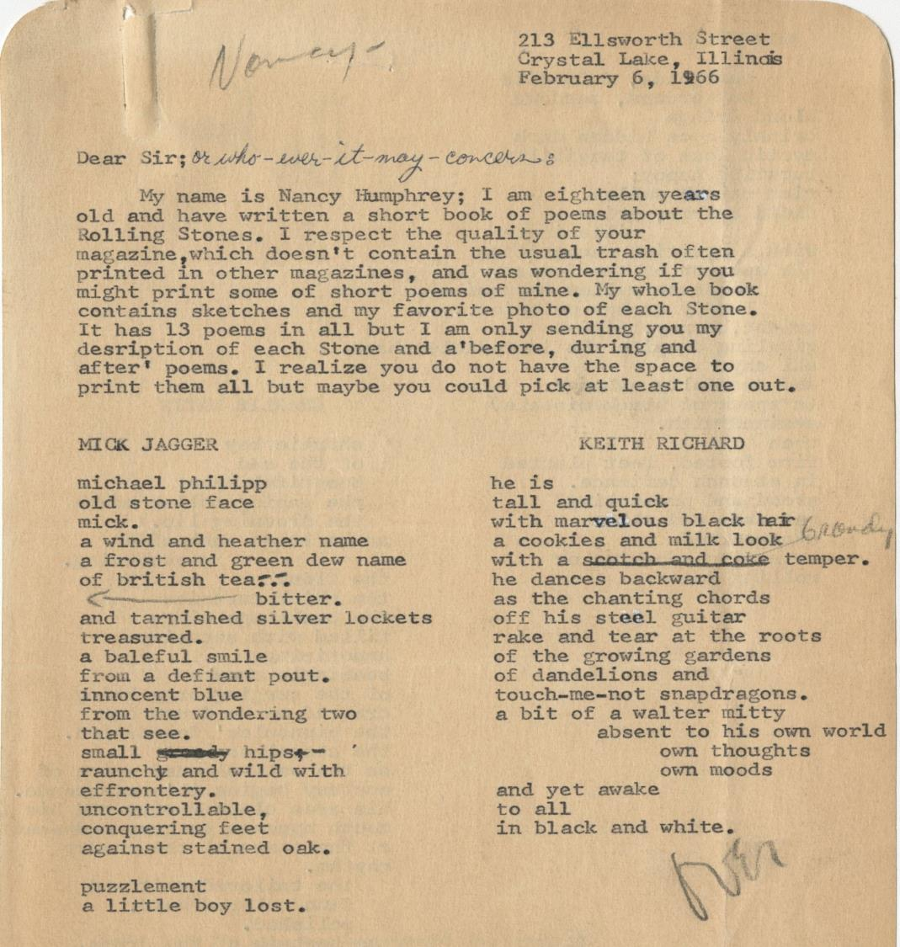
Notes:
Poems submitted to 16

Slide 17
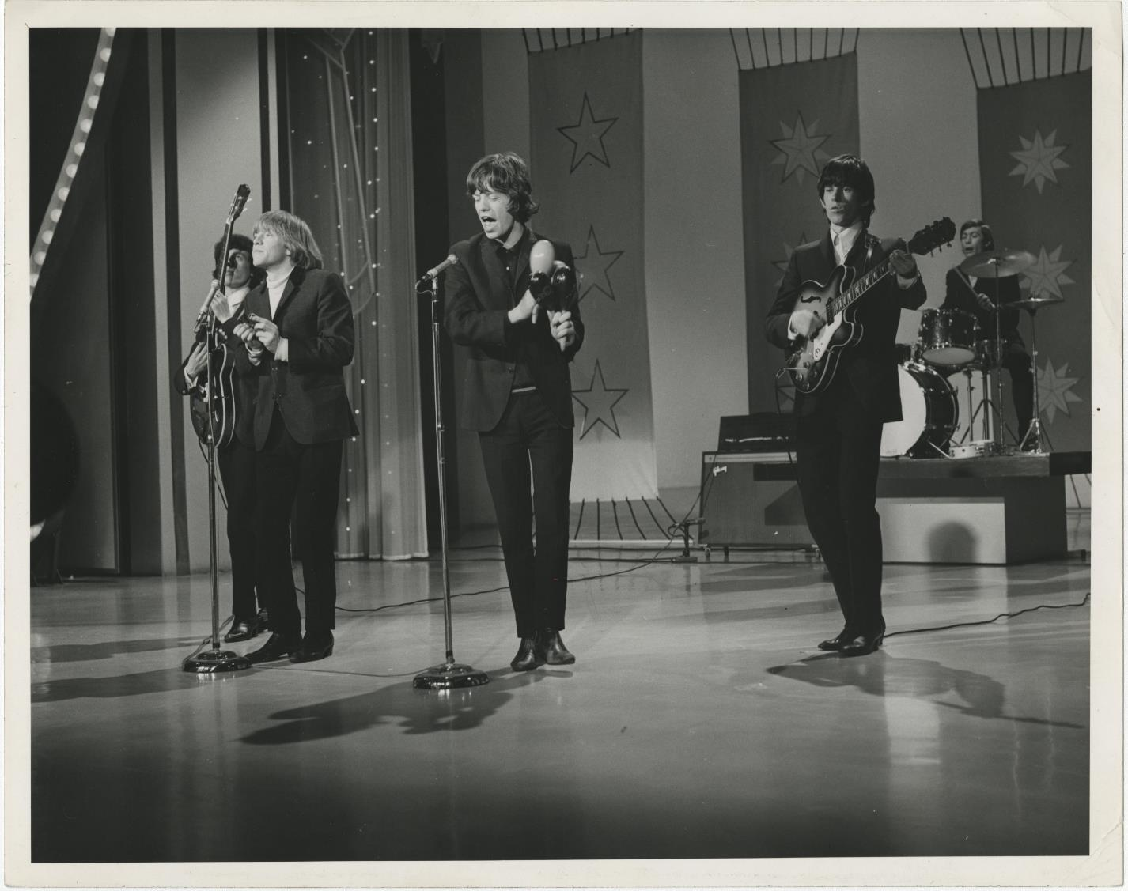
Notes:
Photograph of the Rolling Stones taken by Gloria

