Slide 1
Collaboration to Preserve Our Heritage
An Update on the IMLS Connecting to Collections Initiative
Tom Clareson, Lyrasis
Gina Minks, Amigos

Slide 2
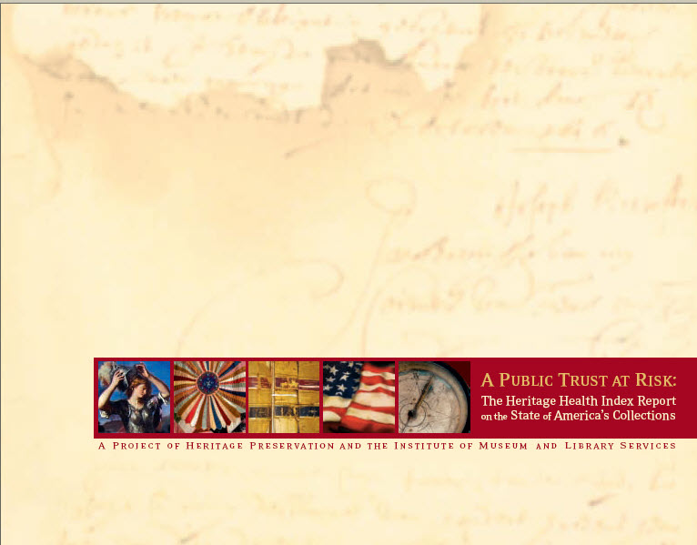
Background on
Connecting to Collections
Began with the publication of the “Heritage Health Index” Findings in 2005
Sponsored by Heritage Preservation and the Institute of Museum and Library Services (IMLS)
Notes:
Nearly 3000 Institutions Surveyed
Report: A Public Trust at Risk: The Heritage Health Index Report on the State of America’s Collections (2005)

Slide 3
HHI Recommendations
Provision of safe conditions for collections
Development of Emergency Plans
Assignment of responsibility for caring for collections to institutional staff
Broad public/private support for collection stewardship

Slide 4
Connecting to Collections:
A Call to Action
National Initiative launched November 2006
Collaboration between museum and library communities
Intended to both educate practitioners and raise public awareness
A five-part program

Slide 5
The Five Components of
Connecting to Collections
National Conservation Summit, June 2007
“National Tour” (four conferences)
Connecting to Collections Bookshelf Grants
Connecting to Collections Planning Grants
Connecting to Collections Implementation Grants
Connecting to Collections Online Community: www.connectingtocollections.org.

Slide 6
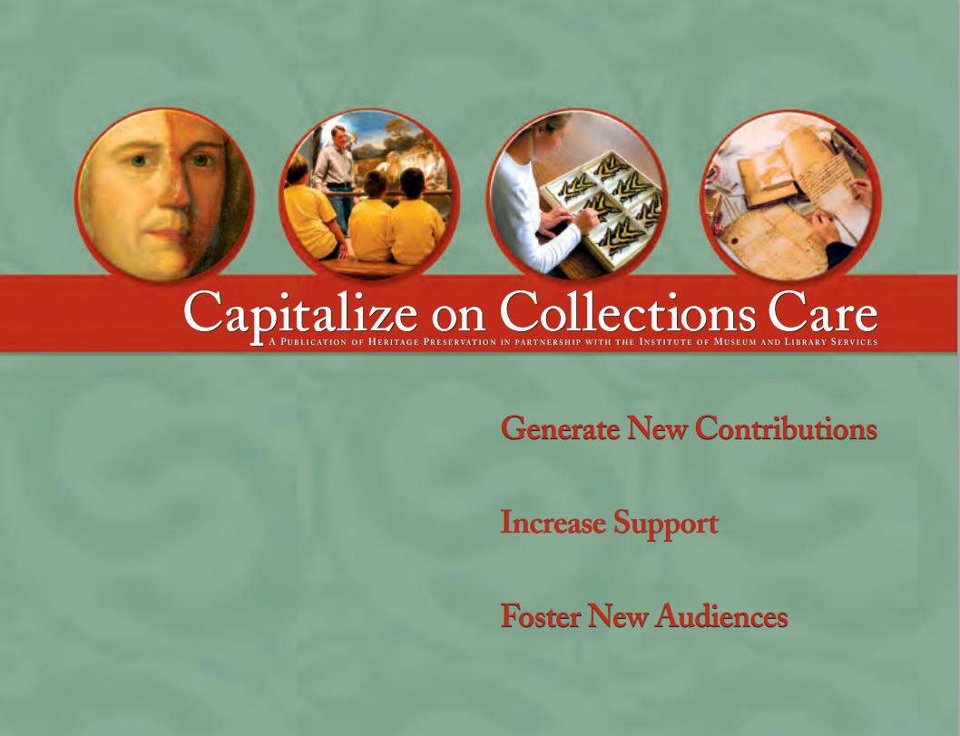
Notes:
Several interviews with museum directors about resources that would be helpful. Capitalize on Collections Care was high on the list, with CA examples.

Slide 7
Implementation Activities Support Overall Goals
Providing safe conditions for collections
Disaster preparedness workshops
Disaster networking workshops
Marshalling public and private support
Project
Development
workshops
24/7 emergency hotline and resources
Stewardship campaign for trustees
Notes:
Entire scope of work in the C3 implementation project

Slide 8
IMLS: Connecting to Collections
Copyright IMLS: http://www.imls.gov/collections/about/pdf/CtoC_Map_Jul09.pdf
Notes:
This map shows recent grant efforts under C2C across the country.
IMLS grants cover a number of different of different programs:
One grant per state is devoted to the Connecting to Collections program which we are discussing here, and many MD institutions have received smaller grants for in-house projects. If your institution is interested in some of these, you should contact IMLS.

Slide 9
Building a
Cooperative Disaster Network
An example from Maryland C2C initiative:
Museums
MDC2C
Archives
Libraries
Repositories
Notes:
The fourteen MDC2C partners are just the beginning.
Any institution that uses MDC2C in the future will be networked to all the partners, both of like kind and unlike.
But crucially, they will be linked closely to local partners for sharing assistance in the event of disasters, and to remote partners who have complementary resources.
All of the information that you put into MDC2C about your available resources, your vendor contacts, your institutional skills, will all be shared with the rest of the network via MdPlan and the Pocket Response Guide.
COOPERATIVE DISASTER NETWORK!!!

Slide 10
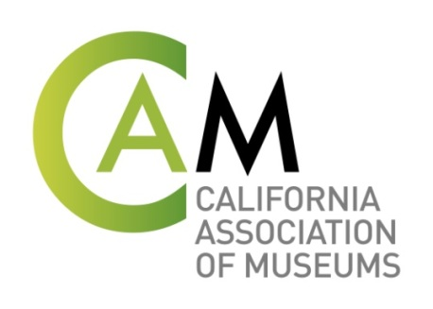
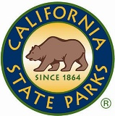
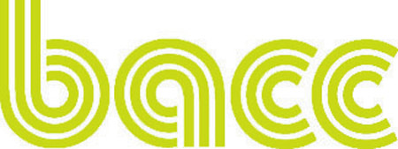
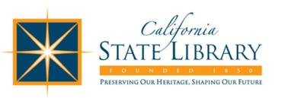
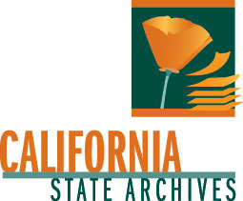
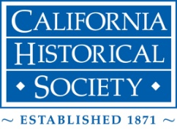
Heritage Collections
Notes:
Red = new connections to the California Preservation Program

Slide 11
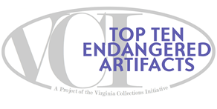
Connecting to Collections
Statewide Implementation Grant: 2011-2013
Heritage Health Index Recommendation
“…The marshalling of
public and private
support for, and
public awareness
about, collections care.”
Something Sexy (Lists!)
Public Awareness Campaign
Something Known
Public Voting Component
Notes:
People love lists. There’s a ‘Best of’, ‘Top 10’, ‘Top 100’ ‘what have you’ list out there for countless subjects, and we’re using that successful format to get the message out about the importance of collections. The format is not unique, but the subject matter is, and this has certainly helped us ‘marshall support’ for our collective cause. (pun intended) So with the “Top 10”, we have a successful PR campaign – something sexy (as requested), something known – such as National Trust for Historic Preservation’s ‘Most Endangered Historic Places’ program and our local ‘Most Endangered Historic Sites’ program of Preservation Virginia – one of our partners. Last, an online public voting element allows for direct public interaction with the program and the participating organizations.

Slide 12
How Does the ‘Top 10’ Work?
Museums, libraries, archives submit artifacts for consideration
Online public voting open for one month
Peer review panel determines final honorees
manage media relations
Works with all sites to maximize PR
Staff works with honorees to maximize announcement
Examples from Oklahoma and Maryland
Notes:
The ‘Top 10’ has been the most successful component of our Implementation Grant because of its public outreach focus. But how does it work? (read over bullet points)

Slide 13
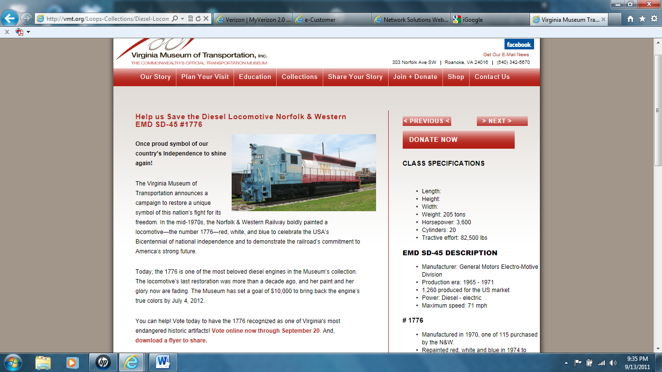
Promotion & Public Voting = the opportunity to rally supporters, expand community, promote a cause
Notes:
Here’s a website screenshot from one of last year’s participants. The VA Museum of Transportation was certainly our best success story and they made an impact through savvy promotion like this. Their success in reaching out to train enthusiasts, which I’ve learned are many, enabled them to be one of our top vote getters in the public voting “competition”.

Slide 14

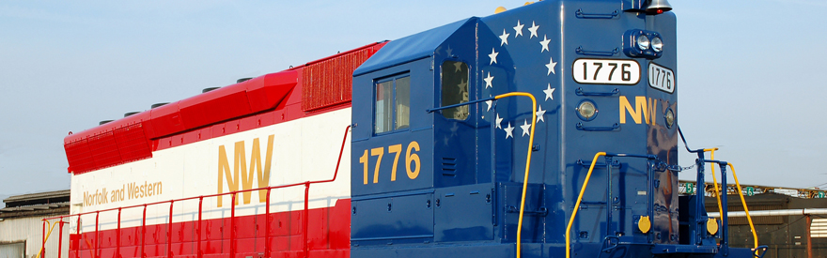
Success Stories
2011
2011 People’s Choice Award Honoree
Virginia Museum of Transportation receives $10,000 Grant from Trains Magazine for the cosmetic restoration of their nominated artifact “1776” Norfolk & Western Locomotive because of their successful ‘win’ in the 2011 online public voting component
Notes:
Because of their participation in the program and the over 35K votes of support from the public, they were awarded a $10K grant from Trains Magazine – a national publication that had 120 applicants for this grant. This is an image of the newly painted “1776” which was unveiled this 4th of July!

Slide 15
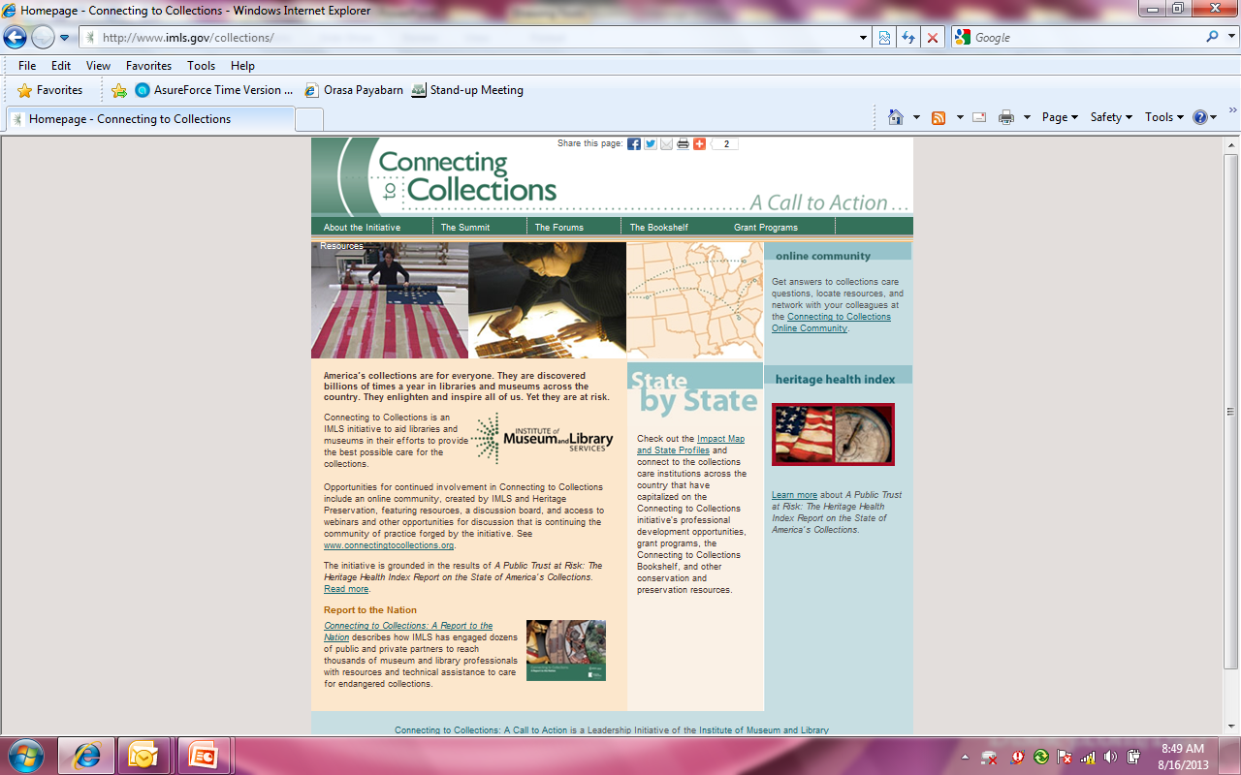
For More Information: www.imls.gov/collections/
Connecting to Collections Online Community: www.connectingtocollections.org

Slide 16
Thank you!!
Look for a digital archive of all the materials developed for the C2C project by Heritage Preservation and IMLS!

