Slide 1
The Blue Devil is in the Details**
Digital Collections Workflow at Duke
←-- **pssst - there he is!
SAA Annual Meeting, Metadata
and Digital Object Roundtable
August 13, 2014
Molly Bragg
Digital Collections Program Manager
Duke University Libraries

Slide 2
Prologue

Slide 3
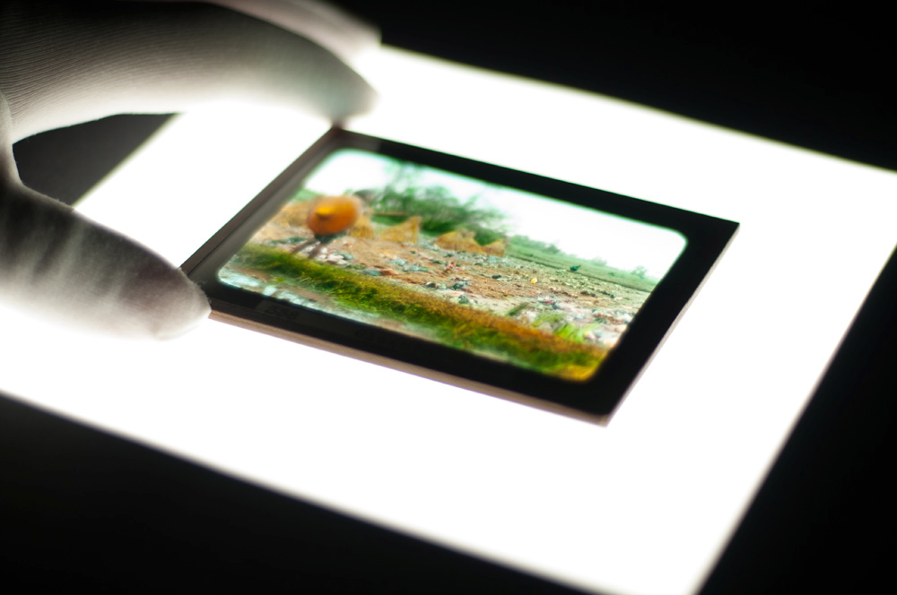
Digitization at Duke
Digital Production Center established: 2005
Still image, video and audio digitization capabilities.
Digitization project types: preservation, patron requests, digital collections projects, other.
Began publishing digital images in late 1990s.
Designed our interface (Tripod) inhouse starting in 2007. The current version launched in 2011.

Slide 4
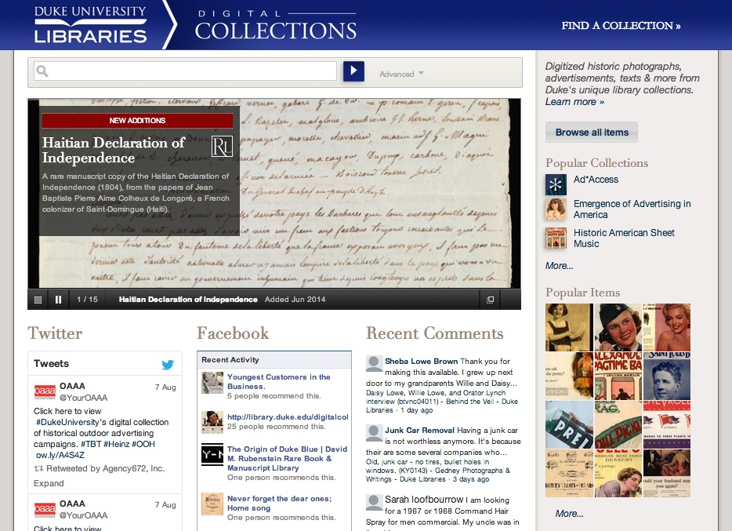
http://library.duke.edu/digitalcollections/

Slide 5
Digital Collections Cast of Characters
Major Players
Project Stakeholders and Partners
DUL Information and Technology Services
David M. Rubenstein Rare Book & Manuscript Library
Department Head
2 Developers,
1 Program Manager
Digital Projects and Production Services Department
DUL Subject and International Area Studies Librarians
Digitization Specialists
Digital Scholarship Services
DPPS Scope: Digitization, Publication, Program Management, Library website and User Interface design for Digital collections and Finding aids.
Conservation Services
Notes:
include other orgs?

Slide 6
Duke Digital Collections Workflow,
in Five Chapters
Notes:
Created in 2013

Slide 7
Chapter I: Inspiration Strikes
Review DUL Collection
Anyone in Duke University Libraries can propose a digital collection project.
Project Champion
Meet with Digital Collections Program Manager
Digital Project Proposal
Notes:
champion has idea
champion creates Proposal documenting idea
Champions any duke staff
do I need captions

Slide 8
Chapter II: Vetting the Proposal
Digital Project Proposal
Advisory Council for Digital Collections
Approved Proposal
Project Champion
Notes:
for strategic importance
ACDC
Evaluate and Set Priority
nervous champion

Slide 9
Chapter III: Feasibility and Implementation
Digital Collections [Allstar] Implementation Team
Digital Collections Program Manager
Digitization Specialist
Digital Projects Developers
Metadata Archivist, Rubenstein Library
Conservator
Basecamp, project management tool
Project Champion
Notes:
Project Plan
Add Champion
talk about managing projects: Basecamp
NO ONE is FULL TIME!

Slide 10
Preservation Masters to Dark Storage
Program Manager
Digital Project Developers
Derivatives to Web Server
Derivatives and Metadata to Duke Digital Collections Interface
Review Materials
Digitization,
Quality Control,
Finalization and Create Derivatives
Derivatives and Digitization Guide to Staging Area
Derivatives and Metadata ingested to CONTENTdm
Project Champion
Metadata Archivist

Slide 11
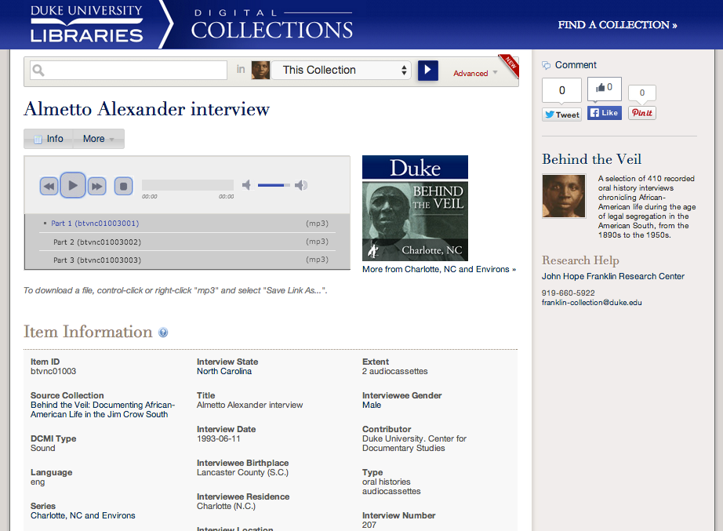
Chapter IV: The Thrilling Conclusion
Much Rejoicing Throughout the Library
Notes:
Hooray!
Publication
PR / Special Collections
Bravo

Slide 12
Chapter V: The Aftermath
Implementation Team
Lessons learned both positive and negative
Project statistics including time spent
Project Summary Report
Project Champion and Program Manager
Notes:
Project Assessment
Track Hours
Project review w/ champion, DCIT, etc
Transfer to the Repository
Promote collection

Slide 13
Epilogue: Does it Work?

Slide 14
Challenges
Proposal process can be complicated
Sharing resources between departments can create bottlenecks
The workflow requires persistent management
Legacy and orphaned projects

Slide 15
Benefits
Opportunities for stakeholders to evaluate projects
Opportunities for Library community involvement
Has produced successful outcomes
Outreach / promotion makes our work more visible

Slide 16
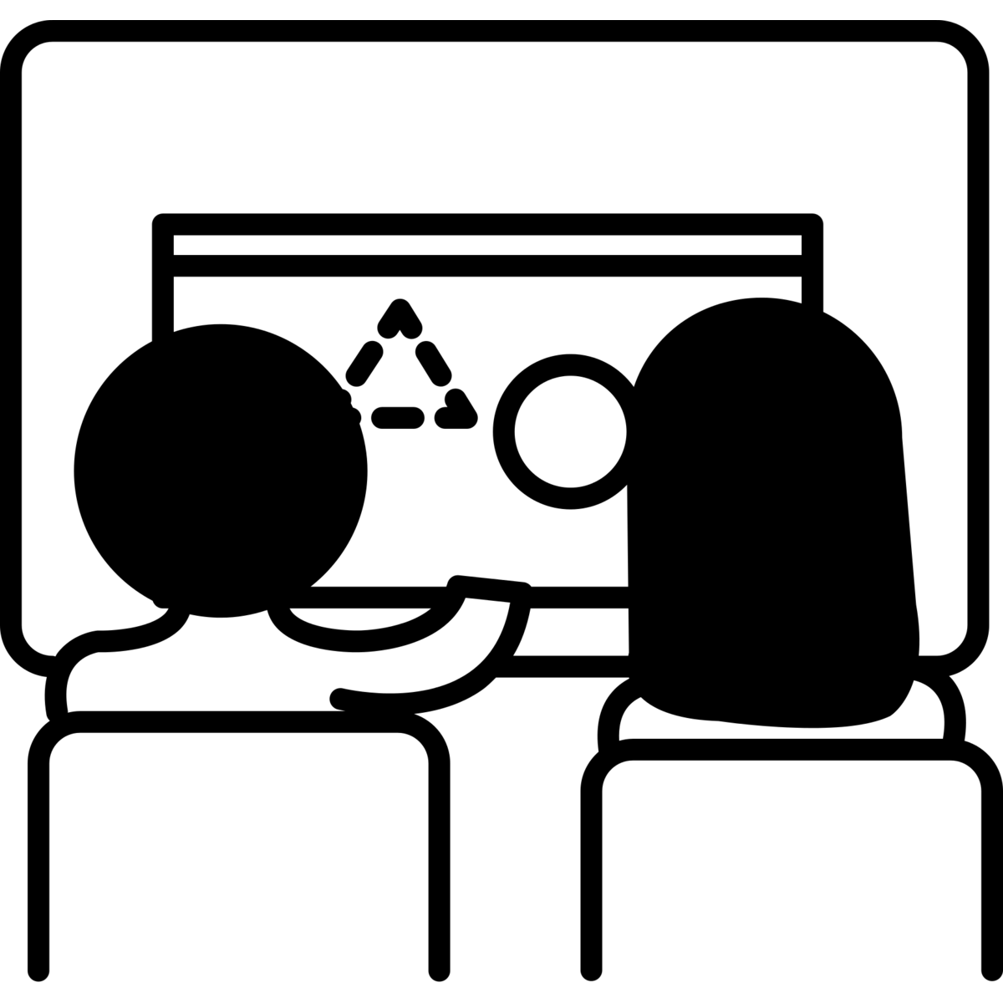
Coming Attractions
Integrate with Duke Digital Repository
Reassess the proposal vetting process
Streamline publication process
Try to expand our team
Help the orphans

Slide 17
The End!
http://library.duke.edu/digitalcollections/
Bitstreams Blog: https://blogs.library.duke.edu/bitstreams/
Twitter: @dukedigitalcoll
Facebook: http://www.facebook.com/dukedigitalcoll
Molly Bragg
Digital Collections Program Manager
Duke University Libraries
molly.bragg@duke.edu
919.660.5888

Slide 18
Acknowledgements
All Icons from “The Noun Project”: http://thenounproject.com/
Many of the icons are in the public domain. Below is a list of attributions for those that are not.
Conductor designed by Luis Prado from the Noun Project
Work designed by Ainsley Wagoner from the Noun Project
Programmer designed by Hadi Davodpour from the Noun Project
Scanner designed by Hussain Khalil from the Noun Project
Project designed by Kevin Laity from the Noun Project
Vhs Tape designed by Mike Wirth from the Noun Project
Light Bulb by Shane David Kenna from The Noun Project
Meeting designed by Lance Hancock from the Noun Project
Approved designed by Yazmin Alanis from the Noun Project
Teamwork designed by Yazzer Perez from the Noun Project
Folder designed by Olivier Guin from the Noun Project
Clipboard designed by Ilsur Aptukov from the Noun Project
Argument designed by Adam Mullin from the Noun Project
Ribbon designed by Nicolò Bertoncin from the Noun Project
Sisyphus designed by Nikolay Necheuhin from the Noun Project
Traveler designed by Nick Abrams from the Noun Project

