Slide 1
FEMA DR-4332-TX
TEXAS DIVISION OF EMERGENCY MANAGEMENT
Applicant’s Public Assistance Briefing
Step 1 of Future Potential Reimbursement
Step 2 is FEMA Recovery Scoping meeting
Step 3 is Your Responsibility

Slide 2
Declared Disaster Summary
Number: DR 4332
Declared: August 25, 2017
Type: Hurricane & Flooding
Incident Period: Start August 23, 2017 thru Sept 15, 2017

Slide 3
Disaster Summary
Categories of Work
A Debris Removal
B Emergency Protective Measures
C Roads and Bridges
D Water Control Facilities
E Buildings and Equipment
F Utilities
G Parks, Rec. Facilities & Other Items
C – G 90% & 10% Cost Share

Slide 4
Declared Disaster Summary
Cost Share:
Category A – Debris
90% Federal Cost Share & 10% You
Effective August 23, 2017
Category B – Emergency Protective Msrs.
100% August 23 to September 22, 2017
90% September 23, 2017 onward

Slide 5
FEMA-DR-4332-TX - Declared Counties with Approved RPA Submission Extensions
County | Extension Deadline
Aransas | 11/22/2017
Bee | 11/22/2017
Bexar | 11/22/2017
Brazoria | 11/22/2017
Calhoun | 11/22/2017
Chambers | 11/22/2017
Colorado | 11/22/2017
Dallas | 11/22/2017
Fayette | 11/22/2017
Fort Bend | 11/22/2017
Galveston | 11/22/2017
Goliad | 11/22/2017
Hardin | 11/22/2017
Harris | 11/22/2017
Jackson | 11/22/2017
Jasper | 11/22/2017
Jefferson | 11/22/2017
County | Extension Deadline
Kleberg | 11/22/2017
Liberty | 11/22/2017
Matagorda | 11/22/2017
Montgomery | 11/22/2017
Newton | 11/22/2017
Nueces | 11/22/2017
Orange | 11/22/2017
Refugio | 11/22/2017
Sabine | 11/22/2017
San Jacinto | 11/22/2017
San Patricio | 11/22/2017
Tarrant | 11/22/2017
Travis | 11/22/2017
Victoria | 11/22/2017
Waller | 11/22/2017
Wharton | 11/22/2017
November
Extension Deadlines

Slide 6
FEMA-DR-4332-TX - Declared Counties with Approved RPA Submission Extensions
County | Extension Deadline
Austin | 12/14/2017
Bastrop | 12/14/2017
DeWitt | 12/14/2017
Gonzales | 12/14/2017
Karnes | 12/14/2017
Lavaca | 12/14/2017
Lee | 12/14/2017
Polk | 12/14/2017
Tyler | 12/14/2017
Walker | 12/14/2017
December
Extension Deadlines

Slide 7
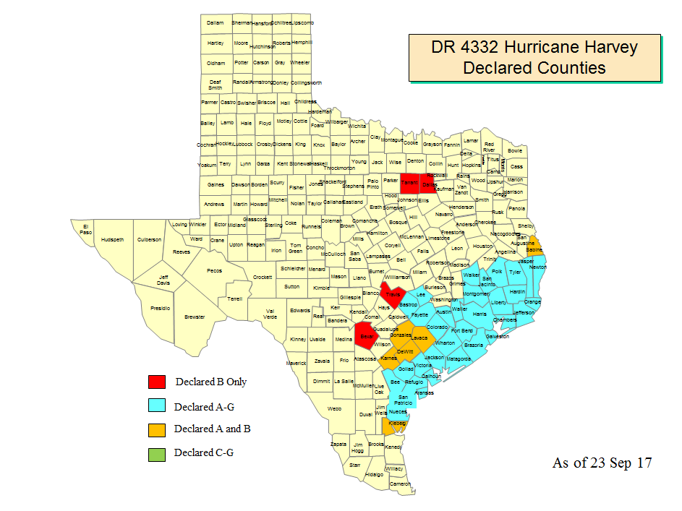

Slide 8
What is the Public Assistance Program?
The Public Assistance Program is a reimbursement program that provides funding to eligible applicants who have suffered damages as a result of a Presidential disaster declaration and whose damages are within a designated area for Public Assistance. Funding under this program is limited to repairing or replacing damaged items/facilities to their pre-disaster condition at the approved cost share. Additional funding may be provided once all other financial offsets have been exhausted. (Ex: insurance; cash donations; other grant awards).
Must maximize insurance claim efforts
FEMA is funding of last resort

Slide 9
Cost
Work
Facility
Applicant

Slide 10
Who is an eligible sub-recipient?
State Agencies and Authorities
Local Governments
Indian Tribes or Tribal Organizations
School districts
Special district or regional authorities
Private Non-Profit that provide services of a governmental nature

Slide 11
Local Governments
Towns, Cities, Counties, Municipalities, Townships
Local Public Authorities
Councils of Governments
Regional and interstate government entities
Agencies of local governments
Note: Each entity must apply and represent itself
A town or city cannot be represented by the county
An ISD cannot be represented by the town

Slide 12
Critical and Non-Critical PNPs Must have IRS 501 or State Charter / Articles of Incorporation as PNP
Critical Service PNPs
Educational
Power
Water
Sewer and Wastewater Treatment
Communications
Emergency Medical Care
Fire Protection/Emergency
Non-Critical PNPs*
Custodial Care
Essential Governmental Service
Museums
Zoos
Community Centers
Libraries
Homeless Shelters
Senior Citizen Centers
Rehabilitation Facilities
Shelter Workshops
Health & Safety Service of a Governmental Nature
*(must be open to the general public)
Must apply to SBA first

Slide 13
Facility Eligibility
Any publicly or PNP-owned building, works, system, or equipment or certain improved and maintained natural features.
General eligibility requirements:
Eligible applicant must be legally responsible for the repair of the damaged facility or performance of eligible emergency services
Must be in active use at the time of the disaster
Caveat: Temporary use issue

Slide 14
Work Eligibility
General eligibility requirements that apply
Direct result of the incident
Must be in the designated area
Must be the legal responsibility of the applicant
Each entity must apply for itself

Slide 15
Cost Eligibility
Generally, costs that can be directly tied to the performance of eligible work.
Costs must be:
Reasonable and necessary to accomplish the work
Compliant with Federal, State, and local requirements for competitive procurement
Reduced by all applicable credits, such as insurance proceeds and salvage values
You must maximize all other $ resources

Slide 16
How to apply for assistance

Slide 17
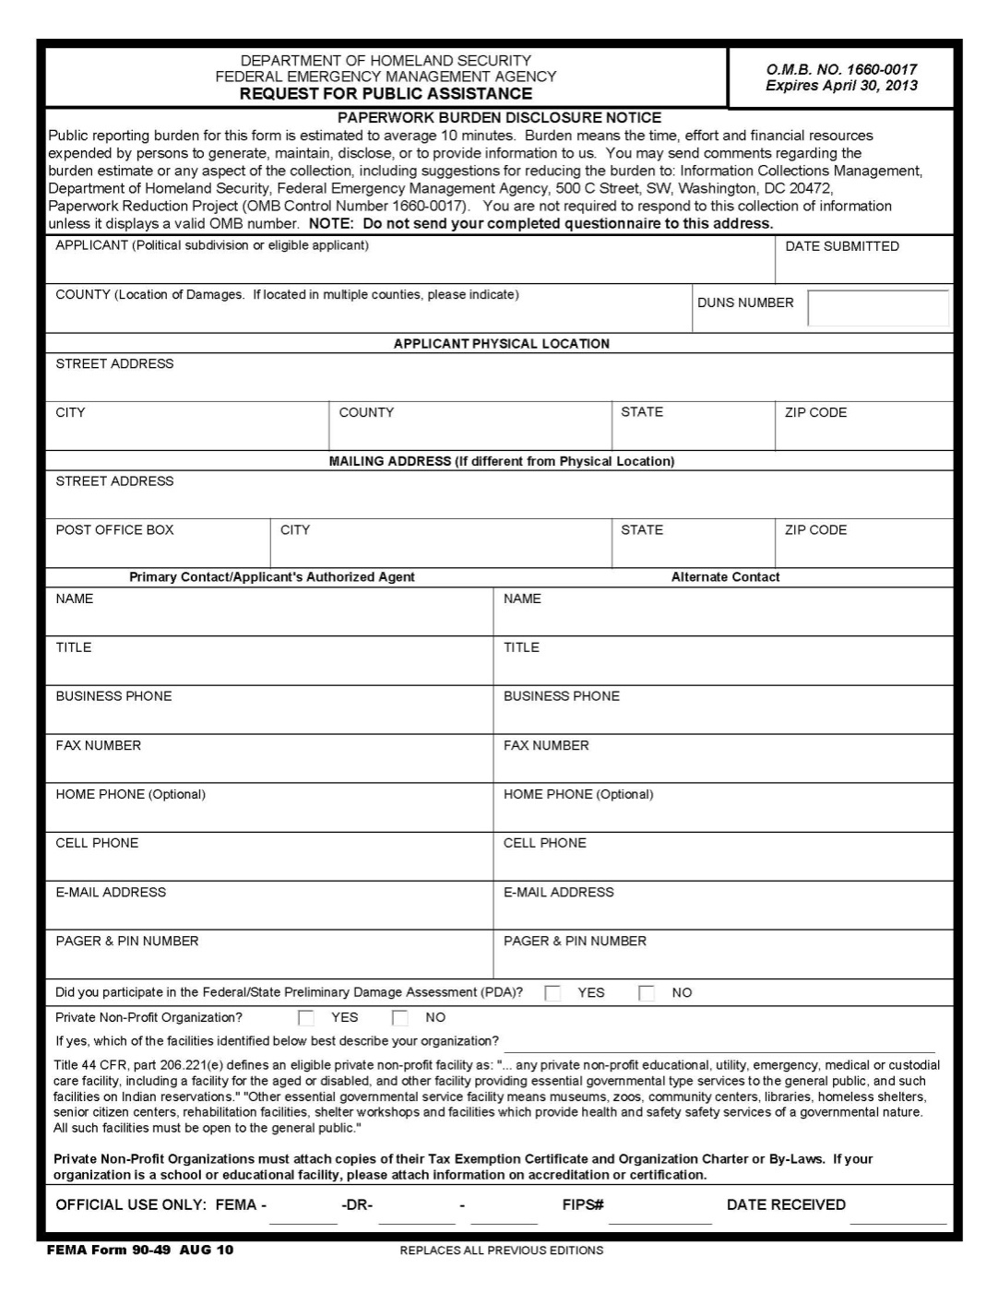
Request for Public Assistance (RPA)
All eligible applicants
Must submit request to the State Within 30 Days of a County’s Designation for PA
Must include DUNS #
(http://www.dnb.com/get-a-duns-number.html)
TDEMRecovery.rpa@dps.texas.gov

Slide 18
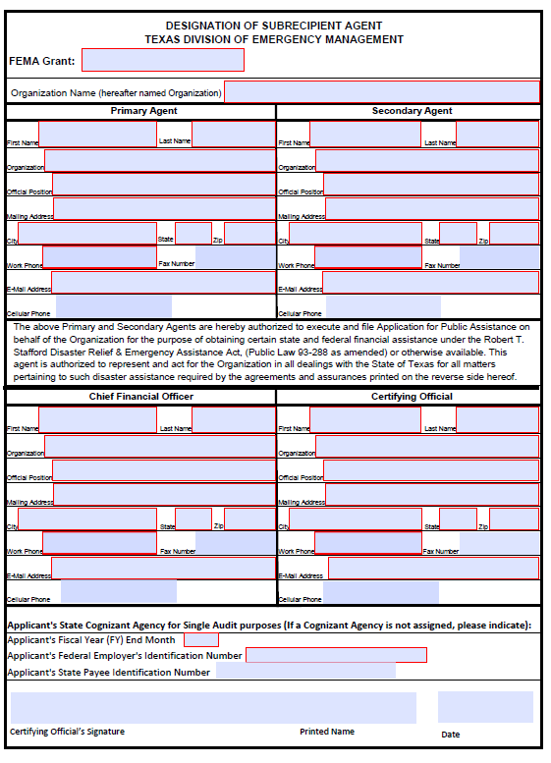
Designation of Subrecipient Agent (DSA)
Applicant DSA will remain the primary point of contact and must be included in and authorize all decision-making
Expertise may be limited but know who to forward to
Form must be completed and submitted to TDEM

Slide 19
Subrecipient’s Primary Agent …
Should know or have direct access to those that know:
Site locations and categories of work
Completed and incomplete work
Contracts vs. Force Account
New Codes or Standards
And should be able to obtain:
Photographs / Sketches / Drawings of damage/loss
Equipment / Materials / Supplies Used or Lost
Procurement methodology and documentation
Insurance documentation (2 copies of policy in effect at the time of the incident; statement of loss; statement of values; proof of loss; adjusters estimate; legal pursuit activities)

Slide 20
Subrecipient’s Certifying Official …
Certifying Official is ultimately responsible!
I have hired a consultant:
Provide TDEM a letter identifying and giving permission to contact
All correspondence will go to DSA w/copy to consultant
Consultants are requested to include TDEM on all communications and correspondence regarding project formulation and progress

Slide 21
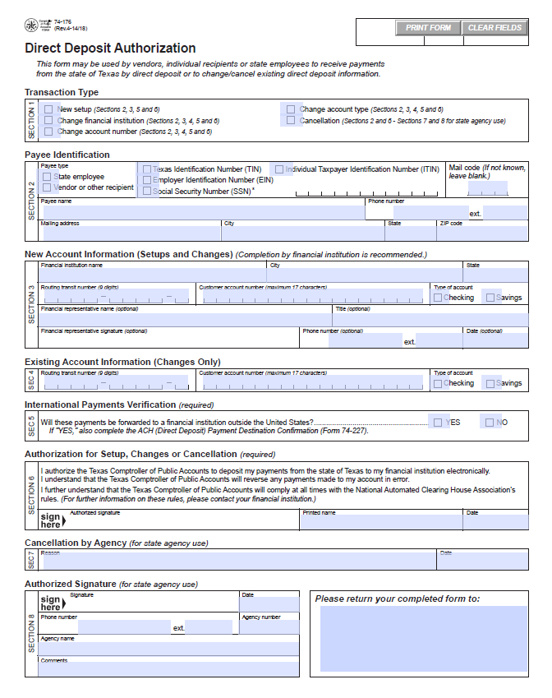
Direct Deposit Authorization
Must be submitted
to the State before
funding is paid

Slide 22
The Application Process
Request for Public Assistance Form
Submit RPAs, DSAs and DDAs to:TDEMRECOVERY.RPA@DPS.TEXAS.GOV
Normally completed at the Applicant’s (Subreciepients) Briefing
(PNP subrecipients must submit additional documentation)

Slide 23
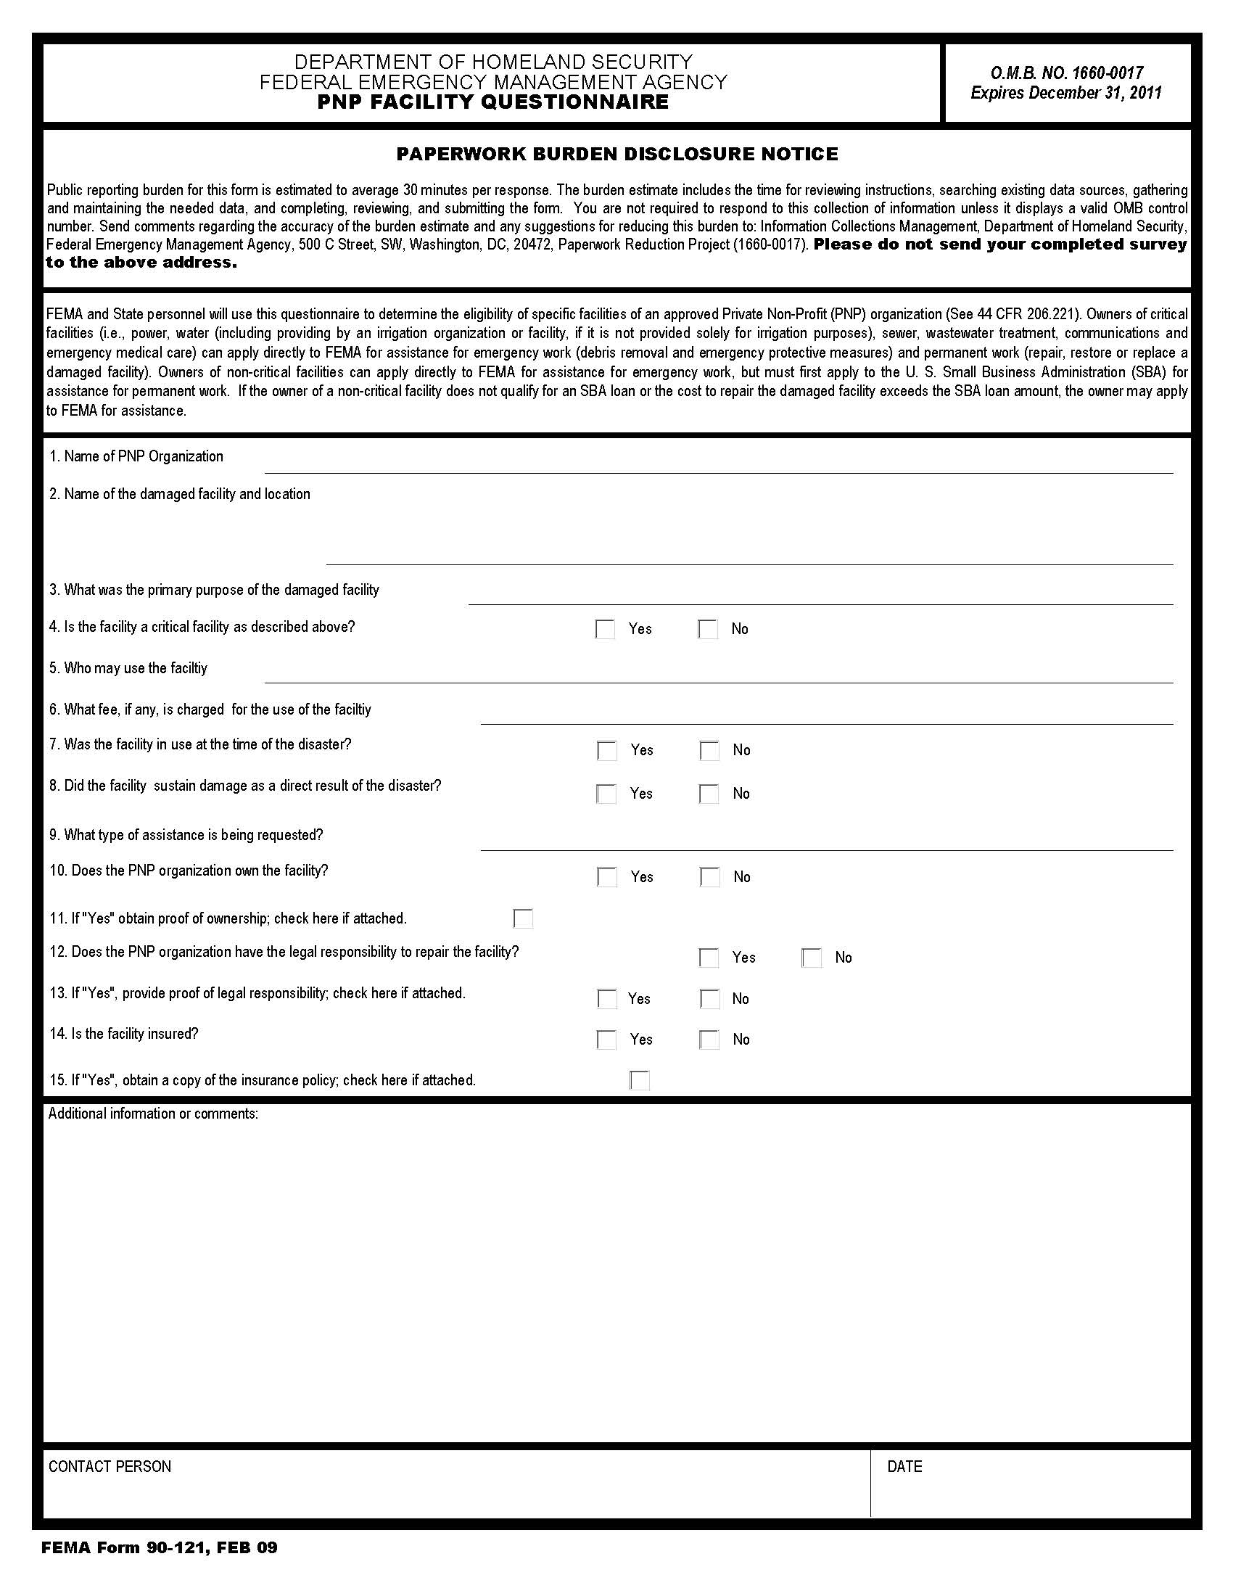
Additional PNP Information
Must have IRS 501 or State Charter
Articles of Incorporation and By-laws as PNP
Open to the General Public
Must complete PNP Questionnaire

Slide 24
Applicant Eligibility Determination
Applicants for Public Assistance
Completed RPA
Debarment checks (www.SAM.GOV)
Entity must be registered in SAM.GOV

Slide 25
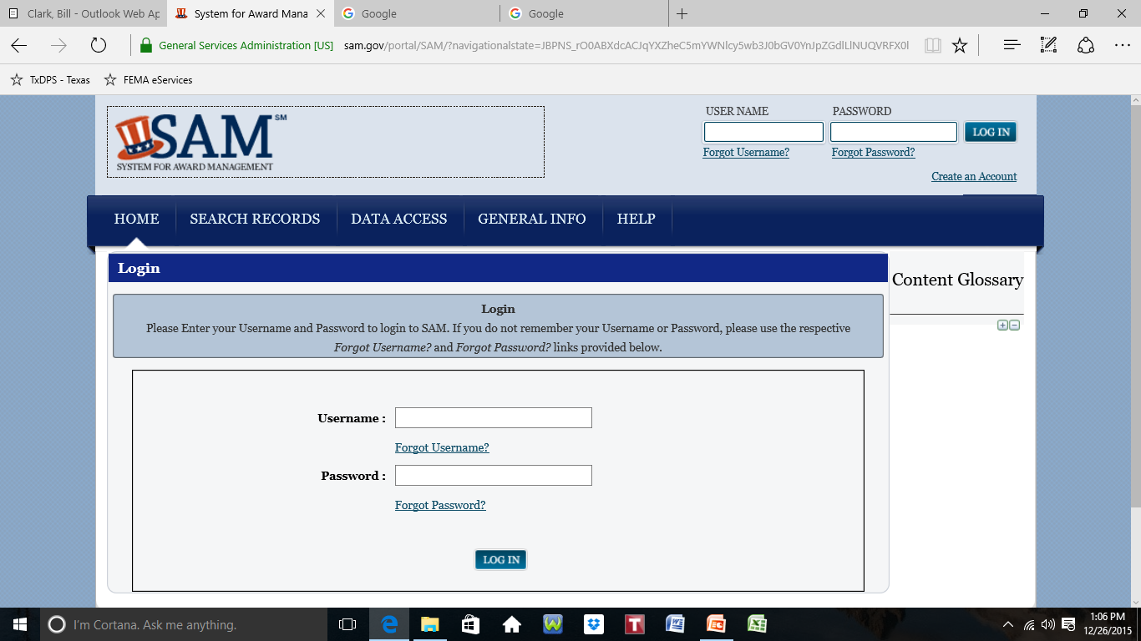
Create an account for complete detailed information

Slide 26
Project Development

Slide 27
Public Assistance Program Project Preparation
This Applicant’s Briefing – TDEM
Exploratory Call – FEMA PDMG
Recovery Scoping Meeting set up by FEMA
Project Formulation: FEMA, Applicant and TDEM
Project Approval
Funding Granted

Slide 28
Project Formulation
Applicant must provide cost estimates
Historical Costs for similar work
Local/State/FEMA Cost Codes and Equipment Rates
Regular & OT Pay policy
Procurement Policy
Contracts
Insurance
Note: You must maximize all other sources!

Slide 29
Special Considerations
Insurance
Mitigation - 406 vs 404
Environmental/Historic Preservation
Codes and Standards
Historic Preservation and Cultural Resources
Special Flood Hazard Areas

Slide 30
Performing Approved Work
Parameters
Scope of Work
Completion Date
Cost Estimate Overrun requires prior approval
Time Extensions
Force Account Work
Contract Work
Bidding Requirements
Engineering and Design Services
Debarred Contractors
Request for Improved/Alternate Projects

Slide 31
Project Administration and Documentation Requirements
If it’s on paper, keep it
If it’s not on paper, put it on paper and keep it
Documentation
Paper trail

Slide 32
Procurement Requirements
Must be of reasonable cost
Generally must be competitively bid
Must comply with Federal, State, and local procurement standards
“Cost plus a percentage” contracts are not eligible
Normal procedures must Not be altered due to reimbursement from Federal funds
Competitive procurement is key!

Slide 33
Procurement Requirements
“FEMA may reimburse costs incurred under time and materials contract only if all of the following apply:
- No other contract available
Contractor exceeds ceiling price at their own risk
Applicant must provide oversight to ensure contractor is using efficient methods and effective cost controls
You must be able to justify!

Slide 34
Procurement
The below site may be assistance to the State and Local communities when determining whether certain contractors are debarred or not;
www.SAM.GOV
Exigent and emergency circumstances exist for Debris Removal (Cat A) and Emergency Protective Measures (Cat B) – “Declared counties can use non-competitively procured contracts for Cats A and B through October 10, 2017”, FEMA memo dtd Sep 10, 2017

Slide 35
Project Management Requirements
Set up of Grant File and individual project files by site
Folders/tabs/electronic
Gather copies of your policies now
Record retention
Grants Management System

Slide 36
Documentation Requirements
DOCUMENT EVERYTHING YOU SPEND TIME & MONEY ON!
Categories To Prepare For:
Force Account Labor Rentals
Force Account Equipment Contracts (procurement Force Account Materials documentation)
DAC (Direct Administrative Cost)

Slide 37
Documentation Requirements
Force Account Labor/Equip
Force Account Materials
Proof of hourly or pay period rate
Fringe rate calculations
Timesheets
Proof of payment
Overtime and Comp time policies
Work performed
Purchasing procedure policy
List of materials used with pricing
Invoices & Purchase Orders
Proof of payment
Where used
Equipment logs identifying operator
Operator timesheets
Proof of equipment ownership
Equipment rate calculations

Slide 38
Documentation Requirements
Rentals
Contracts
Rental/Lease agreement
Invoices
Purchase Orders
Proof of Payment
Equipment use logs
Contract procurement policy
Bid process
Contracts
Invoices/Purchase Orders
Proof of payment
Benefit Cost Analysis
Change Orders
Profit Negotiation
2 CFR §200.318 contract requirements
Debarment
Cost Plus Percentage and Piggyback contracts are prohibited
Time and Materials contract (Caution & Ceiling Price needed)

Slide 39
Documentation Requirements
Direct Administrative Cost
Documented FAL administrative activities & materials used in direct support of this specific Project
Documented project management team costs that can be identified to this specific Project.
Logs identifying specific PW:
Employee name
Date and activity performed
Duration and supplies used
See “Force Account Labor”
Management Team
Contract Rates
Date and activity performed
Management Team invoices
Purchase orders
Proof of payment

Slide 40
Duplication of Benefits
Cannot receive funding from two sources to repair the same disaster damage for example:
Insurance
Other federal awards such as CDBG
Salvage values
Non Federal grants and cash donations

Slide 41
Insurance Requirements
FEMA is required to reduce the grant amount by any insurance proceeds that are received for the insured facility
Must provide copies of all applicable insurance policies and itemized insurance documents and checks/EFTs to TDEM
Obtain and maintain insurance on any facility for future disasters

Slide 42
Project Monitoring
Actual site inspection; scope of work monitoring
Review of documentation
Compliance with grant agreement
Compliance with Period of Performance and time extension
Cost review
Quarterly reporting

Slide 43
Project Funding
Federal and non-Federal (local) share
Small Projects ≤ $123,100
Approved funding for small projects will be processed for payment after:
Obligated by FEMA
Sub-recipient has satisfied all initial application and documentation requirements
The minimum amount for a small project is $3,100

Slide 44
Project Funding
Large Projects >$123,100
Projects are funded after documentation has been received
Advances of funds:
When needed for hardships prior to project completion
Cannot exceed Federal cost share
Ongoing quarterly monitoring of projects is imperative

Slide 45
Project Funding
Payment Request for Large Project
In order to be paid, sub-recipient must complete Payment Request form, per project, and submit to TDEM
Must provide documentation of expended funds before a request for additional funding is approved

Slide 46
Procurement
Use your own documented procurement procedures which reflect applicable State and local regulations, provided that the procurements conform to applicable Federal law and the standards identified in 2 CFR Subpart D - Procurement Standards
Competitive Procurement is key

Slide 47
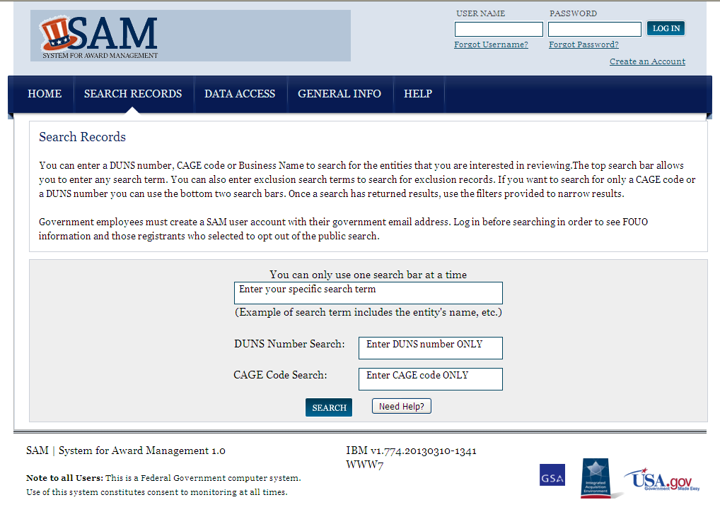
Proof of Debarment Check
Create an account for more detailed information

Slide 48
Proof of Debarment Check
2 CFR §180.325 What happens if I do business with an excluded person in a covered transaction?
If as a participant you knowingly do business with an excluded person, the Federal agency responsible for your transaction may disallow costs, annul or terminate the transaction, issue a stop work order, debar or suspend you, or take other remedies as appropriate.
2 CFR §180.300 What must I do before I enter into a covered transaction with another person at the next lower tier? (prove you checked debarment prior to each payment.)

Slide 49
Lets talk about
Emergency Work and
Permanent Work

Slide 50
Emergency Work
Hurricane Harvey
Cost Share:
Category A – Debris
90% Federal Cost Share 10% You
Effective August 23, 2017
Category B – Emergency Protective Measures
100% August 23 to September 22, 2017
90% September 23, 2017 onward
Notes:
Highlights/concerns

Slide 51
Debris Removal Pilot Program
STRAIGHT TIME FORCE ACCOUNT LABOR
FEMA will reimburse, at the appropriate cost share level, the straight and overtime wages for existing employees and hiring of additional staff
RETAINING RECYCLING REVENUES
Subrecipients shall provide written notification of revenue received as part of its final accounting of actual costs
PREAPPROVED DEBRIS MANAGEMENT PLAN
FEMA will provide a one-time incentive of a 2% cost share adjustment applied to debris removal for the first 90 days
Accepted after June 2013 and before August 23, 2017

Slide 52
Debris Removal Reminders
TCEQ permit is required for staging and/or burning
SHPO form for any historical or archeological sites must be submitted or funding could be jeopardized
Fact Sheets for Private Property Debris Removal (PPDR) are being emailed from the State SOC as well as being posted on GMS
PPDR letters of intent needs to be emailed to valerie.blanton@dps.texas.gov.
Debris clearance need to be sent to Valerie Blanton daily

Slide 53
Emergency Work
Donated Resources
- Volunteer labor, donated equipment and materials are eligible to offset the non-federal portion of the cost for emergency work
- The amount of credit is capped at the non-federal share so that the federal share will not exceed the sub-recipient’s out-of-pocket cost

Slide 54
Emergency Work
Donated Resources
Donated resources must apply to actual emergency work
Must be documented and include name, date, hours worked, work site, work description, and who received or used resources
Value of donated equipment must be determined by using FEMA equipment rates
If materials were donated by a federal agency, such as sandbags donated by the United States Army Corps of Engineers (USACE), the value of the materials can not be applied as volunteer credit

Slide 55
Permanent Work Hurricane Harvey
Categories C - G
The President has approved a cost share adjustment for FEMA DR- 4332 and authorized Federal funds at 90% for permanent work

Slide 56
Permanent Work Hurricane Harvey
Restore to pre-disaster design and function
Damaged facilities must be the legal responsibility of the sub-recipient
May apply current codes and standard
May include cost effective hazard mitigation measures

Slide 57
Alternate Project
When public would be better served by no restoration of facility or function
Funding is 90% of original estimate
Approval before commencing work
Demolition of original structure
Purchase capital equipment
Cost effective hazard mitigation
Supplement an improved project funds
New construction
Repair or expansion of existing facility
Environmental Historic Preservation (EHP) involvement

Slide 58
Improved Project
An opportunity to make improvements to a facility while restoring its pre-disaster function and at least its pre-disaster capacity.
Permanent restoration of large or small projects
Ex: lay asphalt on a gravel road or replace a firehouse with one bay with one that has two
Approval before conducting work
Cost limited to the federal share of restoring the original project or cost of completing the improvement whichever is less
EHP involvement

Slide 59
Permanent Work Pilot Program
To participate must agree to participate in the grants being based on fixed estimates procedure before having access to other alternative procedures:
Consolidation of multiple fixed subgrants
FEMA validation of sub-recipient-provided estimates (prior to acceptance)
Elimination of reduced eligible funding for alternative projects (90% clause)
Use of excess funds
Review of estimates by an expert panel for projects with Fed. Share ≥ $5 million (prior to acceptance)

Slide 60
Permanent Work Pilot Program
Opportunities
Alternate Projects - the federal cost share reduction of 10% is waived
Cost underruns - may be used for FEMA approved activities that reduce the risk of damage from future disasters
Participation - can be on a project-by-project basis
Potential Risks
Timeline - FEMA, the subgrantee, and the grantee must agree on the eligible disaster damage and scope before completing the cost estimate
Cost Overruns - If the approved fixed estimate is less than actual costs, FEMA will not approved additional funds
Direct Administrative Costs – Are considered part of the overall estimate, and no additional DAC will be considered at closeout of a project
Insurance – Estimates are reduced by amount of anticipated or actual insurance proceeds and will not be revised unless actual insurance proceeds are in excess of anticipated amounts

Slide 61
406 Mitigation Permanent Work Only
Mitigation can occur in the following areas:
Roads
Culverts
Bridges
Buildings
Utilities

Slide 62
Hazard Mitigation Scenario
Pre-disaster
Disaster damage
Larger culvert with
concrete wing-walls
New upstream
retention pond
406
404

Slide 63
Hazard Mitigation 404
Hazard Mitigation Grant Program (404)
Assistance for actions taken to prevent or reduce long term risk to life and property from natural hazards
Declared Counties
All areas in the State of Texas are eligible for assistance
Contact 512-424-5489 or email TDEM-Mitigation@DPS.Texas.Gov for additional information and assistance

Slide 64
Project Completion
Project Completion and Certification Report (P.4)
Claim Summary Form / Request for Reimbursement
Final Project Inspection
State compliance reviews of projects
Insurance requirements

Slide 65
Appeals
Any FEMA Determination (within 60 days of notice)
Cost Overrun on Small Projects (after all small projects are completed)
Full financial review of all
FEMA can recoup over-run funds
Process
Timeframe: 60 days from notification
Arbitration determination memo
1st time submit all the initial documents
No second submission

Slide 66
DR 4332
LAST, Your TDEM representative, whether a State employee or a State affiliate, is your primary advocate.
FEMA does want to help you. Let your State representative help FEMA help you.
Include the State person in all communications with anyone regarding your claims.
FEMA requires documentation. Provide your State representative with any documentation you provide FEMA.
NEVER give up your original documents!!

Slide 70
Await automated email
Check Spam/Junk Mail folder
From: support@pagrants.fema.gov [mailto:support@pagrants.fema.gov] Sent: Wednesday, September 16, 2017 10:16 AM Subject: FEMA PA Notification - You have been invited to join the Grants Portal.
Hello Sherry,
You've been invited to join the Grants Portal as a child organization for Texas Department of Emergency Management.
Please click here to fill in your organization's information and create an account.
-FEMA PA Support Team
FEMA-PA-Support@FEMA.DHS.Gov https://pagrants.fema.gov

Slide 71
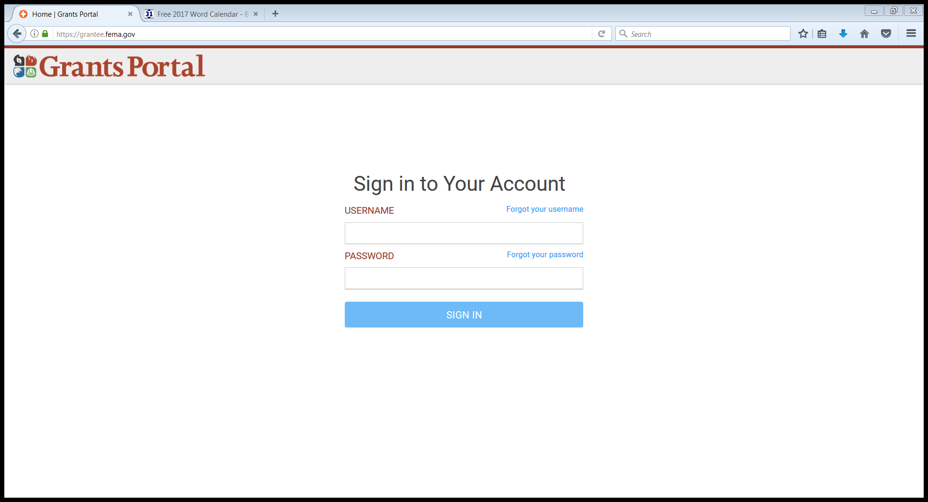
Launch Mozilla Firefox (preferred) or Chrome as your web browser
Web Address is https://grantee.fema.gov
Hotline Number 1-866-337-8448

Slide 72
EXPLORATORY CALL
Introduction to your Program Delivery Manager
Get an initial sense of needs and damages
Identify who needs to be at the Recovery Scoping Meeting

Slide 73
Damage Inventory

Slide 74
Purpose of Recovery Scoping Meeting
In-depth meeting to review Damage Inventory
Gather documentation
Logical grouping of projects
Review priorities
Set up Site Inspections

Slide 75
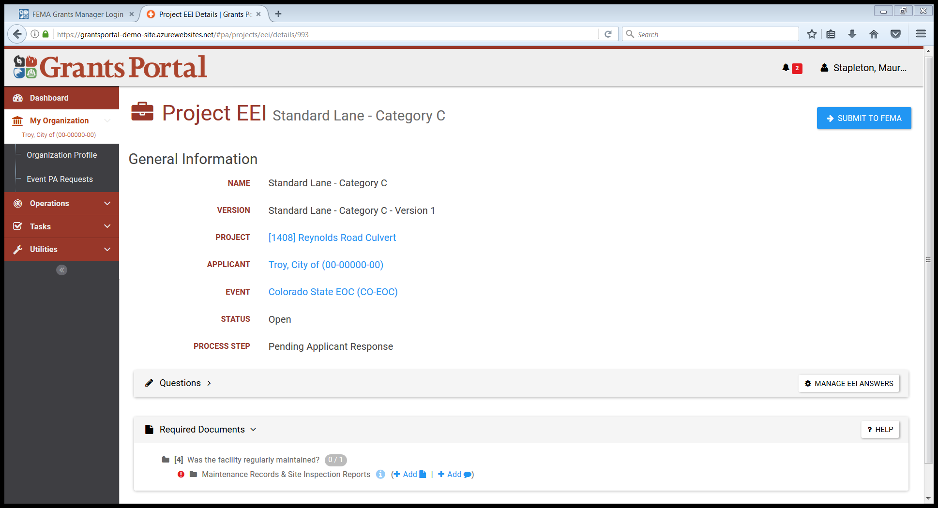
Essential Elements of Information

Slide 76
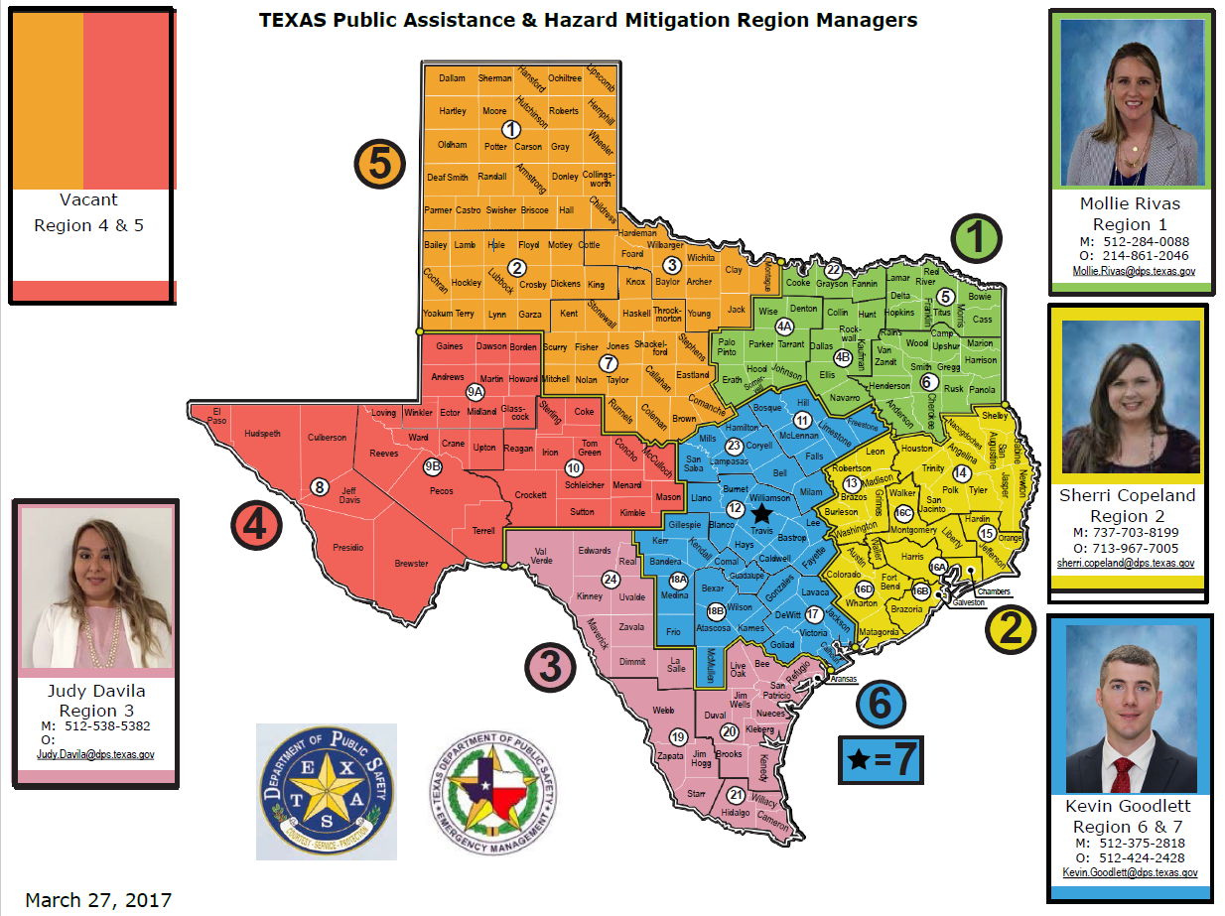
Regional Map

Slide 77
Questions?
Please send a list of all personnel from your organization who attended this briefing.
Name
Title
Phone Number
Email
Send the information to:
TDEM.applicants@dps.texas.gov
Thank You
To obtain a copy of this presentation, please go to this link: NAS Link https://tdemstorage.dps.texas.gov:5001/sharing/WbweF9o5l

