Slide 1
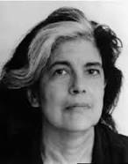
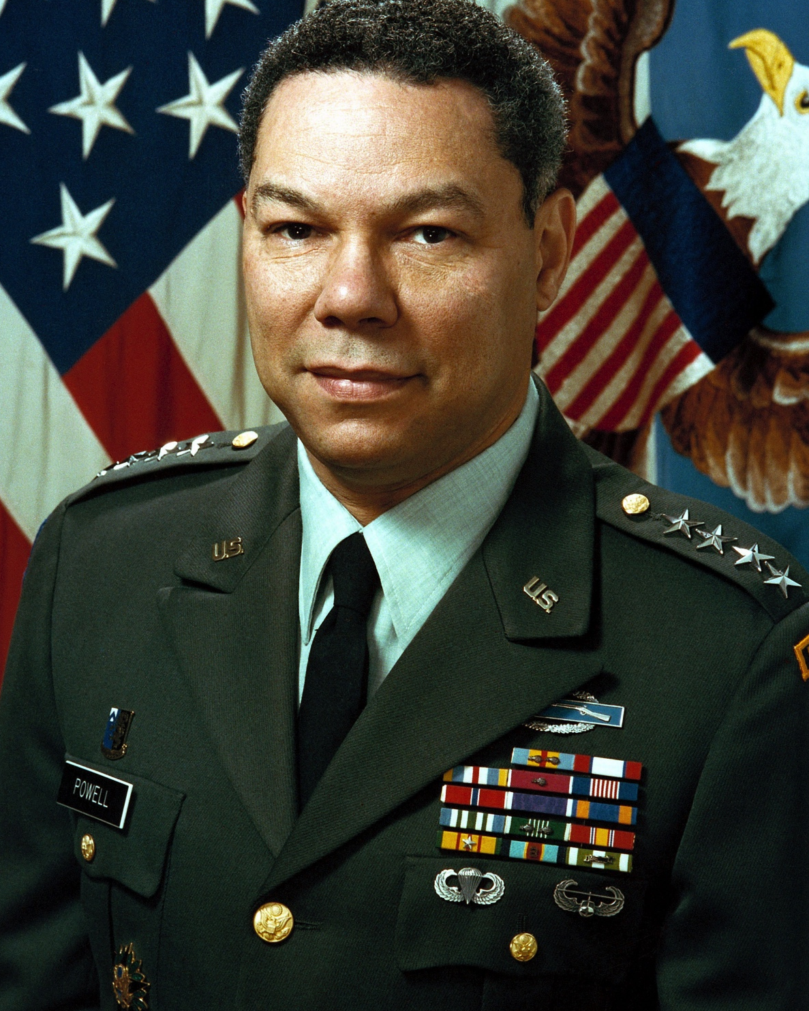
Appraising and Processing Email of Potential Historical Value with ePADD SAA Research Forum – 15 August 2018
@e_padd

Slide 2
Appraising and Processing Email of Potential Historical Value with ePADD SAA Research Forum – 15 August 2018
@e_padd
Notes:
Hi I’m Josh Schneider, assistant university archivist at Stanford and epadd community manager, and I‘m going to talk to you about our work on ePADD

Slide 3
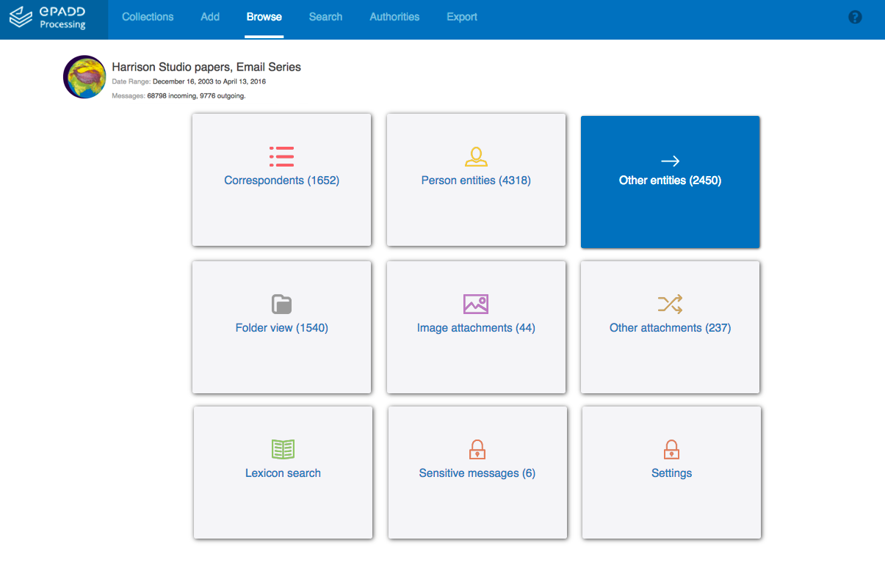
Free & Open Source Software
Incorporates machine learning, automated metadata extraction, and natural language processing
Supports screening, discovery, and access for email
Notes:
ePADD is free and open-source software that helps collection donors, curators, and archivists screen email archives for potentially sensitive information, and make them discoverable and accessible for research.
To support this work, ePADD applies techniques from computer science including natural language processing and named entity recognition..

Slide 4
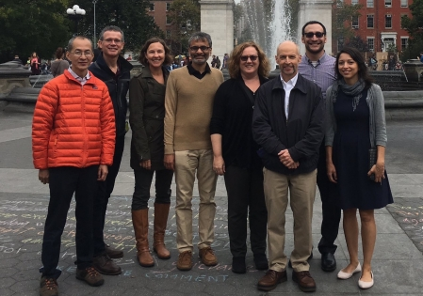
ePADD Phase 2
2015-2018
Notes:
The project is currently is in the last year of an IMLS grant to continue to develop the software and grow the community. The current grant wraps up at the end of October.
Stanford Libraries has pursued this work with partners at Urbana Champaign, Harvard, METRO, and Irvine.

Slide 5
Developed with our User Community, including:
British Library Brown University California Inst. of Technology Center for Jewish History Columbia University Duke University Emory University Fordham University Getty Research Institute Harvard University
Indiana University - PUI Museum of Modern Art National Library of NZ New York Philharmonic New York University Princeton University Rockefeller Archive Center Royal Lib of Copenhagen Smith College Stanford University
University of California, Berkeley University of California, Irvine University of California, Los Angeles University of Copenhagen, Denmark University of Illinois - UI University of Minnesota University of Southern California University of Texas at Austin University of Virginia Wildlife Conservation Society
Notes:
The functionality we’ve developed has been scoped via user stories from our partners and user community, and has been supported by community working groups and other user contributions.

Slide 6
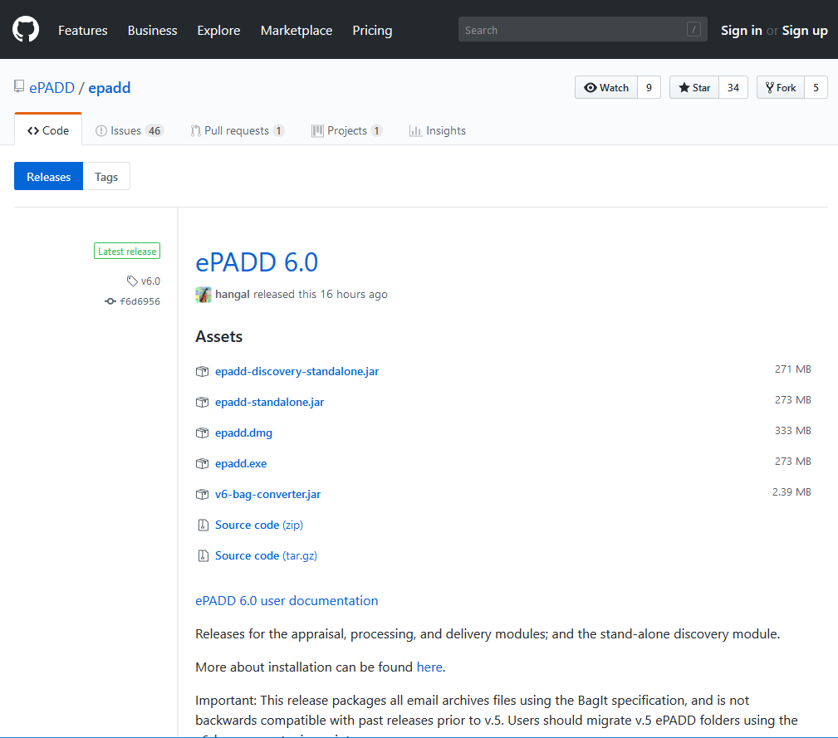
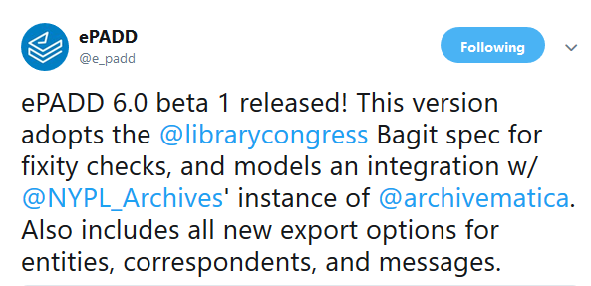
Notes:
For this talk I’m going to focus on some of the most interesting research contributions I think the project has made so far, and for those who are already familiar with the software, I’m also going to highlight some of the new functionalities introduced in the 6.0 release, including interoperability updates and new and expanded export options.

Slide 7
Browsing
Notes:
One area of research has been in how we can best make use of NLP and ML to provide the user with news ways to browse, parse, and otherwise make sense of what can be upwards of hundreds of thousands of messages in a single archive.

Slide 8
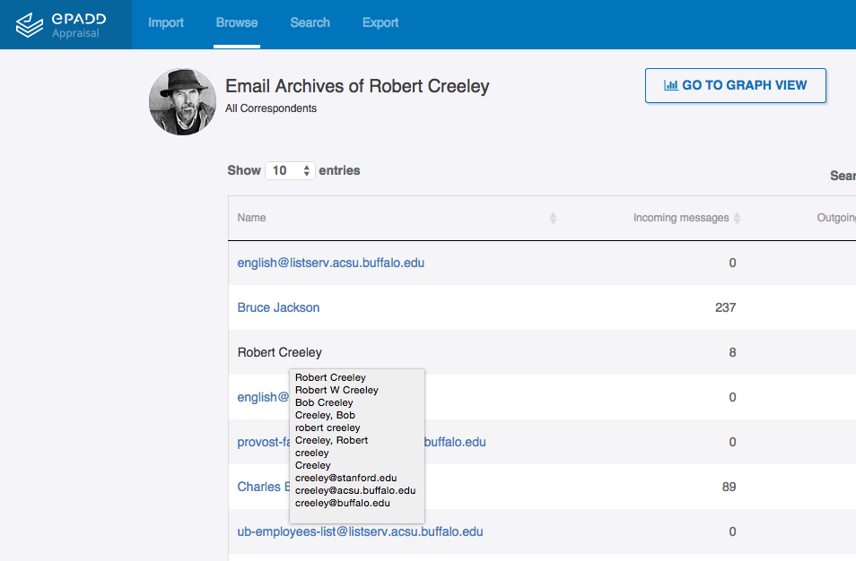
Browsing
Correspondents (with resolved names)
Notes:
ePADD allows users to browse correspondents, and resolves names of correspondents associated with multiple email address to aid analysis and visualization.

Slide 9
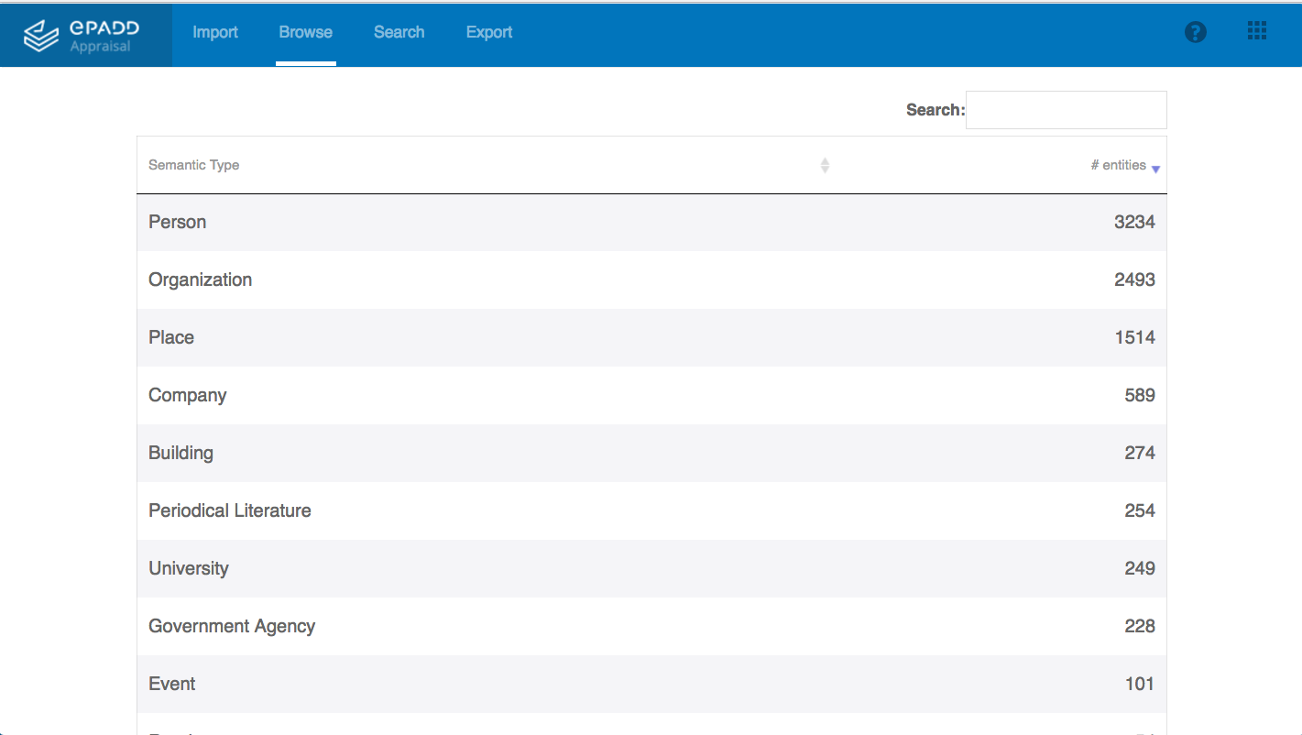
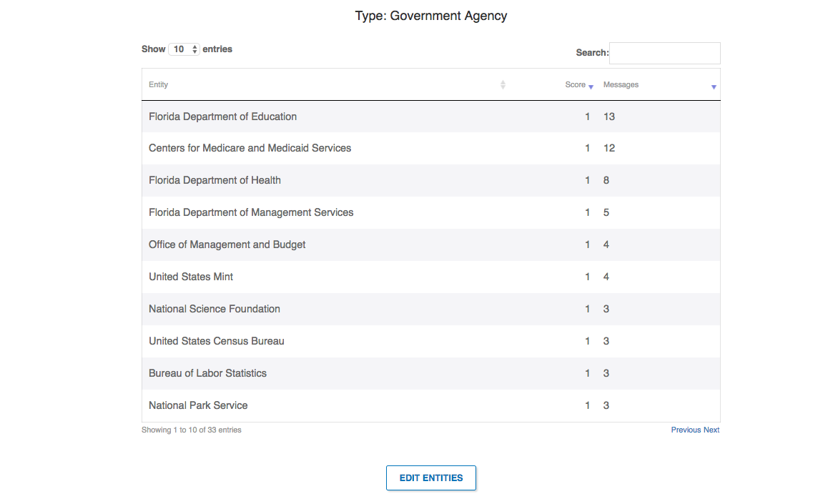
Browsing
Correspondents (with resolved names)
Fine-grained entities (with hierarchical navigation)
Notes:
ePADD also indexes fine-grained name entities within the content of messages, such as persons, universities, government agencies, and events.
We tried a few standard NLP libraries, and ended up creating our own NLP, geared towards supporting archival processing and research, which includes fine-grained entity recognition bootstrapping categories and terms from DBPedia.

Slide 10
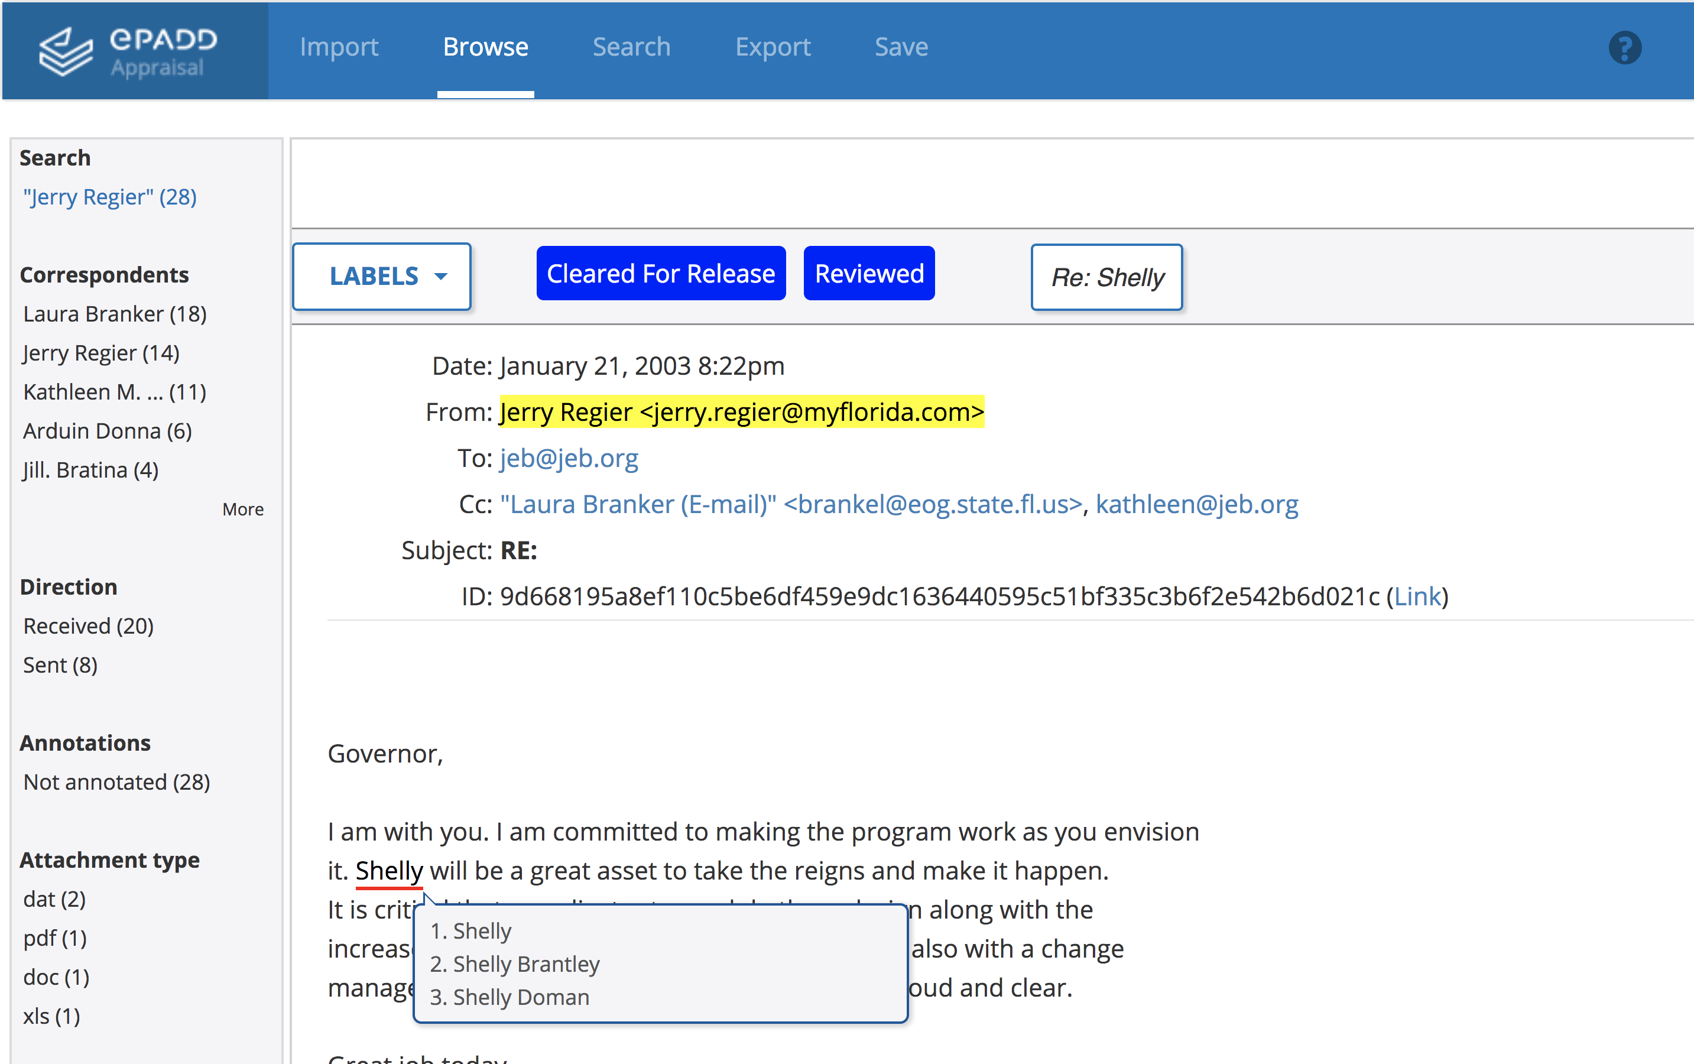
Browsing
Correspondents (with resolved names)
Fine-grained entities (with hierarchical navigation)
.
EDIT TO BE SCREEN WITH ENTITIES IDENTIFIED – USING ML
Notes:
These functions have helped our developers build an entity and correspondent suggestion function that appears within messages.
Actually relies on fairly complicated algorithms that have been retuned several times over the last few years.

Slide 11
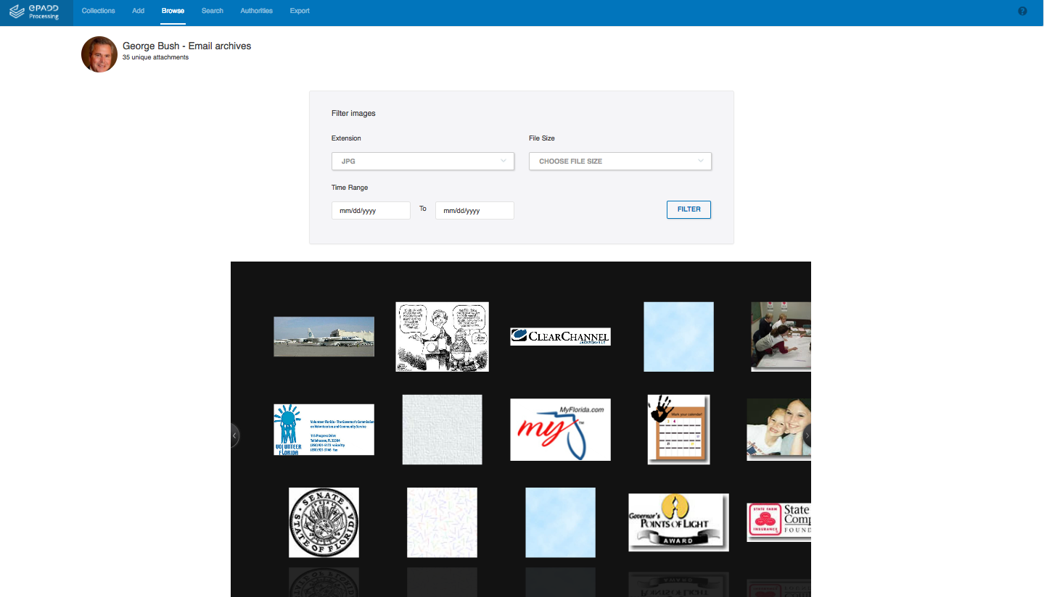
Browsing
Correspondents (with resolved names)
Fine-grained entities (with hierarchical navigation)
Attachments
Notes:
ePADD also supports browsing attachments, including image attachments

Slide 12
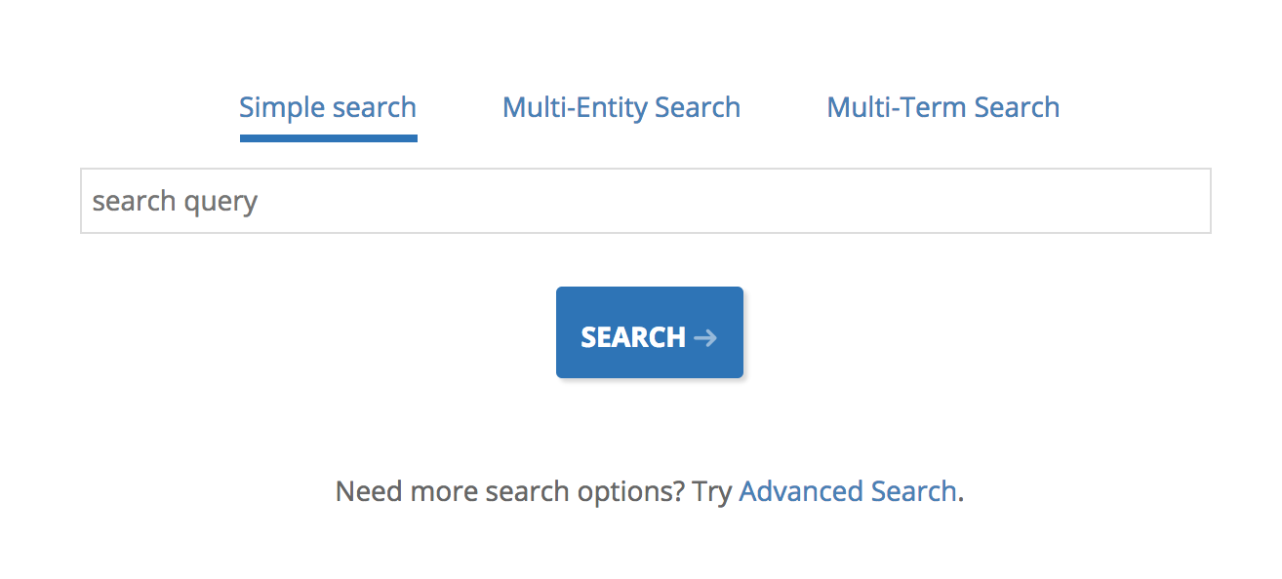
Searching
Advanced Search
Entity Search
Multi-entity Search
Multi-keyword Search
Lexicon Search
Notes:
ePADD supports several ways of searching an email archive. Some of these take advantage of the entity extraction mentioned earlier.
2:30

Slide 13
Screening
Correspondents
Reg Ex
Disease Entities
Sensitive Lexicon
Combining functions
Notes:
ePADD also incorporates a number of functions to aid with appraisal and processing, including screening an email archive for potentially sensitive info. These include customizable regular expression search, browsing messages including terms from the disease entity category, and a dedicated, customizable sensitive lexicon. You can also combine a lot of what we’ve seen to say, restrict access to messages that mention diseases that didn’t come from a mailing list.

Slide 14
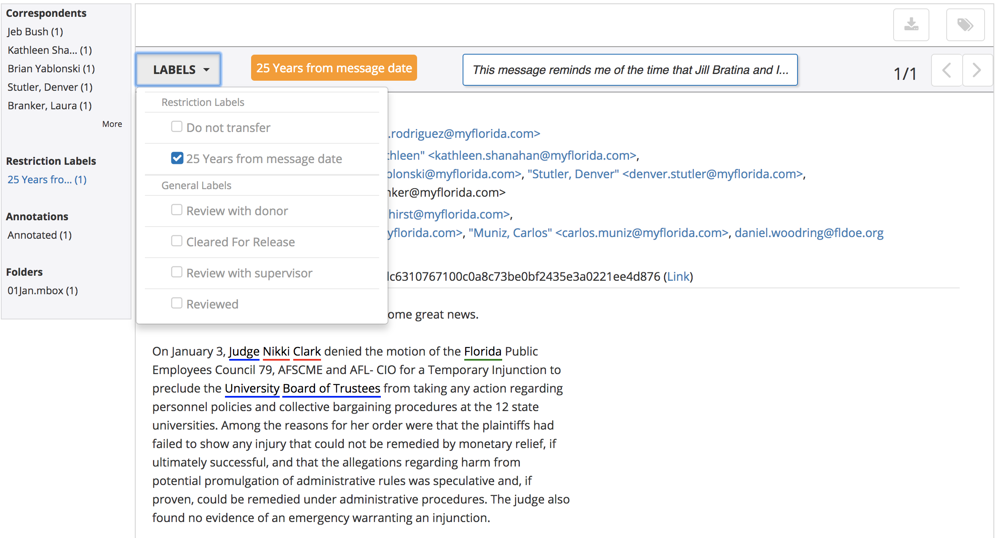
Processing
Screening
Applying labels
Authority reconciliation
Notes:
ePADD records processing decisions, including terms of restriction, via label assignment. All labels are customizable, and you can assign labels to sets of messages as well.
--
Enacting actions via labels was actually a fairly recent development and has worked well.

Slide 15
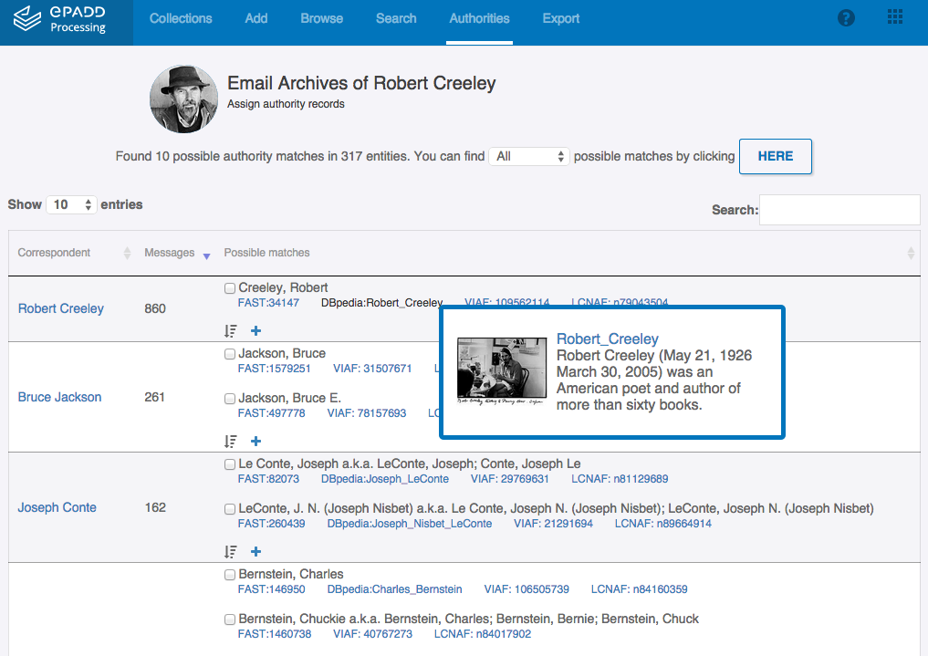
Processing
Screening
Applying Labels
Authority reconciliation
Notes:
ePADD also lets you associate correspondents with authorized headings using OCLC FAST.

Slide 16
* = new for v6
Export between modules (using Bag-it specification *)
Export messages as MBOX to support preservation actions (with new options *)
Export authorized correspondents to support additional publication strategies
Import/export lexicons between collections *
Import/export address book and edit externally *
Import/export labels as JSON to support preservation actions *
Supporting Institutional workflows
Notes:
ePADD 6 introduces lots of support for a wide variety of institutional workflows, including preservation workflows, and interoperability with other tools and services.

Slide 17
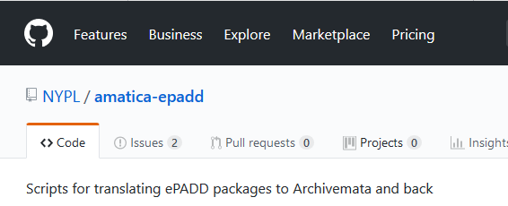
Also new for v6: Modeled integration with Archivematica
Notes:
In addition to adopting the Bagit specification to enable checksum verification and ensure file integrity, we have also modeled an integration with NYPL's instance of Archivematica.
ePADD can identify preservation actions performed on ePADD bags by Archivematica, including filename clean-up and file migration.
ePADD provides access to both original files and migrated files. NYPL staff created scripts to support this workflow on the Archivematica side .
---
This was a collaboration between staff at NYPL and the SUL team:
NYPL: Nick Krabbenhoeft & Susan Malsbury SUL team: Sudheendra Hangal, Chinmay Narayan & Peter Chan

Slide 18
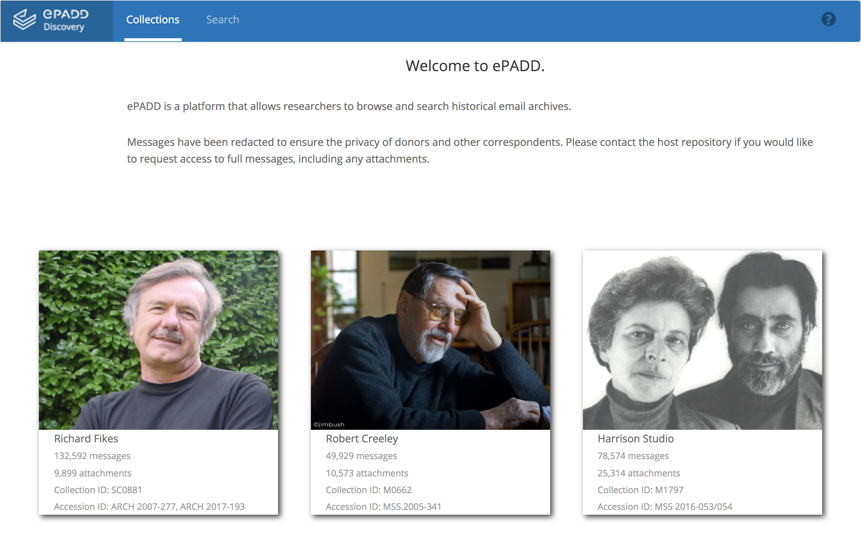
Supporting Discovery
Notes:
One of the most interesting innovations of the software, I think, has been the introduction of a discovery module, mounted on public web server, that helps researchers both discover email archives, as well as learn much more about them than they were able to it in the past so they can make an informed decision about traveling to a physical reading room to access the full corpus.

Slide 19
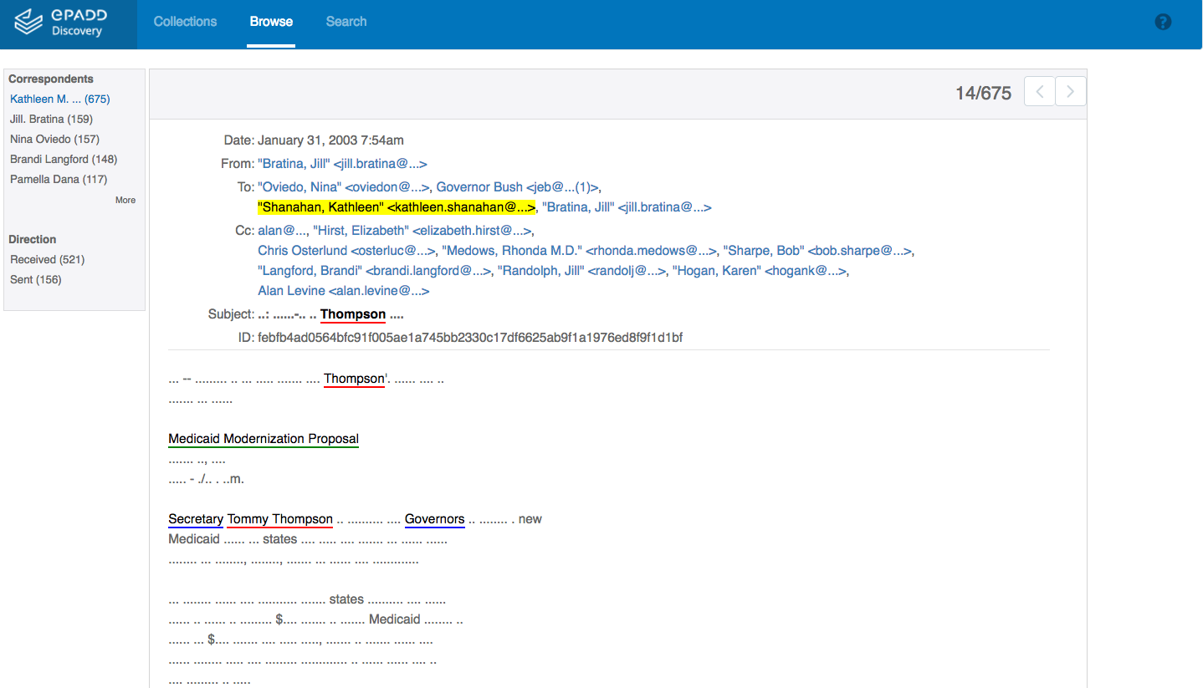
Supporting Discovery
Notes:
In this discovery module, only entities, the name part of email addresses, and message dates are made available. The rest of the context is redacted, protecting privacy and copyright.

Slide 20
Supporting Discovery
Notes:
We’ve introduced cross collection entity search, and we’re aiming for for cross-institution entity search in next release.

Slide 21
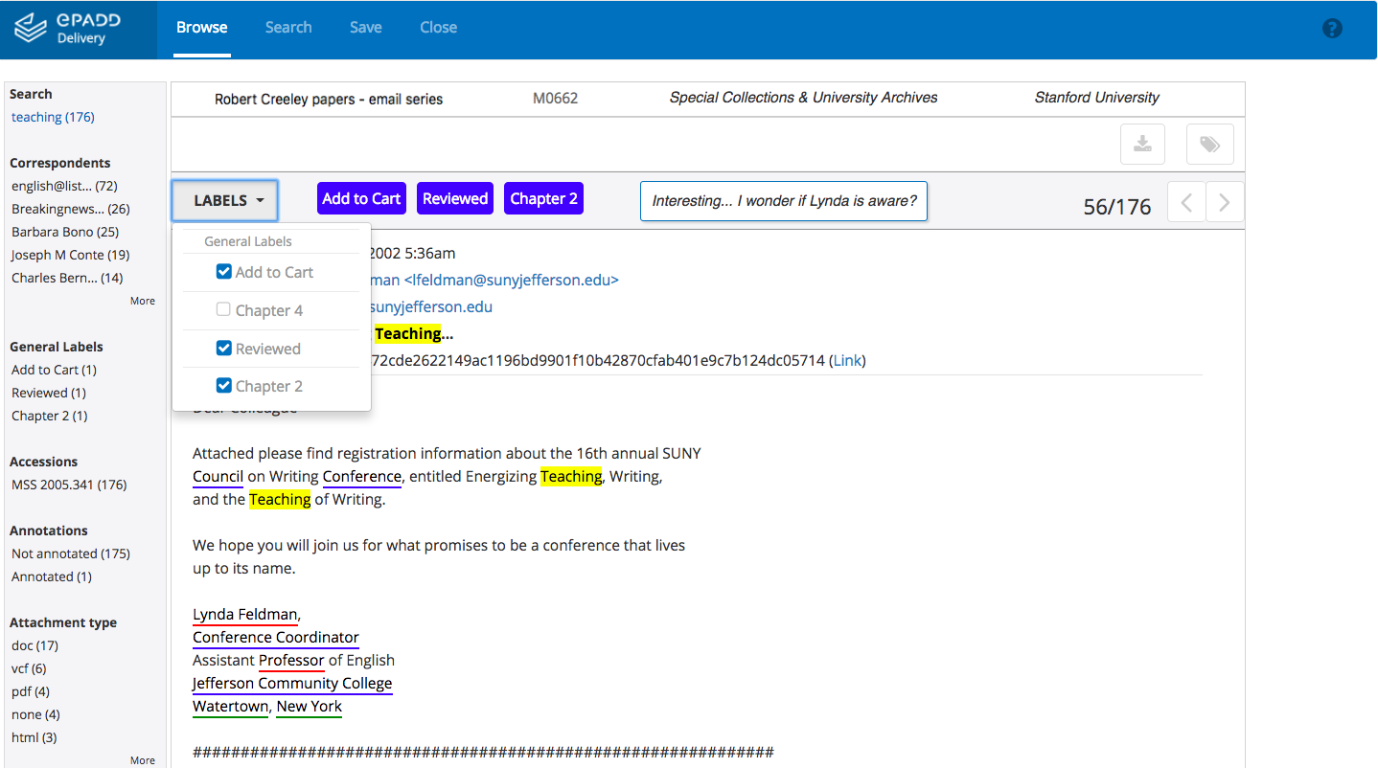
Supporting Access
Notes:
We also support providing researchers with access to the full corpus of email and attachments via a reading room installation. And the user can use labels and one-off annotations to help guide their research request messages.

Slide 22
* = new for v6
Fine-grained named entities as CSV *
Messages as TXT for topic modeling *
Headers as CSV for network analysis *
Attachments (including an option to export just those attachments ePADD is unable to index)
Supporting Access
Notes:
ePADD v6.0 also introduces several NEW export options as seen here.

Slide 23
What’s Next
Notes:
Our final release of the IMLS grant will focus on User interface and experience improvements.
There are lots of future areas of research and implementation, including testing and potentially incorporating a machine-learning driven message classifier to aid in identifying sensitive materials.
We’re also interested in continuing to grow our user community, and exploring new sustainability and governance models.
---
Also:
These include scaling the software to handle even larger email archives.
Developing workflows to preserve external links within messages.
Develop integrations with additional preservation platforms
Support for exporting and publishing metadata in new ways, including as LOD
Considering uncoupling the appraisal module to be a possible stand-alone module for donors and general public
Community development

Slide 24
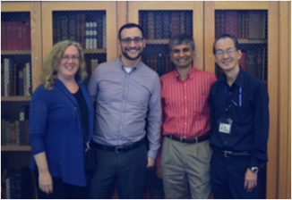
Thanks!
Visit library.stanford.edu/projects/epadd
Follow @e_padd
Watch youtu.be/vu1Oi8TiGiU
Receive epadd_list@stanford.lists.edu
Download / Contribute github.com/epadd
Participate epadd.nimeyo.com
Reach epadd_project@stanford.edu

