Slide 1
Gathering and documenting archival repository location data
Eira Tansey, University of Cincinnati
(co-authored with Ben Goldman, Penn State University
Whitney Ray, State Archives of North Carolina)
August 14, 2018

Slide 2
Where this all started...
Which American archival repositories are exposed to the effects of climate change in the coming decades?

Slide 3
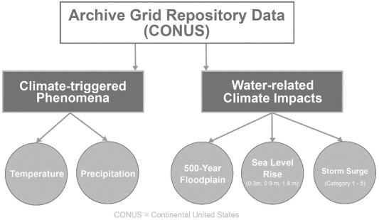
Methods
Intersect 1232 archive locations with environmental data and plausible climate change scenarios

Slide 4
Major Findings
30 locations within a 500-year floodplain
18 coastal locations that would likely be inundated by 1.8-meter (6 feet) sea level rise
84 coastal locations that would likely be inundated by a current category 4 storm surge event if it were a “direct hit” to their coastline
219 coastal locations were found to be at some risk of inundation from the combined effects of future sea-level rise and storm surge
92 locations may experience a 10-degree or greater annual temperature change by 2100

Slide 5
But wait, there’s more!
We have work to do: disaster preparedness, assessment, cooperation, advocacy¹
We need more complete data on our repository locations to inform future efforts
Mazurczyk, T., Piekielek, N., Tansey, E. & Goldman, B. (2018). American Archives and Climate Change: Risks and Adaptation. Climate Risk Management, 20(111-125). https://doi.org/10.1080/01576895.2015.1136226

Slide 6
Where’s the rest of the (Repo)Data?
Goals
Archives don’t have anything comparable to IMLS’s Museum Universe Data File¹
ArchiveGrid data is primarily institutions that have the resources to create and share finding aids online (i.e., well-resourced institutions)
Institute of Museum and Library Services (2015). Museum universe data file FY 2015 Q3 [Data file]. Retrieved from https://data.imls.gov/Museum-Universe-Data-File/Museum-Universe-Data-File-FY-2015-Q3/ku5e-zr2b?_ga=2.19491390.766890092.1524521732-825039837.1524521732

Slide 7
Goals
Goals
Create comprehensive dataset of archival repositories in the United States
Categorize archival repositories by address and type
Share the data in open, reusable format

Slide 8
Methods: Data Gathering
Methods
51 SHRABs and/or State Archives
11 regional archives orgs
7 national archives orgs
46 state-level archives associations
30 metropolitan archives groups
2 individual repositories
4 others
Notes:
36+46+7+11+51

Slide 9
Findings: Limitations
Findings
Existing data sources
Data quality was highly variable
Categorization
Is it an archive?
Subject of material, institutional control
Potential over-representation of some categories

Slide 10
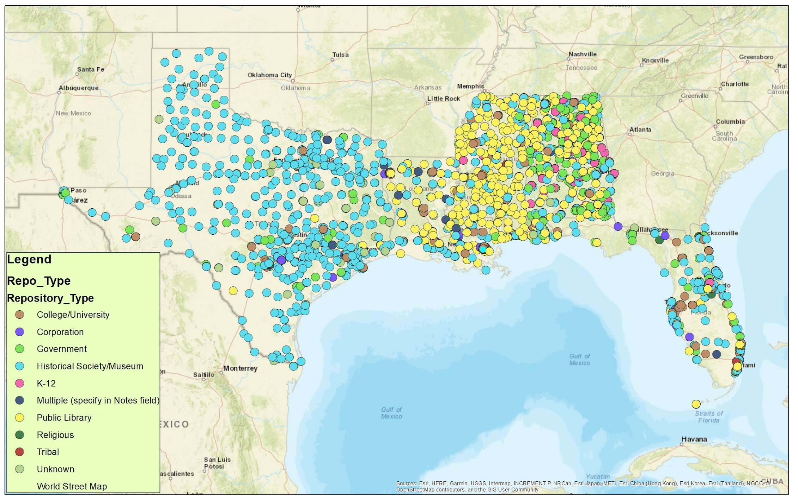
All Gulf Coast repositories

Slide 11
What’s Next
Currently 25,000 available data points for 35 states plus Washington DC
More states will come online later this year
Significant potential reuse for this data
Accessing the data: https://github.com/tanseyem/RepoData
Stewardship of this data for the future is TBD
If you use it, we’d love to hear from you!
Contact eira.tansey@uc.edu

