Slide 1
“What’s in the Box?”
Kristen Korfitzen
Nathalie Proulx
University of Denver
Notes:
Hello My name is Kristen Korfitzen and I am the reference services manager for the special collections and archives at the University of Denver.
and I am Nathalie Proulx and I am the Archivist for The Dance Archive in Special Collections and Archives at the University of Denver.

Slide 2
What’s the Problem?
Under described or under processed collections inhibit their use for instruction and exhibit creation
Notes:
We are here to talk today about our experience of how under described or under processed collections inhibit their use for instruction and exhibit creation.
What do we mean by that? When we get requests for instruction sessions or are in the beginning stages of exhibit planning, we want to be able to provide the best experience for patrons that we can. But, We are often working with collections that have been minimally processed. This contributes to a lack of knowledge about our collections, which is embarrassing and not good service.
Reprocessing your collections can seem overwhelming. Although time consuming and labor intensive, appraising your collections results in a greater knowledge of what you have.
This seems obvious, we know, but we have experienced the shame of calling back boxes and being totally blindsided by what was in them. (by no fault of any of our lovely coworkers at the moment). We have had students find enough “oops” boxes that reworking some of our heavy use collections was necessary sooner rather than later.

Slide 3
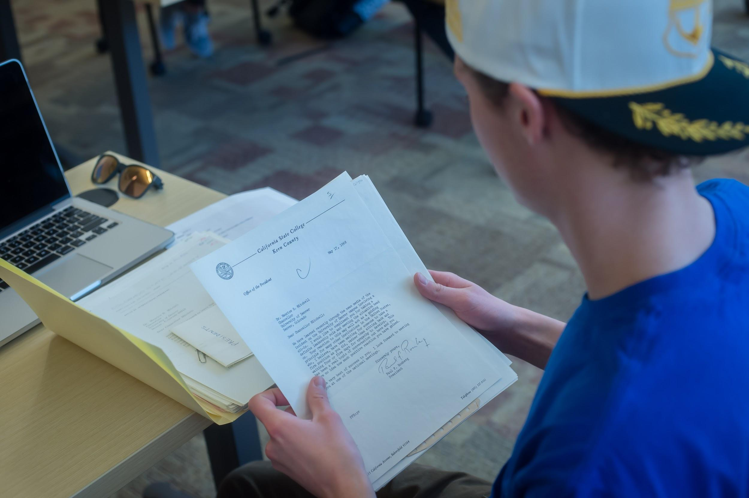
The connection between instruction, exhibits, and processing collections
Notes:
To make this process less daunting, we looked back at our instruction requests. what are faculty asking to use?
We have worked hard to develop close relationships with our faculty, and as a result we have several repeat courses that we help co-teach.
One of our more regular “classes” has a final project which involves creating an exhibit about the student experience at DU. We have hosted this class for the last 3 years and will continue to host it in the future. With our upcoming exhibit on the history of Dance at DU our university collections were a natural place to start appraising
We had our student employees create a master list of small university collections (1-3 boxes) that were lacking adequate description and metadata and started with those.
We began calling back these collections and literally looking at “what’s in the box.” Sometimes what was physically in the box was not represented correctly in our collection management system, ArchiveSpace. These collections are then flagged to be reprocessed and pertinent information pulled for exhibits and instruction.

Slide 4
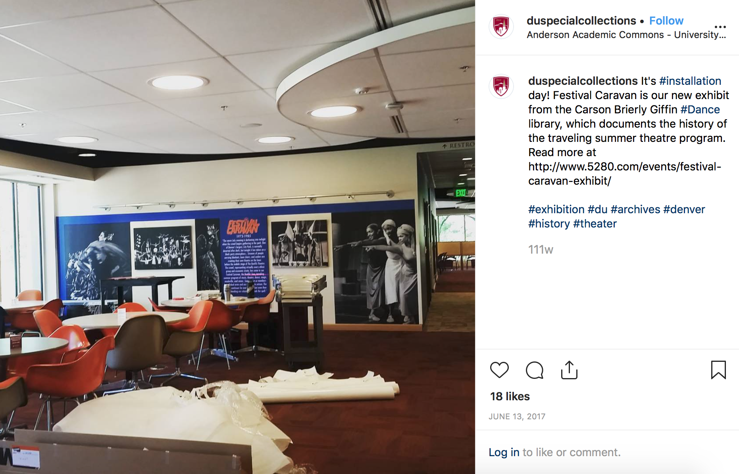
@duspecialcollections
Notes:
Opening boxes works! We have been able to add more description resulting in these collections becoming more discoverable to students and patrons.
Anecdotally, students that were using University Collections to complete research projects this past academic year, found collections that had been worked on during the 1-3 box project using basic search methods
We are in the process of pulling official circulation data for our annual report and expect to see an increase in usage stats for these collections.
In exhibit preparation, greater description of our collections allows us to pull together research from multiple collections, even if tangentially related to the exhibit topic.
An example of this is our exhibit on the University of Denver Dance Department. This content of this exhibit is being pulled from a large amount of collections from the department itself and individual papers of teachers, choreographers and dancers. Having better processed collections helps make the connections between these materials easier to find.

Slide 5
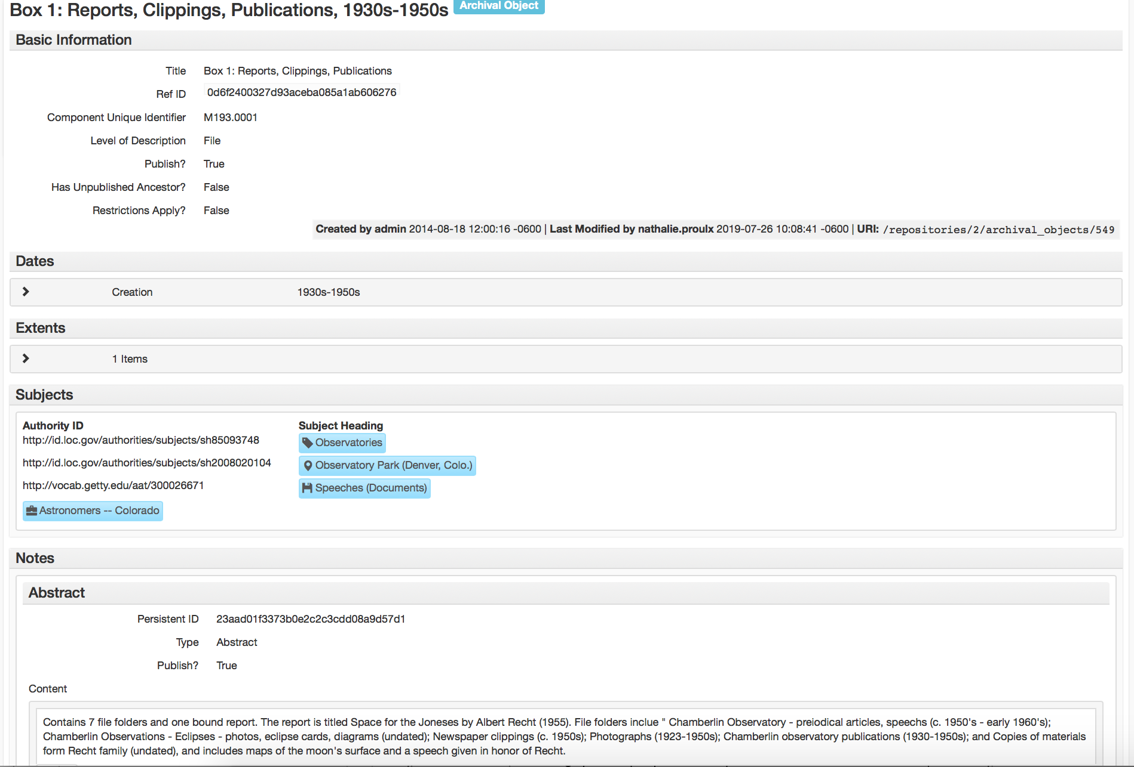
Reflective Title
Subjects Added
Abstract Enhanced
Notes:
It is inevitable as we make more information available to students for their research that they will stumble onto things we’ve missed. Having several multi session classes with the same research area (in this case student life at DU) has helped us further isolate collections to reprocess. We know that most librarians are limited to one shot instruction sessions, but if you are using archives to teach take a look back and see if there are any common subjects you get requests for.
Instruction sessions using university archives has made their “discoverability” a priority. Over the years we have seen several of the same topics come up in student projects over and over. Our students are interested in topics like female students at DU, GreekLife at DU, Sports at DU etc… these classes have influenced how we add box level description. We are making a conscious effort to incorporate subject headings that students have used as their search terms while working in the archives to make those collections more discoverable.

Slide 6
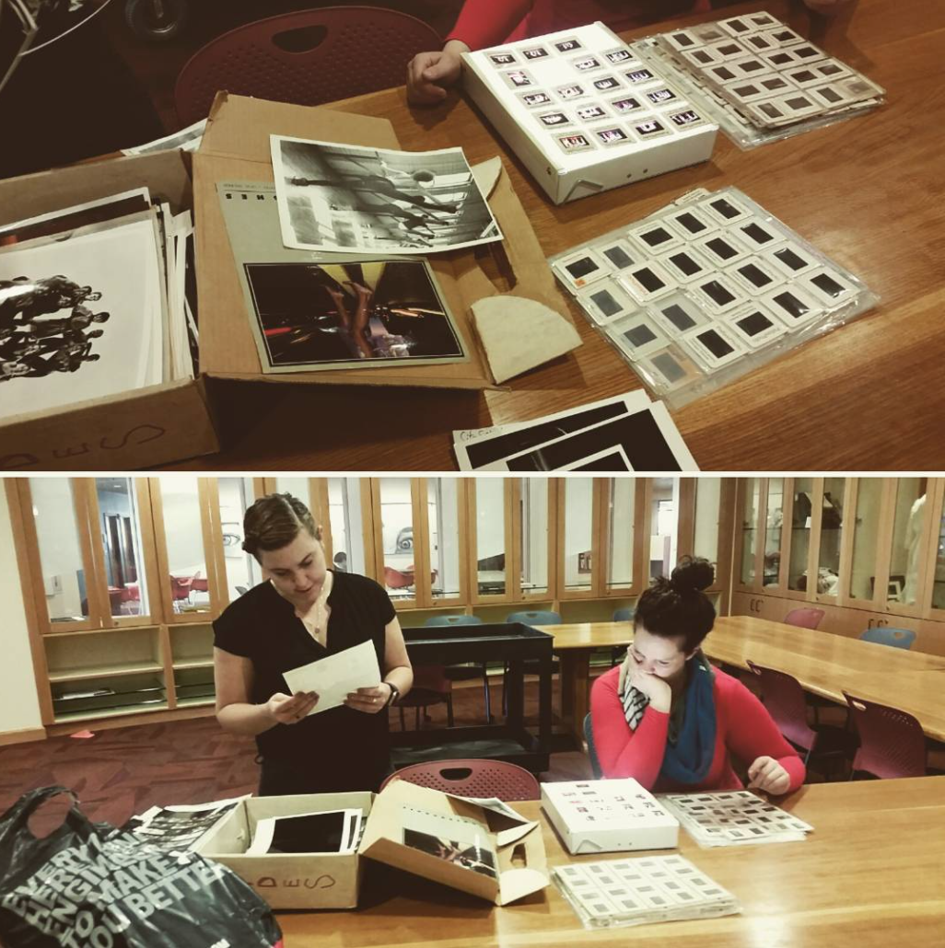
Who Benefits?
Students
Faculty
Your Department!
Notes:
Opening your boxes benefits everyone. Assess your collections and call back those that haven’t been touched in years. Implement smaller projects to do a bit at a time.
Students have better access to information and can do more in depth projects coming away from the instruction session with a deeper understanding of their topics.
Faculty benefit because we are able to collaboratively design the instruction experience and better help them reach their goals
Our department benefits because we have a better sense of what our patrons are using and what they want from us.
We also benefit because we know what’s in our collection.

Slide 7
Thank You
Follow us on Instagram!
@duspecialcollections
@dancearchivedu
Notes:
Thanks for your time and go out and start exploring!

