Slide 1
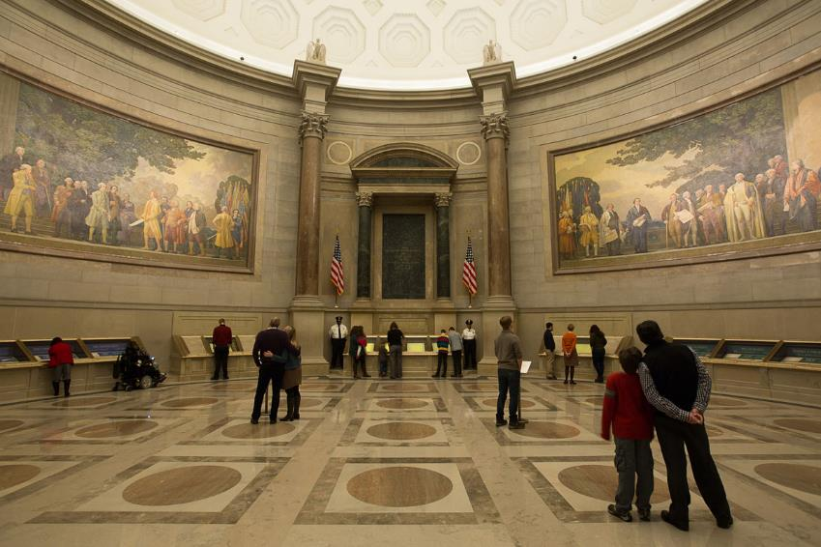
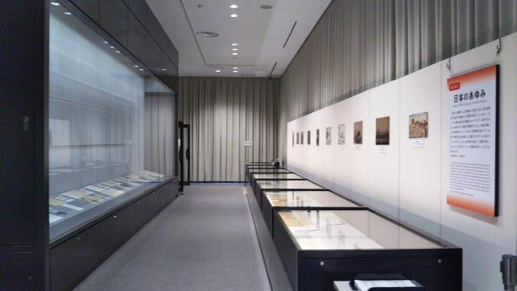
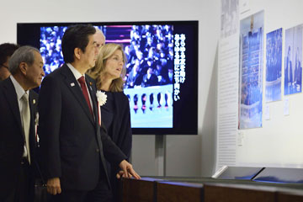
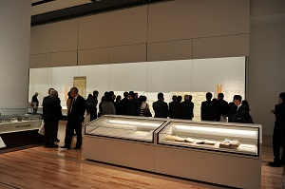
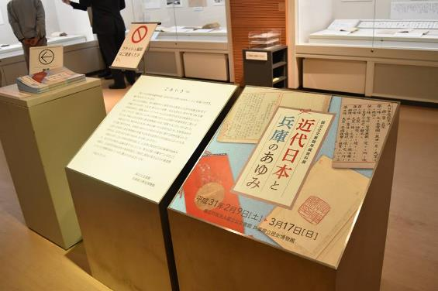
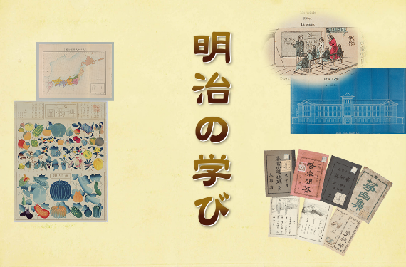
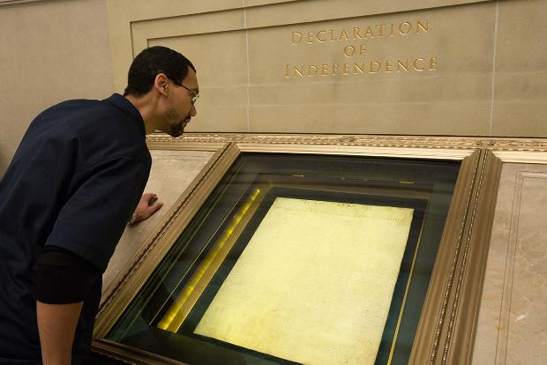
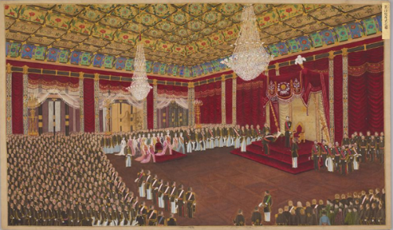
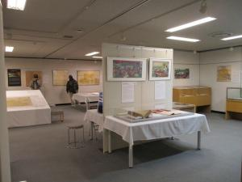
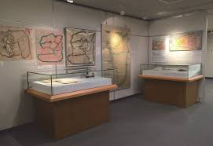
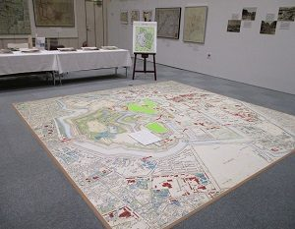
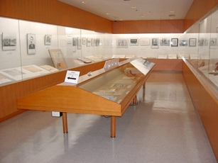
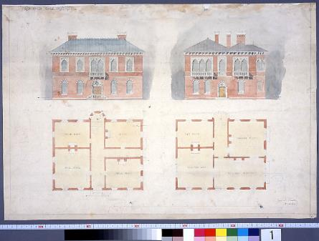
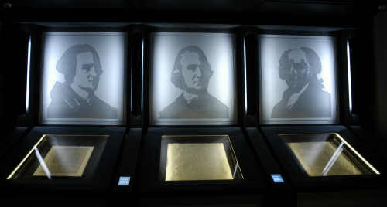
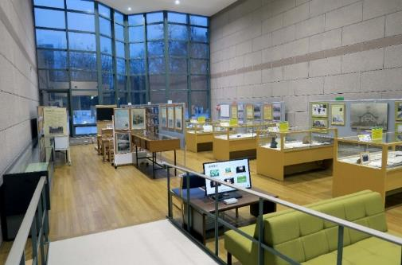
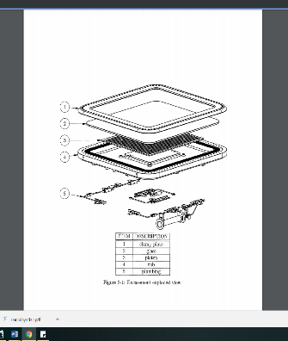
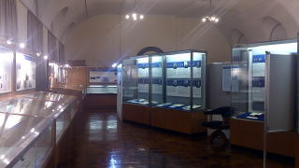
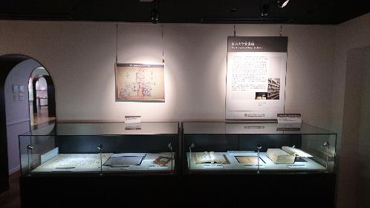
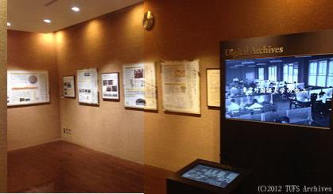
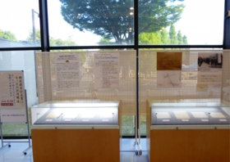
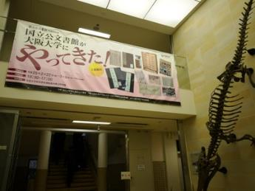
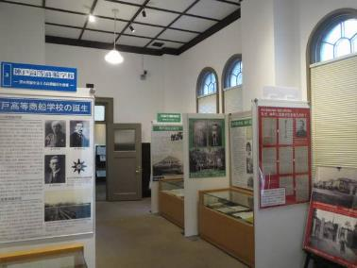
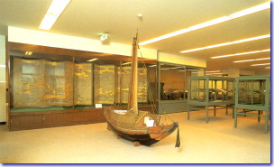
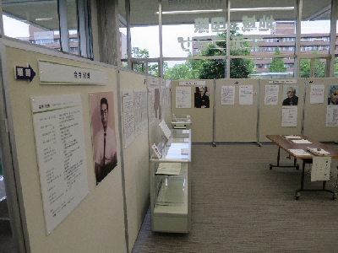
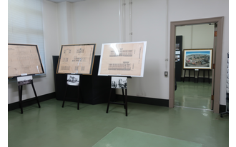
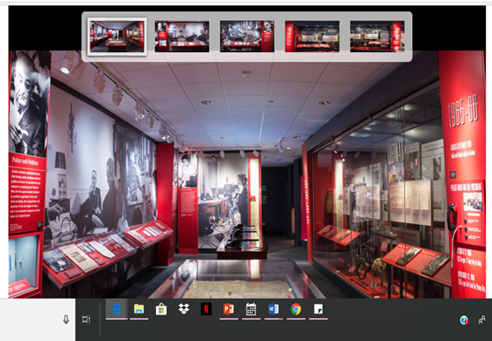
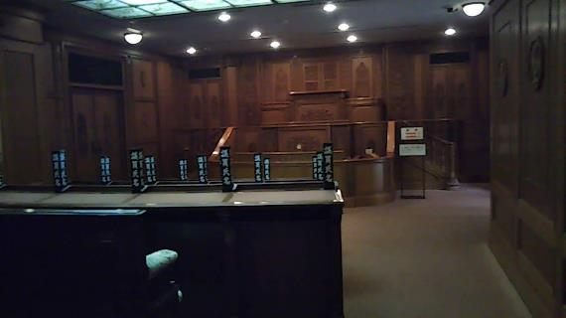
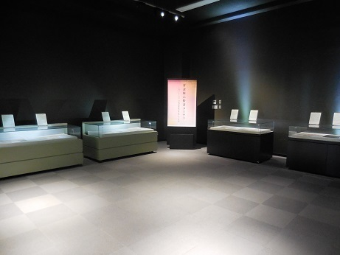
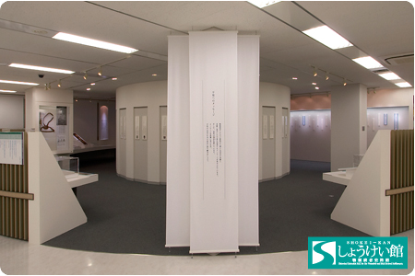
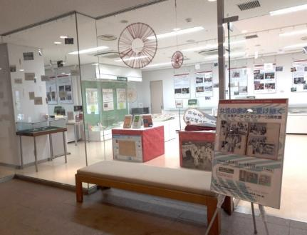
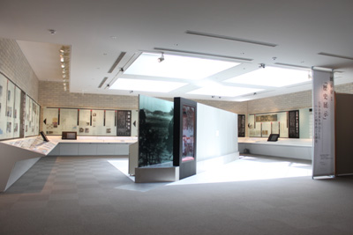
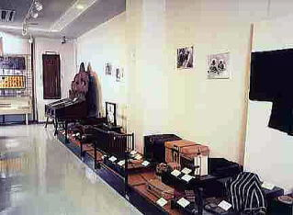
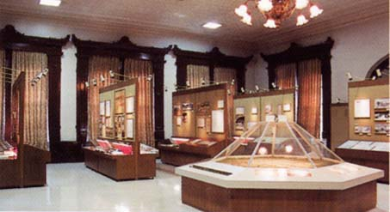
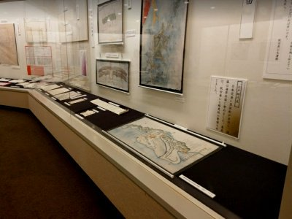
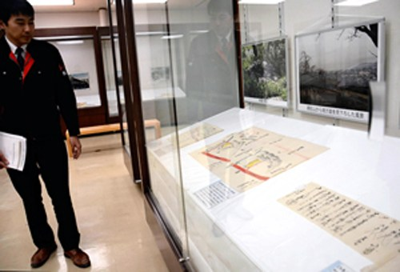
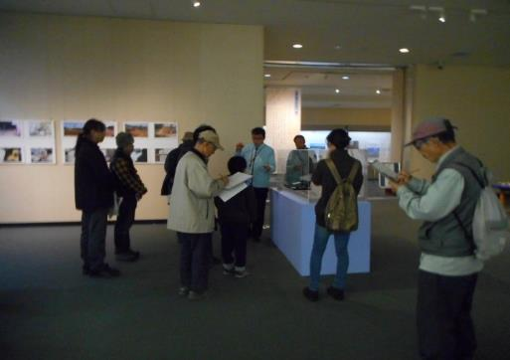
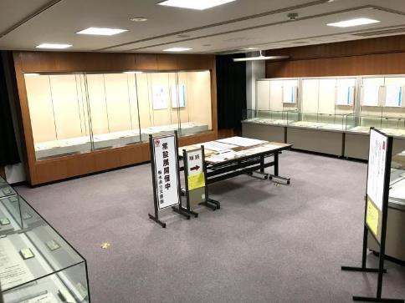
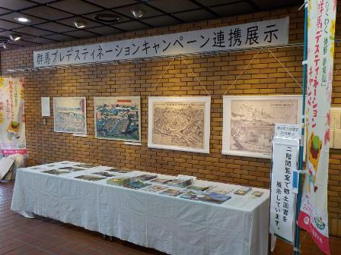
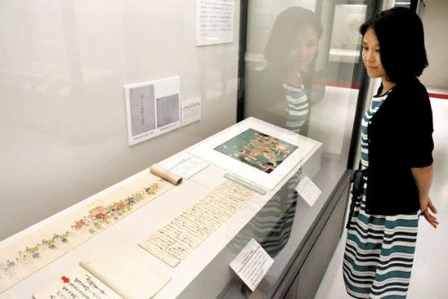
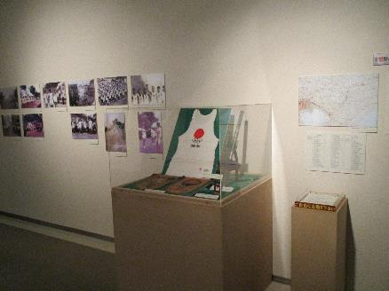
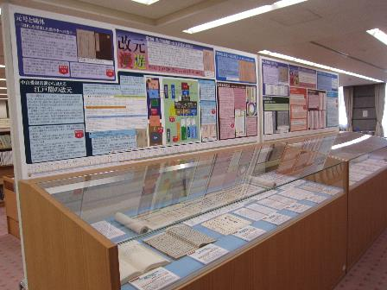
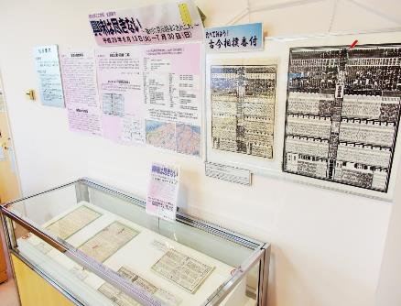
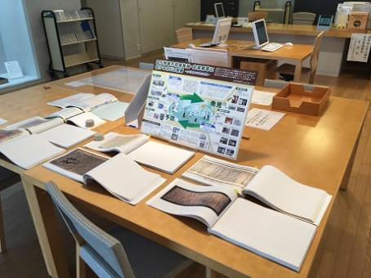
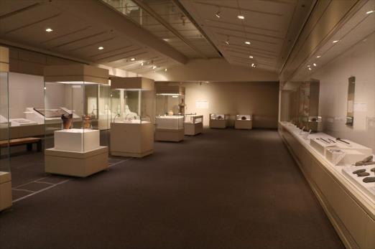
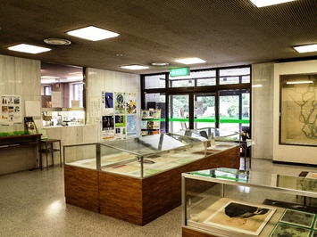
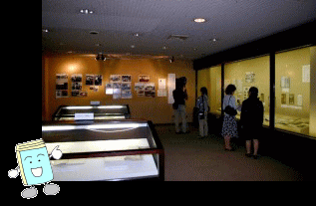
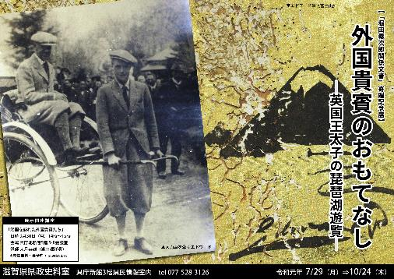
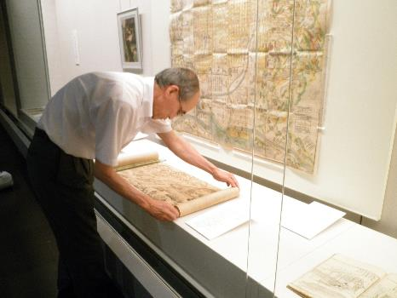
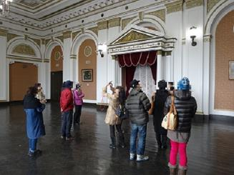
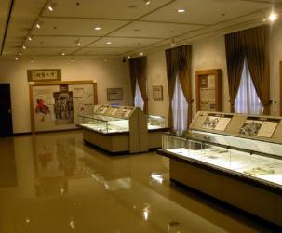
Exhibits of Archives in Japan
Listed by National Archives http://www.archives.go.jp/links/
Images are cited from their HP, Twitter, and News-clips.
Exhibitions in US
Archives I Rotunda
Yayoi TSUTSUI (Hitotsubashi University )
Homepages and SNS show us Exhibitions of Archives over Japan.
Article 23 : The head of the National Archives of Japan, etc. shall actively endeavor to provide Specified Historical Public Records and Archives (limited to those whose use may be permitted pursuant to the provision of Article 16) for public use through exhibitions or other means.
1987 Public Archives Act
2009 National Records and Archives Management Act
National Archives of Japan
Permanent Exhibit International Exhibit “JFK” in 2015 Collaboration with Mie Prefectural Museum Travel Exhibit in Hyogo Online Exhibit
National Archives etc. the Imperial Household Archives Collaborate Exhibit on Meiji Empress Diplomatic Archives Bank of Japan Archives
the Imperial Household Archives, Tokyo Metropolitan Library, Tokyo Metropolitan Archives from “Digital Archives!
Massachusetts Archives, Commonwealth Museum
Homepage Gallery
National Archives etc. National University Archives
Hokkaido University Archives Tohoku University Archives University of Tokyo Archives TUFS Archives Tokyo Tech Museum and Archives
University of Tsukuba Archives Nagoya University Archives
Kyoto University Archives Osaka University Archives Kobe University Archives (Maritime Museum of Kobe Univ) Hiroshima University Archives Kyushu University Archives
LBJ Presidential Library
Selected from National Affinity Institutions
Constitution Memorial Center National Institute of Japanese Literature Shokei-kan National Women’s Education Center the Hansen’s Decease Museum Shiga University
Please tell about your archives’ exhibits.
Prefectural Archives ～Not all prefectures have archives. Not all prefectural archives have their own exhibit hall.
The Archives of Hokkaido Akita Prefectural Archives Fukushima Prefectural Archives Ibaraki Prefectural Archives and Museum Tochigi Prefectural Archives
Gunma Prefectural Archives Saitama Prefectural Archives Chiba Prefectural Archives Kanagawa Prefectural Archives Niigata Prefectural Archives Toyama Prefectural Archives
Fukui Prefectural Archives Nagano Prefectural Museum of History Gifu Prefectural Historical Archives Aichi Prefectural Archives Archives of Shiga Kyoto Institute , Library and Archives
Osaka Prefectural Archives the Archives of Hyogo Prefectural Government Shimane Prefectural PRC Okayama Prefectural Archives Kagawa Prefectural Archives Okinawa Prefectural Archives
Wakayama Tottori Hiroshima
Some Municipal Archives Itabashi City Archives Samukawa city Archives Matsumoto city Archives
Nagoya City Archives Sagamihara city Archives Daisen City Archives Kobe City Archives
Discussions
-the roles and function of exhibits of Archive comparing with the museums Story or Context ?
Who take in charge of exhibits in Archives? Should archivists be exhibit designers?
-the importance of exhibits comparing with other functions and activities of Archives veterans cannot wait
What is the most important mission of archives? Providing access to the archival materials
-the efforts for exhibits provided by the archives under the tight budget and small personnel monthly / reuse / in the reading room …

