Slide 1
Establishing a Solid framework for audiovisual Archiving education: Current developments and future Prospects for the development of AV competencies
Karen F. Gracy, Ph.D.
School of Information, Kent state University
kgracy@kent.edu
Notes:
Archives that hold A/V materials are at a critical point, with many cultural heritage institutions needing to take immediate action to safeguard at-risk media formats before the content they contain is lost forever. Yet, many in the cultural heritage communities do not have sufficient education and training in how to handle the special needs that A/V archive materials present.
To compound the challenges, currently, there is no certifying body for audiovisual archiving programs or practitioners;
Several abortive efforts aimed at establishing a system for accreditation or certification for moving image archivists in the last 15 years (never progressing beyond conversations at AMIA meetings).
There also is no commonly agreed-upon guidelines or competency framework for developing curriculum in this area, at either graduate level or for professional development.
Thus, we felt that this work was needed and will provide a valuable resource to the AV archiving community.

Slide 2
Audiovisual Competency Framework Working Group
Current Projects
Snowden Becker, UCLA
Identification of soft skills relevant to AV Archiving work
Edward Benoit, Louisiana State University
Analysis of recent employment advertisements to identify competencies
Janet Ceja and Adam Schutzman, Simmons College
Analysis of syllabi for AV Archiving Courses to identify competencies
Karen Gracy, Kent State University
Study of competency sets and educational guidelines of allied fields to generate High-level competencies as a framework for lower-level competencies
Notes:
Recently, several archive educators and students created an informal group to help foster “educational opportunities in audiovisual archiving for those engaged in the cultural heritage sector.” Currently, the AV Competency Framework Working Group is developing a set of competencies for audiovisual archive training of students in graduate level education programs and in continuing education settings. The projects listed above relate to that project.
This report provides a brief background for the competency project and shares results of my recent research analyzing high-level competencies in allied fields to see how they may contribute to the creation of competencies for audiovisual archiving.

Slide 3
Influences of LIS and Allied Fields on Audiovisual Archiving Education
Audiovisual Archiving and Preservation
Library and information science
Archival science
Conservation
Museology
Media histories
Moving image and sound production
Notes:
Before we begin to talk about competencies, we need to look at the various fields that have influenced audiovisual archiving and preservation as it matured into its own profession. These are important to keep in mind, as most of them have generated some sort of educational guidelines or competency sets that have some relevance for AV archiving.

Slide 4
Knowledge and Skills of the Audiovisual archiving profession
1) Foundational Knowledge
2) Specialized (format-specific or function-specific) Knowledge
4) Practical/on-the-job application of knowledge to real world environments
3) Soft Skills
Notes:
We also need to think about the various types of knowledge and skills that go into the education of AV archivists. Graduate programs in audiovisual archiving must balance requirements for a broad-based education in the theoretical and historical foundations of the profession with equally strong needs for specialized knowledge and skills relating to the formats and functions of archival AV. They also need the soft skills that allow new professionals to function effectively in the workplace. These three types of learning must also be supplemented with significant opportunities to apply knowledge in real world settings.

Slide 5
Audiences and Uses for AN audiovisual archiving Competency Model
Students and Working Professionals
Educators
Employers
Audiences and Uses
Certifying Bodies and Professional Associations
Notes:
Finally, we must keep in mind our audience for competencies. A competency model that focuses on the AV field should provide value to four different constituencies. The Working Group aims to create a framework that is shaped by the needs of all of these groups, and will involve all of these constituents in our research and development process.

Slide 6
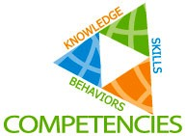
Competencies—What Are They?
A competency is …
“ … the capability to apply or use a set of related knowledge, skills, and abilities required to successfully perform ‘critical work functions’ or tasks in a defined work setting.”—University of Texas, School of Public Health

Slide 7
Types of Competencies
Professional/Organizational—generic/core competencies required of all professionals in a field (can be either behavioral, “soft” skills, or core subject knowledge, or both).
Functional—standards of performance needed by an individual working in a specific role or function (could be technical expertise and/or specialized knowledge).
Job—specific behaviors, skills, knowledge sets required for exceptional performance in a specific job.
Leadership—factors that lead to success in managerial, executive, and administrative positions.
Notes:
Definitions taken from human resources literature.
In an educational setting, we tend to be more focused on the first two types (as they often relate more to student cognitive development), but …
We should also provide some opportunities to develop competencies in the 3rd and 4th categories via activities that occur outside the classroom (internships/practica, social activities, and problem-solving activities).

Slide 8
Competencies and the Three Primary Domains of Learning
To design competencies for a program or field, one should ideally consider the three primary learning domains:
Cognitive Domain
Psychomotor Domain
Affective Domain
Moving image archiving is a profession that should require competencies from all three of these domains.
Notes:
Cognitive domain: Reflects Bloom’s Taxonomy (1956) of learning
Often the primary focus of tertiary education
Helps students acquire knowledge of a particular discipline or field (the theoretical constructs and their historical contexts)
Psychomotor Domain: Involves skills requiring physical movement, coordination, and/or use of the senses such as sight, hearing, smell, touch, etc.
While often underplayed in graduate education (assumption is often that students will gain many of these necessary skills in their first professional job) …
In the AV archiving field it is essential that students make initial steps toward mastery of these skills to be successful in obtaining their first professional position.
Affective Domain: Includes those “soft skills” that we are interested in cultivating (communication, project and task management, teamwork, etc.).
The classroom should not be the only place where this learning occurs (other settings can include internships, conferences, social gatherings, etc.).

Slide 9
Goals for Competency Development: Theoretical Foundations vs. Practical Skills?
Is it really either/or?
How can we close the gap between what entry-level positions expect and what knowledge and skills the typical graduate actually has at the completion of an educational program?
How can we help entry-level and mid-career professionals continue to expand their knowledge, acquire new skills, and progress to new stages in their career?
Notes:
Theoretical foundations in the academic discipline vs. practical, competitive skills for a professional career. Competencies should be useful for both graduate and continuing education.

Slide 10
Defining high-level competencies
Notes:
This part of the talk will review some recent research that I conducted to examine competencies from a variety of allied fields to generate relevant categories of competencies for AV Archiving.

Slide 11
Competency Sets and Guidelines Analyzed for this Part of the project
Academy of Certified Archivists Role Delineation Statement (2012)
American Alliance of Museums Museum Curator Competencies (2014)
American Institute of Conservation Essential Competencies of the Conservator (2003)
American Institute of Conservation Requisite Competencies for Conservation Technicians and Collections Care Specialists (2005)
American Library Association Core Competences of Librarianship (2009)
Art Libraries Society of North America Core Competencies for Art Information Professionals (2006)
American Society of Information Science & Technology Educational Guidelines (2001)
Association for College and Research Libraries Competencies for Special Collections Professionals (2017)
Audiovisual Archiving: Philosophy and Principles (2016, 3rd ed.), written by Ray Edmondson for UNESCO
Core Competencies for Visual Resource Management (2007), written by Hemalata Iyer for IMLS
Curriculum Development for the Training of Personnel in Moving Image and Recorded Sound Archives (1990), written by Helen Harrison for UNESCO
ICON (Institute of Conservation) Professional Guidelines for Conservator-Restorers (2002)
Society of American Archivists Graduate Programs in Archival Studies guidelines (2016)

Slide 12
METHODOLOGY USED to analyze competency sets of allied fields
This research involved content analysis of each document containing competency statements using qualitative data analysis software (NVIVO). Activities included:
Tagging each topic or skill found in each document
Grouping similar tags together and merging categories as needed to combine similar topics or skills
Organizing them in a hierarchical fashion to identify competency groupings with broader scope and the more specific competencies that belong to those groupings.
Identifying patterns across disciplines to see how different allied fields share certain competencies, and competencies that are specific to particular fields.

Slide 13
DATA ANALYSIS
322 initial nodes (tags) generated during coding of competency sets and guidelines.
Nodes were then consolidated and organized into a hierarchical structure.
After reorganization, the hierarchy features 19 top-level nodes, which correspond to high-level competencies for eight allied cultural heritage professions, including:
Archival science
Audiovisual preservation and archiving
Conservation
Information science
Librarianship
Museology
Special collections librarianship
Visual resources management

Slide 14
The 19 High-Level Competencies Drawn from competencies of Allied cultural heritage disciplines
Accession and deposit of materials
Allied and complementary disciplines
Appraisal and selection
Assessment and evaluation of services and their outcomes
Classification, cataloging, arrangement, and description
Collection management
Communication, collaboration, and outreach
Concepts of archival theory, methodology, and practice
Format knowledge
History of cultural heritage institutions and the professions
Information science
Legal issues, concerns, and responsibilities
Literacies (digital, information, technological)
Management and administration
Original and applied research
Preservation and conservation
Professional and social responsibilities
Soft skills (people skills)
Technology (application to cultural heritage work)

Slide 15
Example of Full (Expanded) hierarchy for a high-level competency (includes all allied fields)
Format knowledge
Archival material knowledge
Basic media-related physics and chemistry
History of audiovisual production
History of technology of cultural heritage
Knowledge of basic history, theory, and best practices related to special collections
Physical and technological characteristics of records and papers
Recording technologies of the various audiovisual media
Related material to AV resources (non-AV)
Terminology knowledge

Slide 16
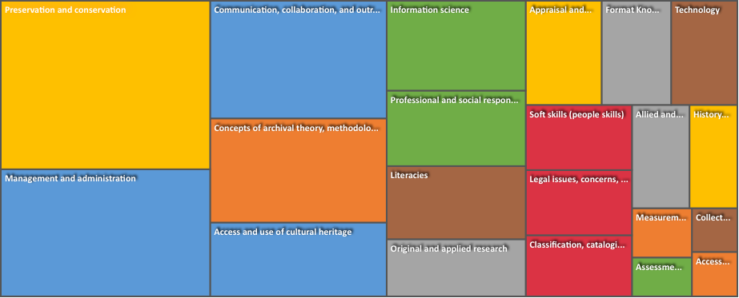
Coded instances for each high-level competency area
Notes:
Graphic generated from NVivo.

Slide 17
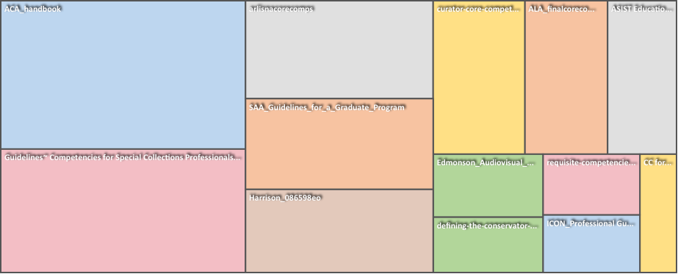
Comparison of Nodes drawn from each set of competencies or guidelines
Notes:
Graphic generated by NVivo.

Slide 18
Limitations of this study
Current high-level competencies do not reflect need for education in media histories and moving image and sound production.
This study may not reflect the most recent developments in the field, and must be aligned with analyses of recent job ads and syllabi.
After alignment of these three data sources, the results will need to be validated by instructors, employers, and students.
Notes:
Current high-level competencies do not reflect need for education in media histories and moving image and sound production.
Additional research is needed to identify knowledge and skills in these areas and integrate them with the high-level competencies.
This study may not reflect the most recent developments in the field, and must be aligned with analyses of:
Syllabi (Janet Ceja and Adam Schutzman)
Recent employment advertisements (Edward Benoit)
After alignment of these three data sources, the results will need to be validated by:
Instructors currently teaching in this area
Employers (i.e., working audiovisual specialists in libraries, archives, museum, and other noncommercial and commercial environments such as laboratories and corporate archives)
Current and recently graduated students in the field.

Slide 19
Next steps
Filling in the Gaps
Additional data collection and analysis (interviews and focus groups)
Defining Core Competencies and Building Out Specialized Knowledge Areas
identify core knowledge and fully describe specialized knowledge areas.
Establishing Levels of Competencies
match competencies to levels of expertise and to particular needs of learners at different stages of education and training.
Notes:
Filling in the Gaps
The research team fully expects that during the validation process (interviews and focus groups with instructors, working professionals and students) that we will identify gaps in our draft competency set and use their feedback to help us fill in gaps and refine competencies.
Defining Core Competencies and Building Out Specialized Knowledge Areas
The research team will be reliant on instructor and working professional input to identify core knowledge and fully describe specialized knowledge areas.
Establishing Levels of Competencies
The research team hopes to match competencies to levels of expertise and to particular needs of learners at different stages of education and training.

Slide 20
Thank you for listening!
For more information about this project, please contact me at kgracy@kent.edu or visit the Project website at: https://sites.google.com/a/kent.edu/audiovisual-competency-framework-working-group/.

