Slide 1
Fonds Farewell: Mapping American Archival Vulnerabilities to Climate Change

Slide 2
Researchers
Eira Tansey
Digital Archivist,
Records Manager
University of Cincinnati
Ben Goldman
Digital Records Archivist,
Kalin Librarian for Technological Innovations
Penn State University
Nathan Piekielek
Geospatial Services Librarian
Penn State University

Slide 3
Problem Statement
Which American archival repositories are most vulnerable to the effects of climate change in the coming decades?

Slide 4
Methodology
Intersect archive locations with climate change models in ArcGIS.
ArchiveGrid
Repository data
(CONUS)
NOAA sea level rise data:
1’, 3’, 6’

Slide 6
1231 institutions
46 institutions
Mapped using ArcGIS
Located in coastal areas mapped for sea-level rise

Slide 7
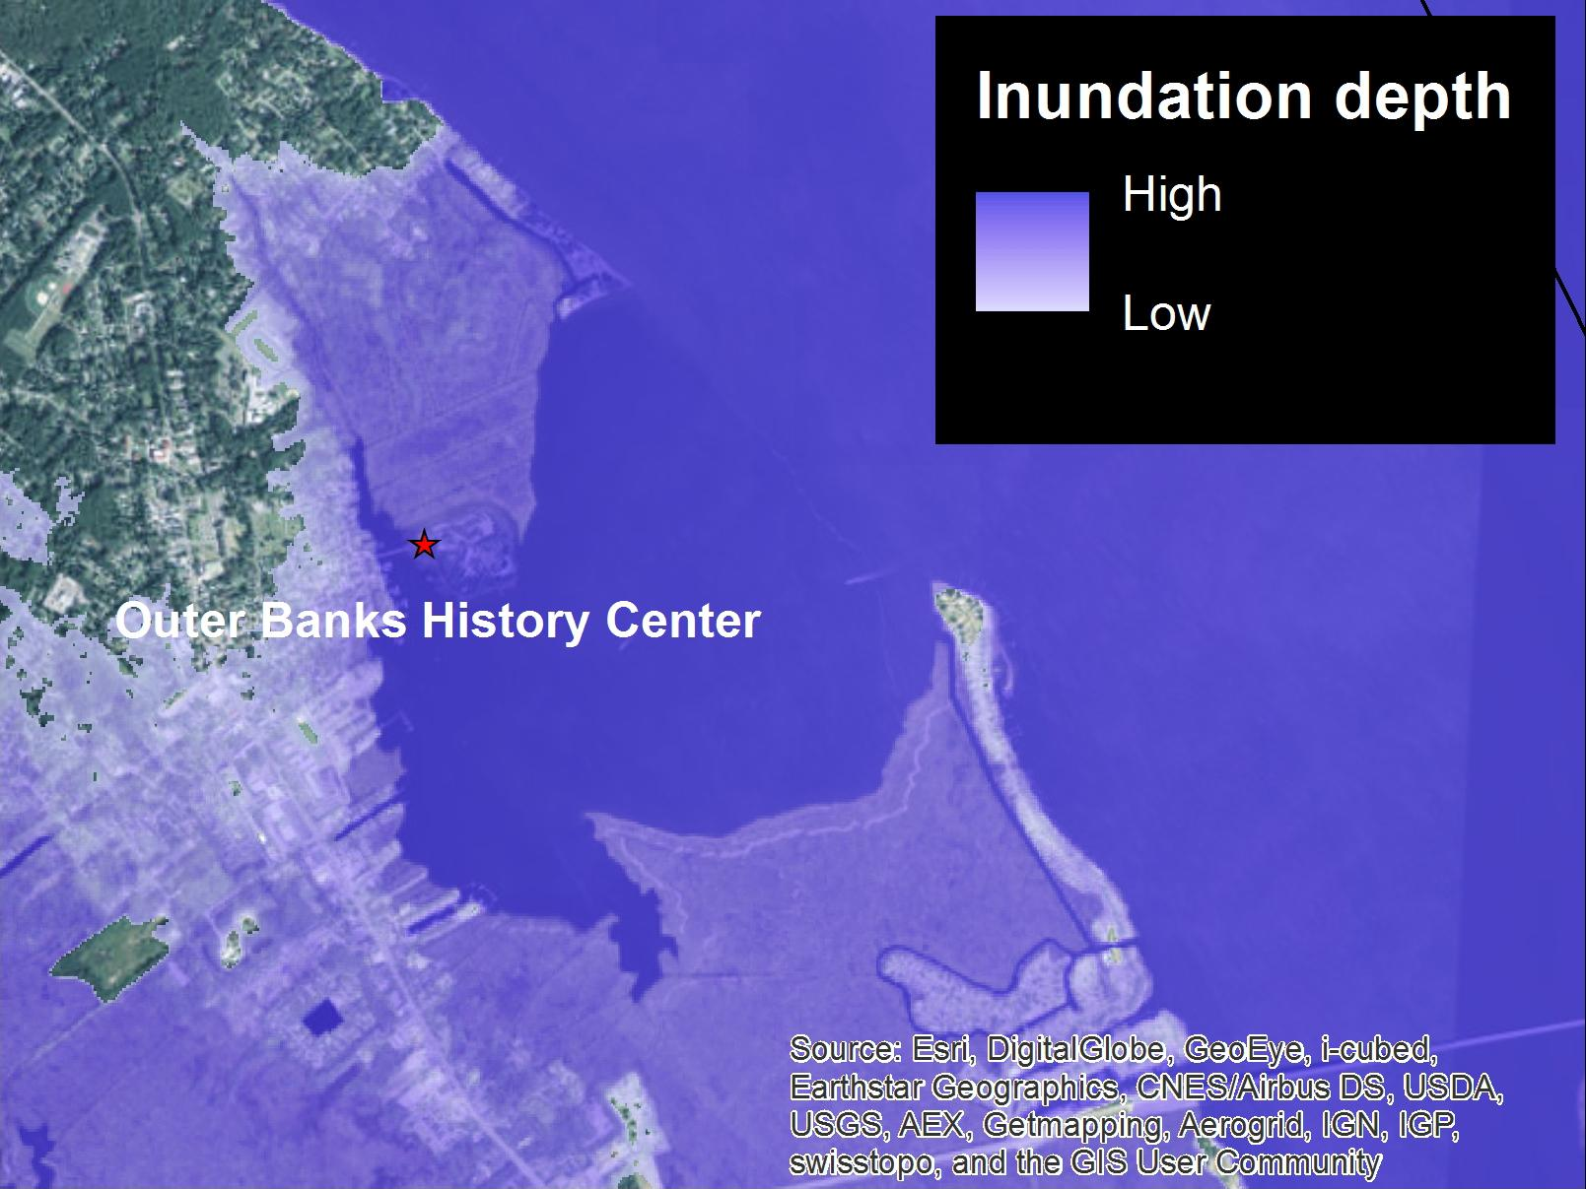
Sea Level Rise, 1 ft Scenario
3 institutions with inundation risk
1 institution = high confidence
2 institutions = low confidence

Slide 8
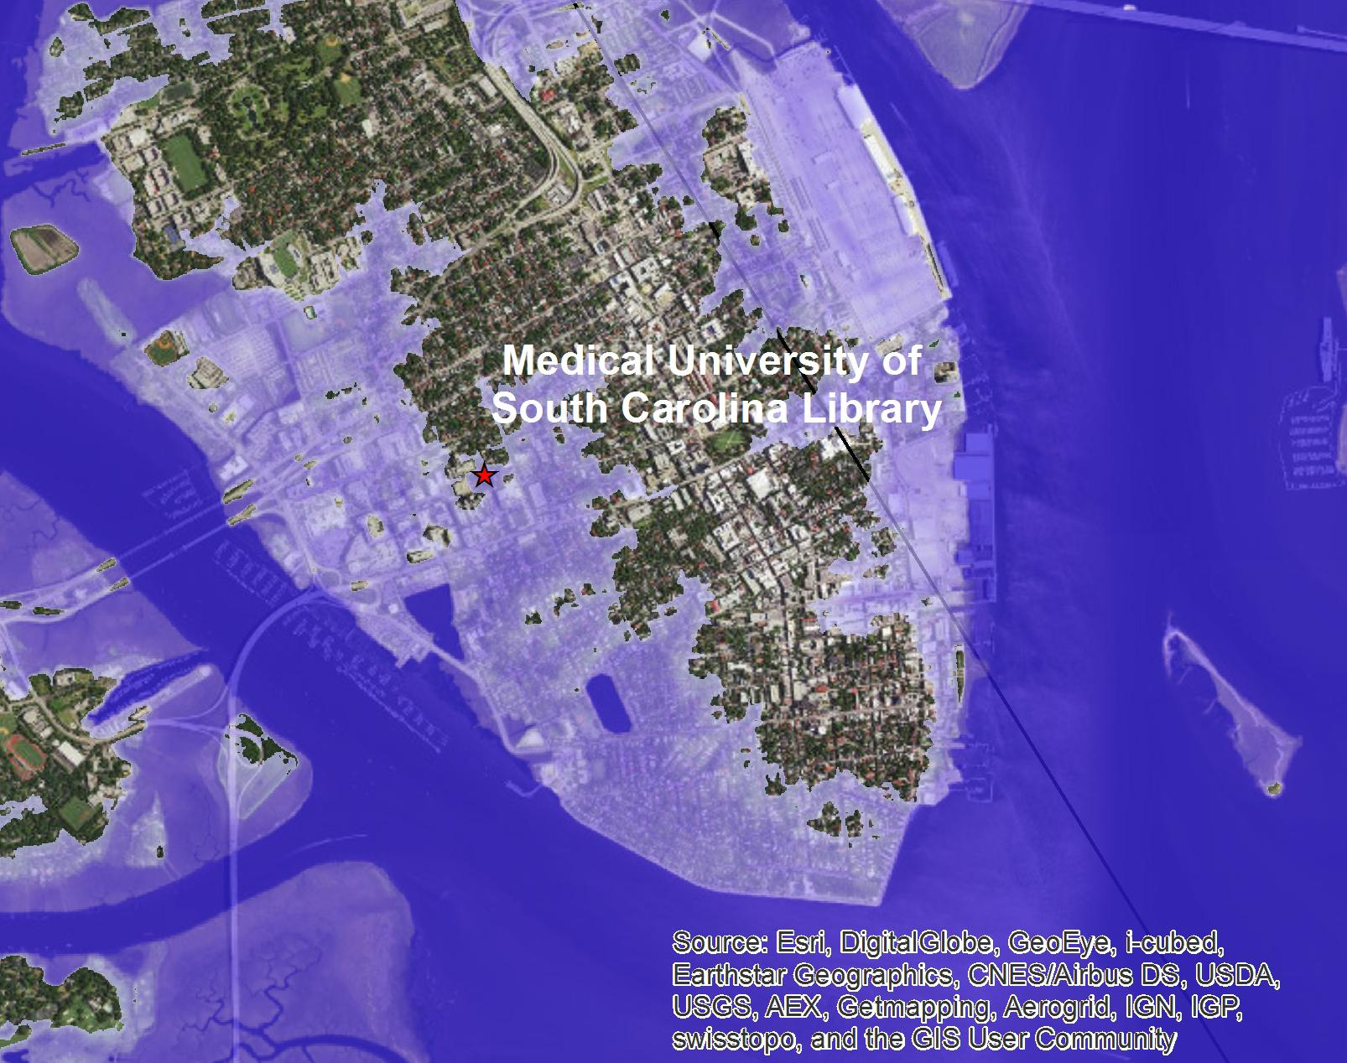
Sea Level Rise, 3 ft Scenario
8 institutions with inundation risk
2 institutions = high confidence
6 institutions = low confidence

Slide 9
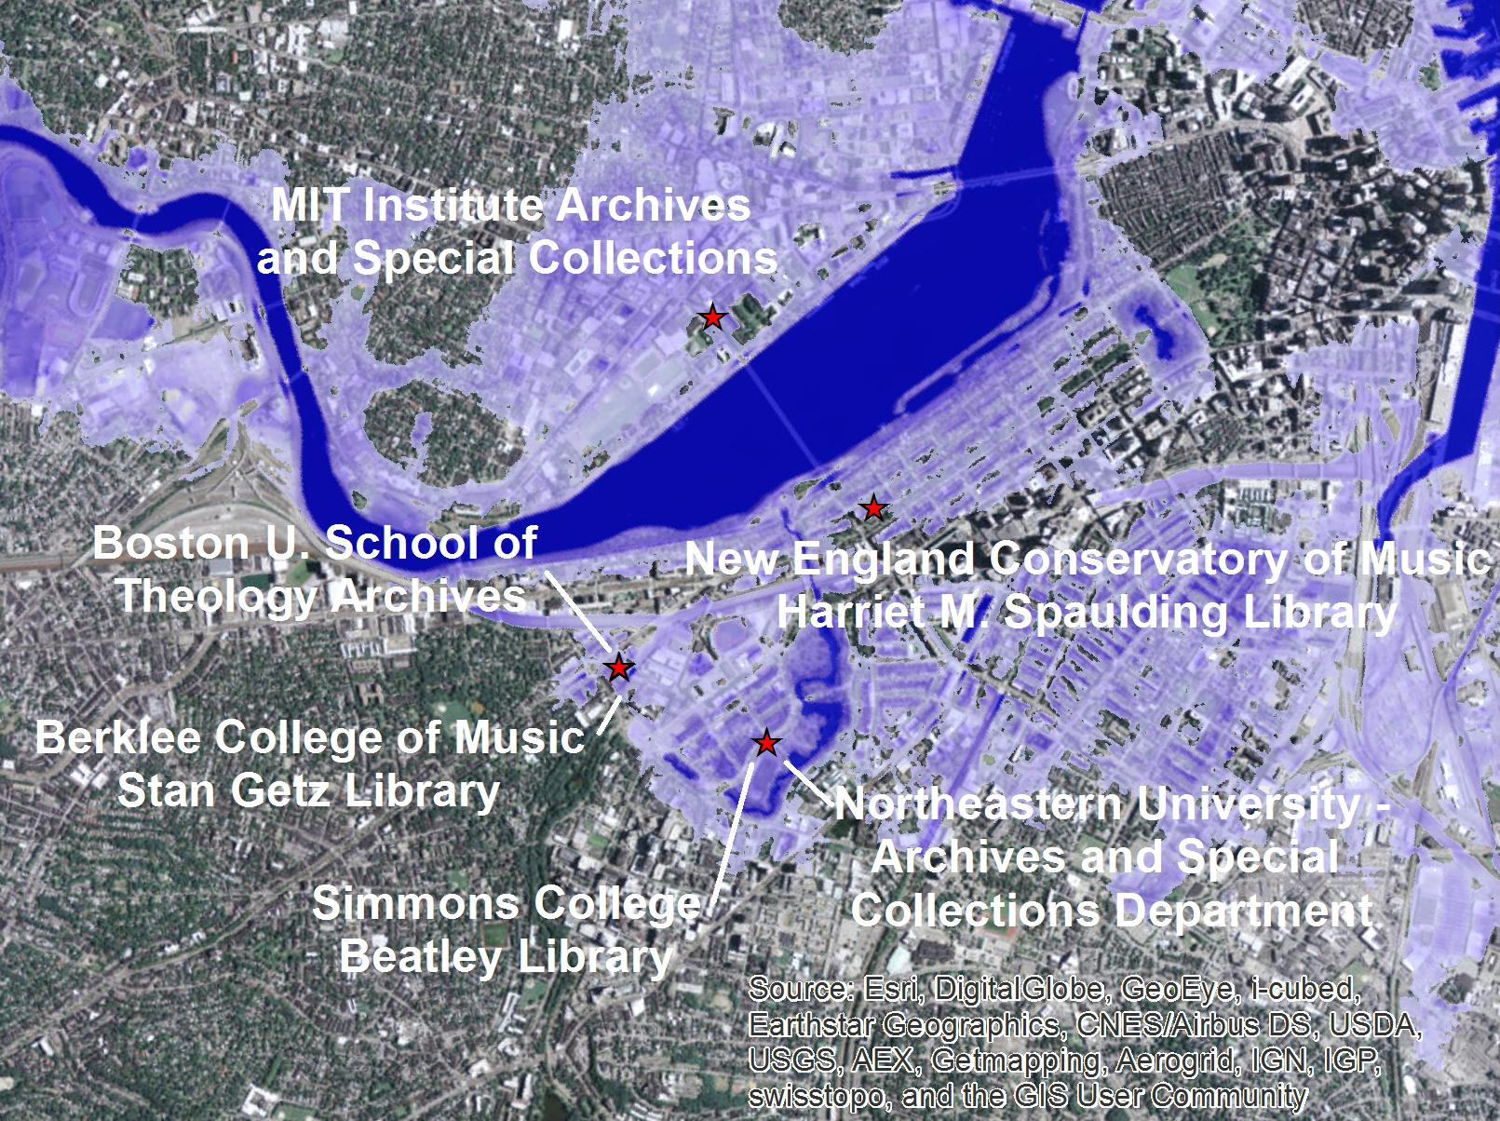
Sea Level Rise, 6 ft Scenario
22 institutions with inundation risk
10 institutions = high confidence
12 institutions = low confidence

Slide 10
What the world’s top climate scientists say...
The vertical bars:
Dark blue = RCP 2.6
Light blue = RCP 4.5
Orange = RCP 6.0
Red = RCP 8.5
The spread is 5-95% of likely confidence of SLR for 2100. The plus sign in the middle is the mean.
The x-axis lines:
Yellow = tidal gauges (since 1970)
Purple = satellite record (since 1993)
Projected range from RCP4.5 scenario for 2006-2100 = gray shade
Colored lines in shade = 3 climate models
2010
1 meter = 3.2 feet
1970-2100
0.6 meter = 1.9 feet
Sea-level rise scenarios from IPCC 5th assessment report, 2013 (Working Group 1, Figure 13.23). RCP = representative concentration pathways, aka anticipated scenarios of future emissions trajectories

Slide 11
Discussion
Quality of archival repository data
Not nearly comprehensive
Facility design
Getting to know climate data
Areas of risk for sea-level rise
Primary - Atlantic Coast
Secondary - Gulf Coast
Beyond sea-level rise
Storm surge - think of Hurricane Sandy, Katrina… and how would this get worse on top of increasing sea-level rise?

Slide 12
Further Research
Refinement of archival repository data
Refinement of initial SLR/inundation scenarios
Add storm surge data from National Hurricane Center
Add 500 year flood plain data from FEMA
Examine impacts of temperature and precipitation
Regionally-focused case studies
Non-U.S. repositories
Align with local/regional adaptation planning efforts

Slide 13
Thanks!
Look for us at:
PASIG, NYC, October 2016
AMIA, Pittsburgh, November 2016
Libraries and Archives in the Anthropocene Colloquium, May 2017 (fingers crossed)

