Slide 1

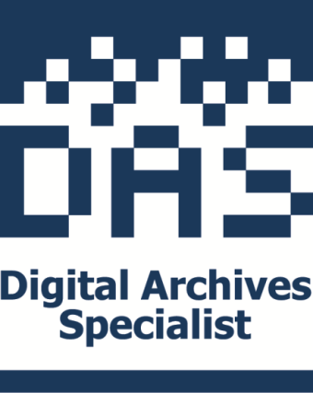
Digital Repositories
Presenter:
Lori Lindberg MLIS CA
©2016 Society of American Archivists

Slide 2
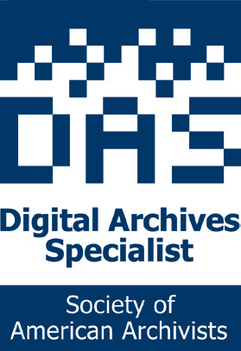
Digital Archives Specialist (DAS)
Curriculum and Certification Program offered by SAA:
  Foundational Courses—must pass 4
  Tactical and Strategic Courses—must pass 3
  Tools and Services Courses—must pass 1
  Transformational Courses—must pass 1
  Course examinations are administered online.
2
Notes:
*

Slide 3
Getting Started…
Introductions, Logistics, Goals
Notes:
*

Slide 4
DAS Core Competencies
This course contributes to the following DAS Core Competencies:
1. Explain the nature of digital records and their lifecycle.
2. Communicate and define terminology, requirements, roles, and responsibilities related to digital archives to a variety of stakeholders.
3. Formulate strategies and tactics for appraising, acquiring, describing, managing, organizing, preserving, and delivering digital archives.
4. Incorporate technologies throughout the archival lifecycle.
5. Strategically plan for the sustainability of digital archives.
6. Employ standards and best practices in the management of digital archives.
7. Design a defined set of services for designated community

Slide 5
Learning Outcomes
At the end of this course, you should be able to:
explain the basic decisions underlying the development of a digital repository program
differentiate between the components necessary to implement a viable digital repository service

Slide 6
Learning Outcomes
evaluate existing and proposed repository initiatives at your local institutions for identified elements of a successful deployment
reference existing digital repositories and the characteristics they illustrate
identify areas in which you might build your knowledge base and/or skill sets to meet the needs of a digital repository program

Slide 7
In Other Words:
We will review…
what YOUR digital repository service needs are
what choices YOU need to make
standards, best practices, models, and resources that can guide and support YOUR decision-making process

Slide 8
Today’s “Nots”
We will not…
focus on how to digitize
focus on how to create metadata
focus on specific hardware/software products; or make product recommendations
focus too heavily on any one component

Slide 9
Module 1:
Identifying Repository Needs, Motivations, and Key Decision Points
“…offers a convenient way to store, manage, reuse and curate a variety of digital materials…”
Maureen Pennock, DCC TechWatch - Eprints

Slide 10
Why Repositories? (2005)
“All institutions which maintain long-term collections of paper, recorded sound and recorded images have to make the shift to managing long-term electronic storage.”
PrestoSpace

Slide 11
Why Repositories? (2011)
“The future of scholarly communication is a Web in the Cloud”
Thorny Staples

Slide 12
SAA Code of Ethics
V. Authenticity and Integrity
Archivists strive to preserve and protect the authenticity of records in their holdings by documenting their creation and use in hard copy and electronic formats.
They have a fundamental obligation to preserve the intellectual and physical integrity of those records. Archivists may not alter, manipulate, or destroy data or records to conceal facts or distort evidence.

Slide 13
SAA Code of Ethics
VI. Access
Archivists strive to promote open and equitable access to their services and the records in their care without discrimination or preferential treatment, and in accordance with legal requirements, cultural sensitivities, and institutional policies.
Archivists recognize their responsibility to promote the use of records as a fundamental purpose of the keeping of archives…

Slide 14
SAA Code of Ethics
VIII. Security/Protection
Archivists protect all documentary materials for which they are responsible and guard them against defacement, physical damage, deterioration, and theft…

Slide 15
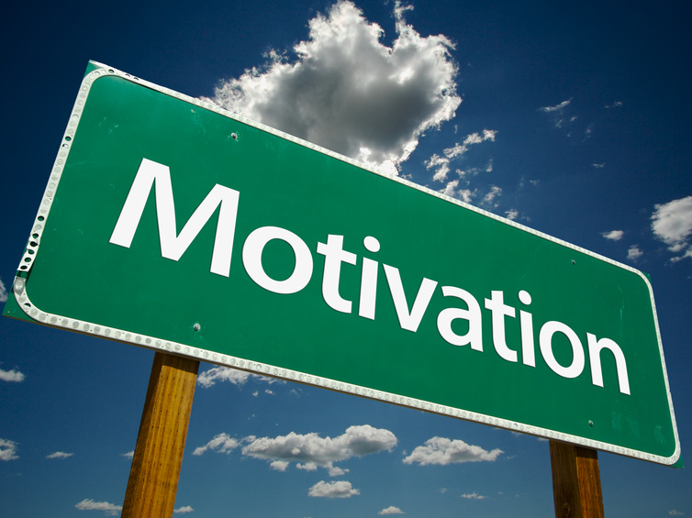
Worksheet 1:
What Motivates YOU?
When considering local digital repository service drivers and needs, what are your motivations?

Slide 16
Module 2:
The Repository Landscape; Standards and Best Practices; Content and Metadata Choices

Slide 17
Definitions
Digital Repositories

Slide 18
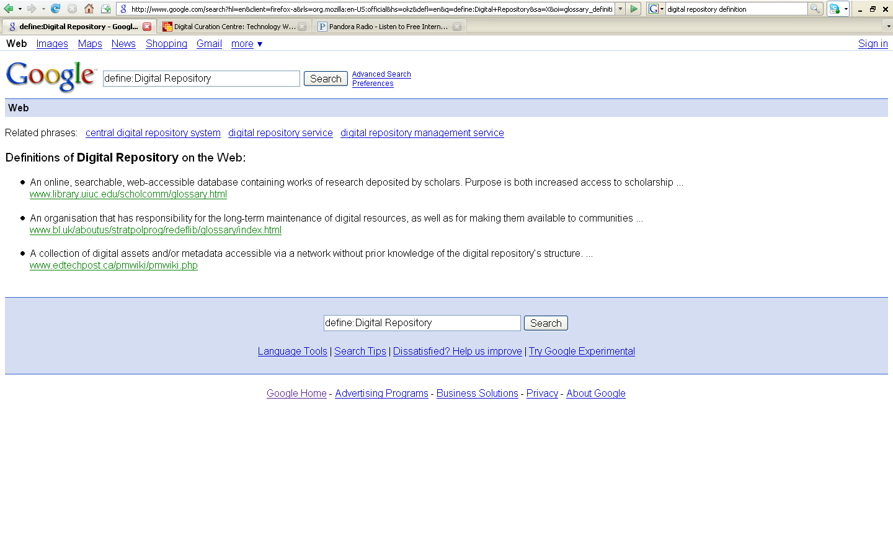

Slide 19
Digital Repository Defined
A. A place
B. An organization
C. A collection of assets
D. A server and network or other mechanism providing electronic storage
E. A service for its members
F. All of the above…

Slide 20
Digital Repository Defined
A. A place
B. An organization
C. A collection of assets
D. A server and network or other mechanism providing electronic storage
E. A service for its members
F. All of the above…

Slide 21
Digital Repository Defined
plays a vital role in the curation of digital materials
offers a convenient way to store, manage, reuse and curate a variety of digital materials
can take many forms and carry out many different functions, to service many different communities
can mean a number of different digital storage initiatives, which are often also referred to as
  institutional repositories
  digital archives
  digital libraries
Maureen Pennock, DCC TechWatch - Eprints

Slide 22
Let’s Consider…
“Preservation is the creation of digital products worth maintaining over time…”
Paul Conway, Rationale for Digitization and Preservation

Slide 23
“Preservation is the creation of digital products worth maintaining over time…”
IS.
  Preservation is a reality and not merely a metaphor for or symbol of access.
CREATION.
  The time to be concerned about the long-term persistence of digital products is when a system is designed and before digital conversion has begun.
PRODUCTS.
  A digital product has its own identity and exists within a market economy.
  It is not necessary to sell or license a digital product for the product to have an identity within a community of end-users.
Paul Conway, Rationale for Digitization and Preservation

Slide 24
“Preservation is the creation of digital products worth maintaining over timetime…”
WORTH.
  The work to design and create a digital product adds value to the information contained in the documents that serve as sources.
MAINTAINING.
  The persistence of digital products requires careful attention to the maintenance of content (the bits and bytes) functionality (how the bits work in a system).
OVER TIME.
  Preservation in the digital world is not absolute, but depends instead on the continuing transformative impact of the digital product on the information work of end-users.
Paul Conway, Rationale for Digitization and Preservation

Slide 25
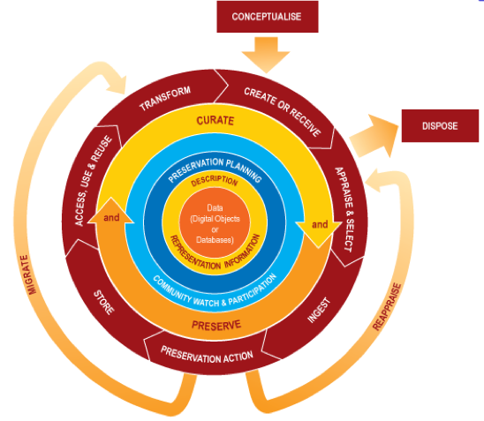
Data Curation Lifecycle
Digital Curation Centre

Slide 26
Digital Repositories
Types
“…An Open Source Dynamic Digital Repository…”
MacKenzie Smith et. Al., DSpace

Slide 27
Types of Digital Repositories
Digital Library
Digital Archive
Institutional Repository
Electronic Theses and Dissertation Repository
Learning Object Repository
Open Access Repository

Slide 28
Types of Digital Repositories
Digital Asset Management Repository
Preservation Repository
Dark Archive
Consortial Digital Repository
Subject- or Discipline-Oriented Repository
Metadata Repository
Other Types?

Slide 29
Up Close: Institutional Repository
A “digital collection capturing and preserving the intellectual output of a single or multi-university community”
A non-exclusive institution or community-wide service
Be actively taking submissions
Have some mechanism for creator to submit work
Departments, programs, units, formats, subjects may have IR-like, but scoped repositories
Case for IRs, SPARC; Cat McDowell, Evaluation IR Deployment

Slide 30
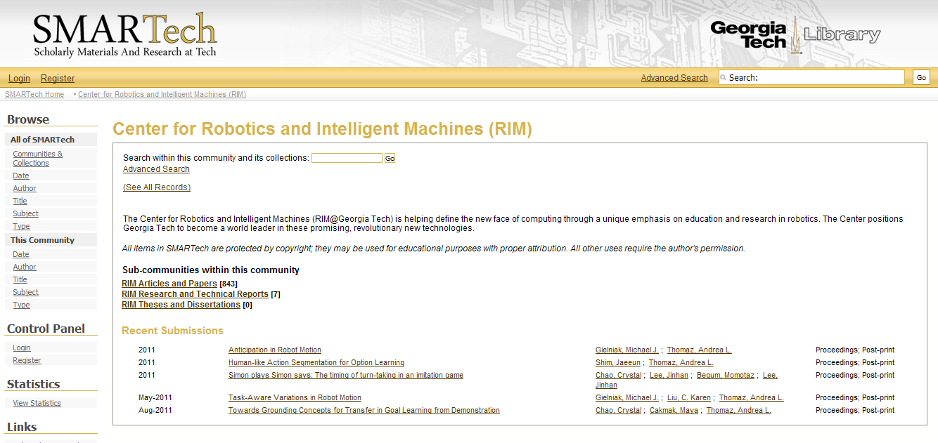
Up Close: SmarTech
Georgia Tech

Slide 31
Up Close: ETD Repository
A system for managing the life-cycle of electronic theses and dissertations (ETDs) from initial submission to final publication.
Texas Digital Library

Slide 32
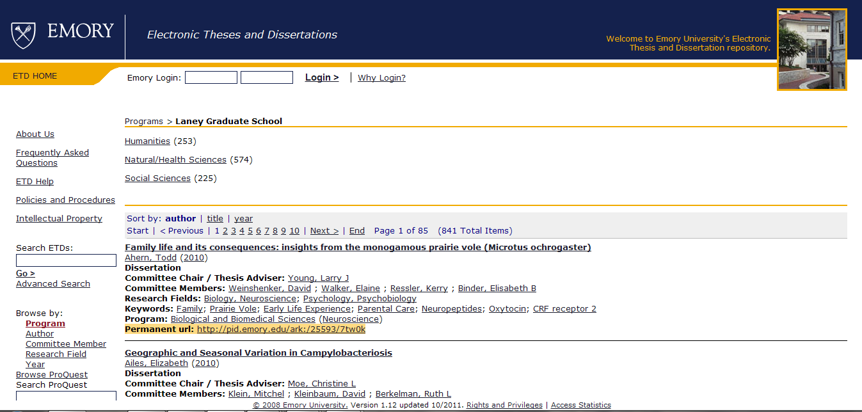
Up Close: EmoryETDs
Emory University

Slide 33
Up Close: Digital Archives
A digital collection for which an institution has agreed to accept long-term responsibility for preserving the resources on the collection and for providing continual access to those resources in keeping with an archive’s user access policies.
Archive-It

Slide 34
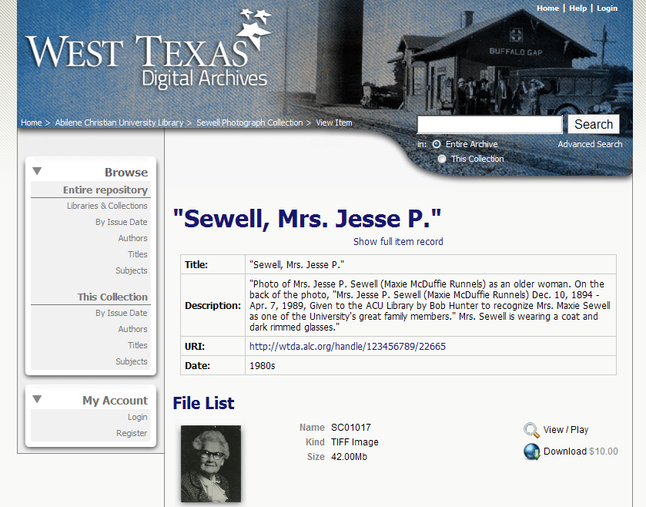
Up Close:
West Texas Digital Archives
West Texas Digital Archives

Slide 35
Up Close:
Learning Object Repository
Has a well-researched user interface and architecture that facilitates use by educators and learners
Permits various levels of inter-activity:
  Search
  Submissions
  Comments/reviews
  Creating personal collections
May contain LOs, or connect users to LOs stored elsewhere
GMU – Teaching with Technology Guides – Learning Resources

Slide 36
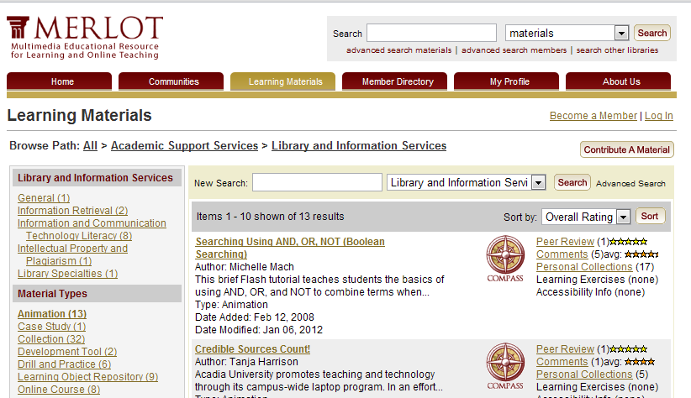
Up Close: MERLOT
Multimedia Educational Resource for Online Learning and Teaching

Slide 37
DR Functionality: A “Short” List
Authentication/Authorization
Content Deposit
Metadata Capture
File Management
Usage Controls
Security
Discovery and Access Tools
Disaster Recovery
Migration and Preservation Planning

Slide 38
Digital Repositories
Standards and Best Practices
“At the very basic level, the definition of a trusted digital repository must start with “a mission to provide reliable, long-term access to managed digital resources to its designated community, now and into the future”
TDR, 2002

Slide 39
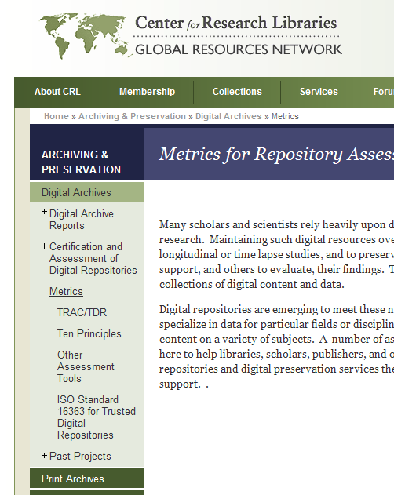
Identifying Components: Places to Start
OAIS
TRAC -> ISO/DIS 16363
NISO’s “Framework”
CRL’s “Ten Principles”
All often used as foundations, guides, and measures for digital repository initiatives

Slide 40
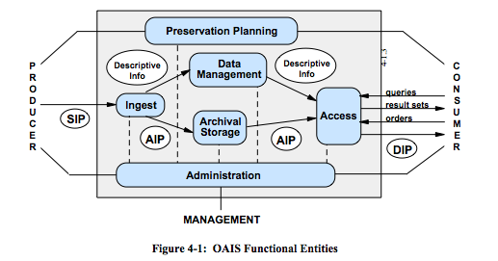

Slide 41
Open Archival Information System (OAIS)
Conceptualizes Information Packages
  Submission (SIP)
  Archival (AIP)
  Dissemination (DIP)
Includes functions
  Ingest
  Archival Storage
  Data Management
  Administration
  Preservation Planning
  Access

Slide 42
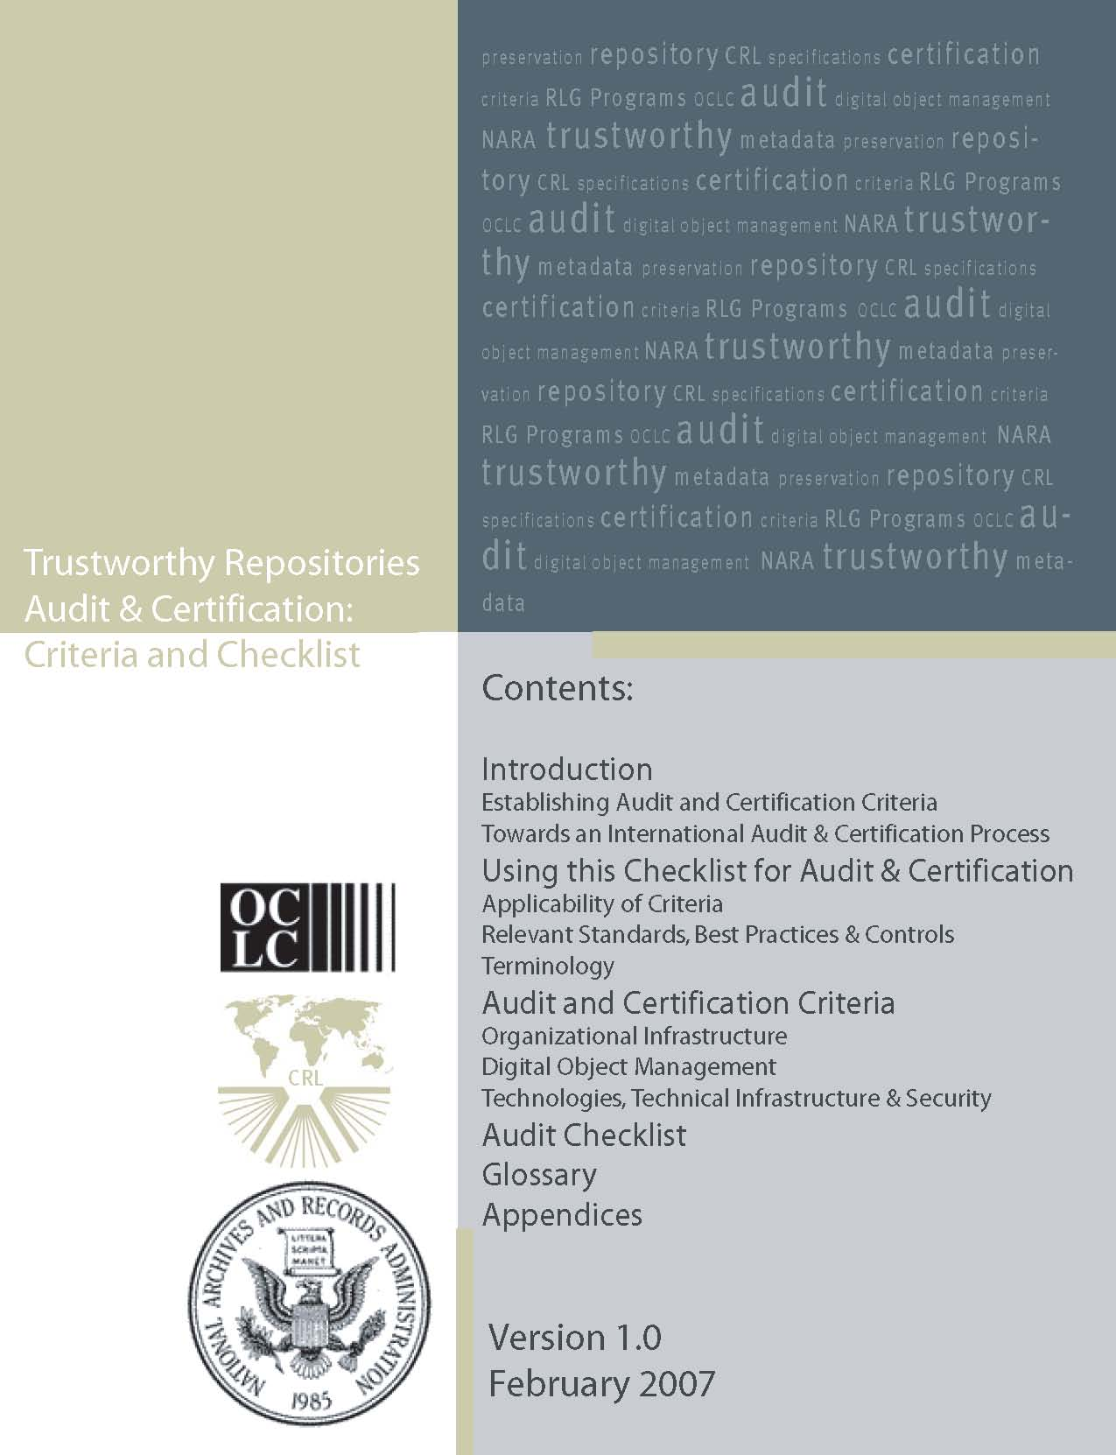
Evaluating Trustworthiness
Trustworthy Repositories Audit & Certification: Criteria and Checklist
  Builds on Open Archival Information System (OAIS) reference model
Trustworthy Digital Repositories Audit & Certification (TRAC), CRL.
Notes:
Basis for comparing local capabilities against a set of core criteria
Can be used as an objective measure or a planning document – or both!
Reliable, long-term access now and in the future
Responsibility for long-term
maintenance of digital resources
Commonly accepted conventions
and standards
Policies, practices, and performance
that can be audited and measured (TRAC)

Slide 43
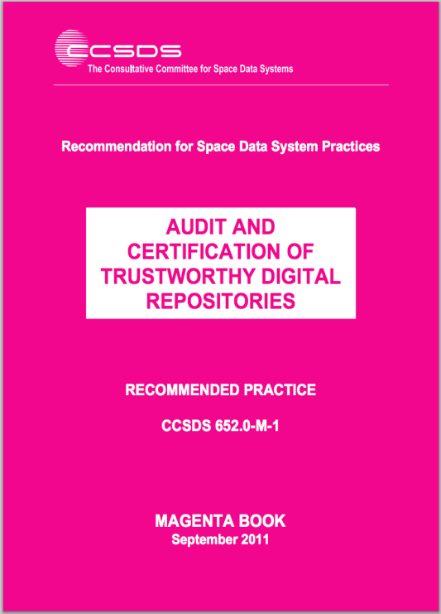
Evaluating Trustworthiness
Covers three broad aspects:
A/3. Organizational infrastructure
B/4. Digital object management
C/5. Infrastructure and Security Risk Management
Audit and Certification of Trustworthy Digital Repositories, CCSDS.
Notes:
Basis for comparing local capabilities against a set of core criteria
Can be used as an objective measure or a planning document – or both!

Slide 44

Evaluating Trustworthiness
ISO/DIS 16363
  Formalizes TRAC into a Standard
Audit and Certification of Trustworthy Digital Repositories, CCSDS.
Notes:
Basis for comparing local capabilities against a set of core criteria
Can be used as an objective measure or a planning document – or both!
Reliable, long-term access now and in the future
Responsibility for long-term
maintenance of digital resources
Commonly accepted conventions
and standards
Policies, practices, and performance
that can be audited and measured (TRAC)

Slide 45
What the Framework Offers…
NISO Best Practice intended for two audiences:
  Organizations planning and implementing digital collections initiatives
  Funding organizations that want to encourage the development of good digital collections
A Framework of Guidance for Building Good Digital Collections, NISO.

Slide 46
What the Framework Offers…
Includes sets of Principles as guidance
  Collections
  Objects
  Metadata
  Initiatives
Identifies existing resources that support the development of sound local practices
Encourages community participation
A Framework of Guidance for Building Good Digital Collections, NISO.

Slide 47
CRL’s Ten Principles
The Repository…
  Commits to continuing maintenance of digital objects for identified community/communities
  Demonstrates organizational fitness (including financial, staffing, and processes) to fulfill its commitment
  Acquires and maintains requisite contractual and legal rights and fulfills responsibilities
Ten Principles, CRL.
Notes:
Ten basic characteristics of digital preservation repositorie
The key premise underlying the core requirements is that for repositories of all types and sizes preservation activities must be scaled to the needs and means of the defined community or set of communities.
s:

Slide 48
CRL’s Ten Principles
The Repository…
  Has an effective and efficient policy framework
  Acquires and ingests digital objects based upon stated criteria that correspond to its commitments and capabilities.
  Maintains/ensures the integrity, authenticity and usability of digital objects it holds over time.
Ten Principles, CRL.
Notes:
Ten basic characteristics of digital preservation repositorie
The key premise underlying the core requirements is that for repositories of all types and sizes preservation activities must be scaled to the needs and means of the defined community or set of communities.
s:

Slide 49
CRL’s Ten Principles
The Repository…
  Creates and maintains requisite metadata about actions taken on digital objects during preservation; … about the relevant production, access support, and usage process contexts before preservation
  Fulfills requisite dissemination requirements
  Has a strategic program for preservation planning and action
  Has technical infrastructure adequate to continuing maintenance and security of its digital objects.
Ten Principles, CRL.
Notes:
Ten basic characteristics of digital preservation repositorie
The key premise underlying the core requirements is that for repositories of all types and sizes preservation activities must be scaled to the needs and means of the defined community or set of communities.
s:

Slide 50
Module 3:
Building a Repository Service: Components

Slide 51
Key Components
Hardware
Software
Content
Controls
Trust
Community

Slide 52
The Parts Nobody* Sees
Basic Hardware
Servers
Storage
Back-up Systems
Basic Infrastructure
Networking / Connectivity
Power
HVAC
Security
*ALMOST Nobody…

Slide 53
Software:
The Parts People See
May be used to support back-end, front-end, and “middleware” applications
Commercial
Open Source
Hybrid
Home-grown

Slide 54
Content:
The Things People Want
Active Scholarship
Records of Enduring Value
Unique Resources
  Digital Assets, Digital Objects, Items, Resources, Files, “Stuff”
Notes:
Now let’s look at the third circle there – CONTENT. A bit to go over here.

Slide 55
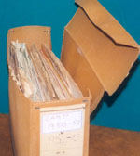

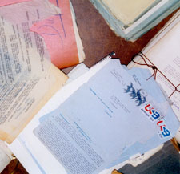
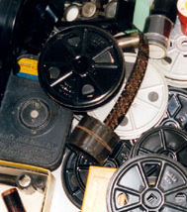
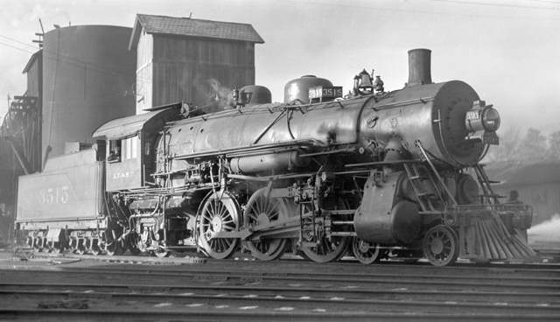
“Born Analog” Content…
Records, ledgers, transcripts, photographs, film, diaries, maps, correspondence, paintings, artifacts, artwork, texts, audio, video, datasets, learning objects, institutional records, official documents, bulletins, directories and publications…

Slide 56






…Becomes Physical Items in Collections…

Slide 57
…And can be Transformed into Quality Digital Objects
Images
  Format, bit depth and resolution
Audio
  Format, sample rate and quantization (compression)
Text
  Format, levels of accuracy, levels of encoding,
3-D objects
  Levels of detail, capture to support static vs. dynamic representation

Slide 58
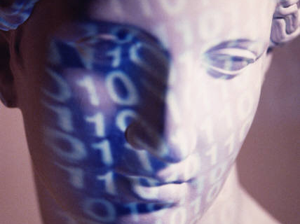
Handout 1:
Digital Capture Quality Basics
A brief review of quality choices for common digital file formats and types

Slide 59
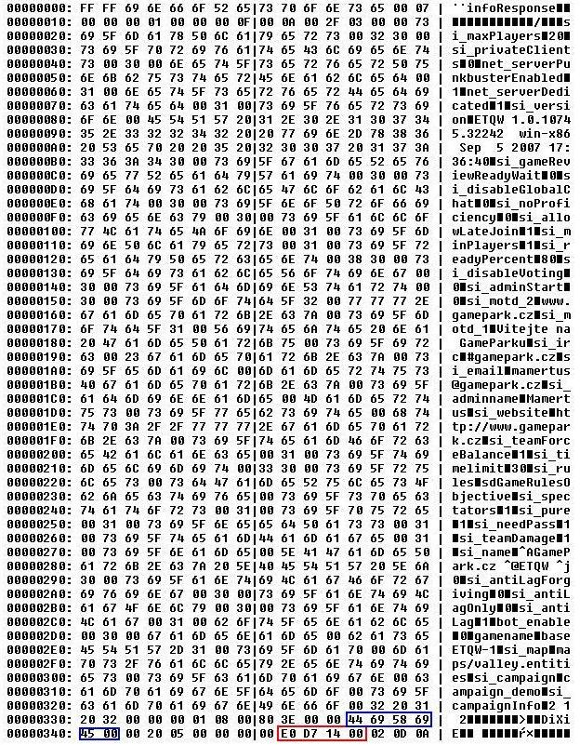

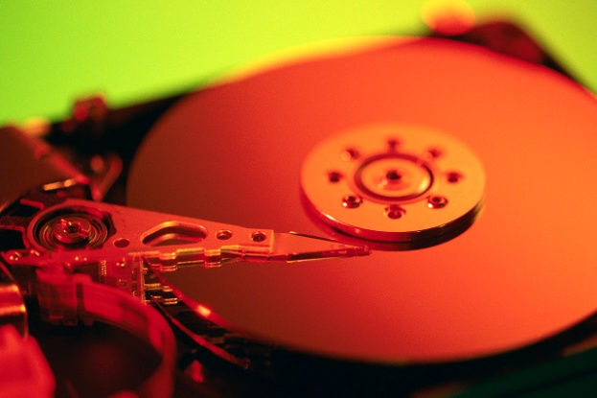
“Born Digital” Content…
Electronic records and documents, digital audio, digital video, digital still imagery, datasets, multi-media works, online publications, web sites, interactives, blogs, wikis…

Slide 60
…Unlike Physical Collections…
© VICTORIA VESNA,, 2004.

Slide 61
…Follows a Different Path
“at much greater risk of either being lost and no longer available as historical resources, or of being altered, preventing future researchers from studying them in their original form…”
“Millions of digital materials, such as Web sites mounted in the early days of the Internet, are already lost—either completely or in their original versions.”

Slide 62
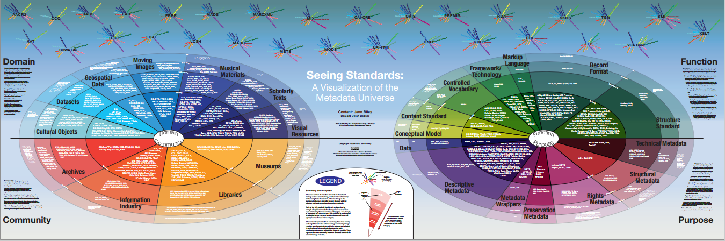
Content Brings Its Own Metadata Needs
Metadata is often specific to a community, a content type, a format, or an audience.
Seeing Standards: A Visualization of the Metadata Universe, Jenn Riley.

Slide 63
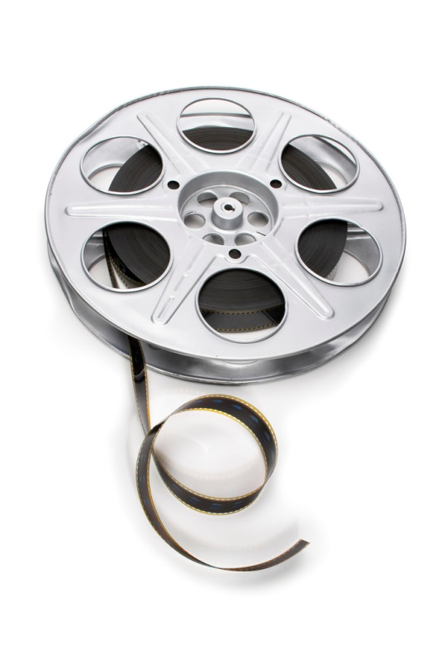
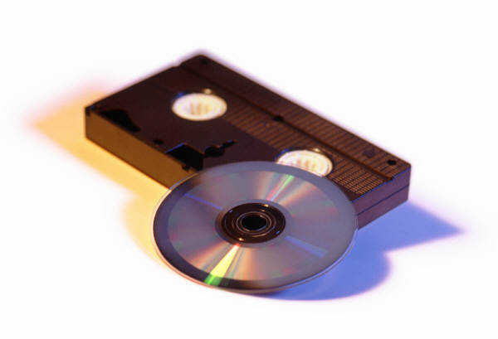
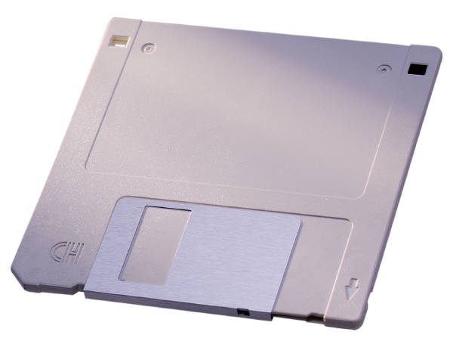

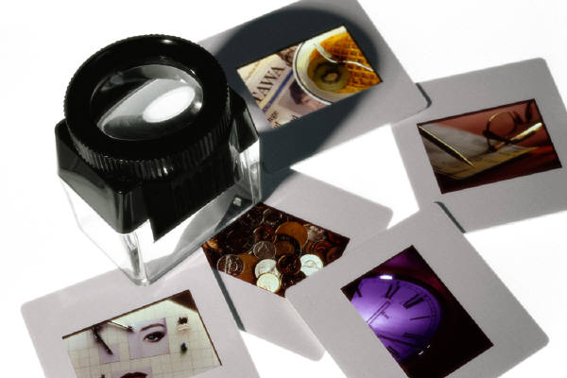
…Or No Metadata at All!

Slide 64
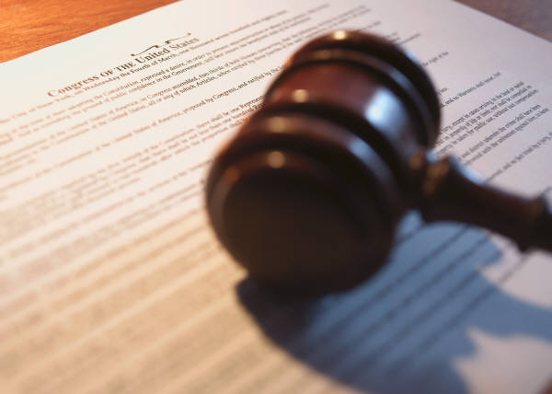
Handout 2:
ARL Code of Best Practices and Fair Use for Academic and Research Libraries
Understanding Rights and Responsibilities

Slide 65
Key Components
Hardware
Software
Content
Controls
Trust
Community
Notes:
Okay, let’s review our slide with our components of a digital repository again – We’ve just gone over the first three: Hardware, software and content. Now let’s go over the last three: controls, trust and community.

Slide 66
Controls: Keep Things in Order
Deposit
Review
Access
Reproduction
Security
Risk and Disaster Mitigation

Slide 67
Trust: What Keeps the DR Going
Reliable, long-term access now and in the future
Responsibility for long-term
maintenance of digital resources
Commonly accepted conventions
and standards
Policies, practices, and performance
that can be audited and measured (e.g.TRAC)

Slide 68
Community: What Makes it Happen
An ever-changing web of personal, organizational, cooperative, conceptual, and contractual understandings, agreements, and consensuses

Slide 69
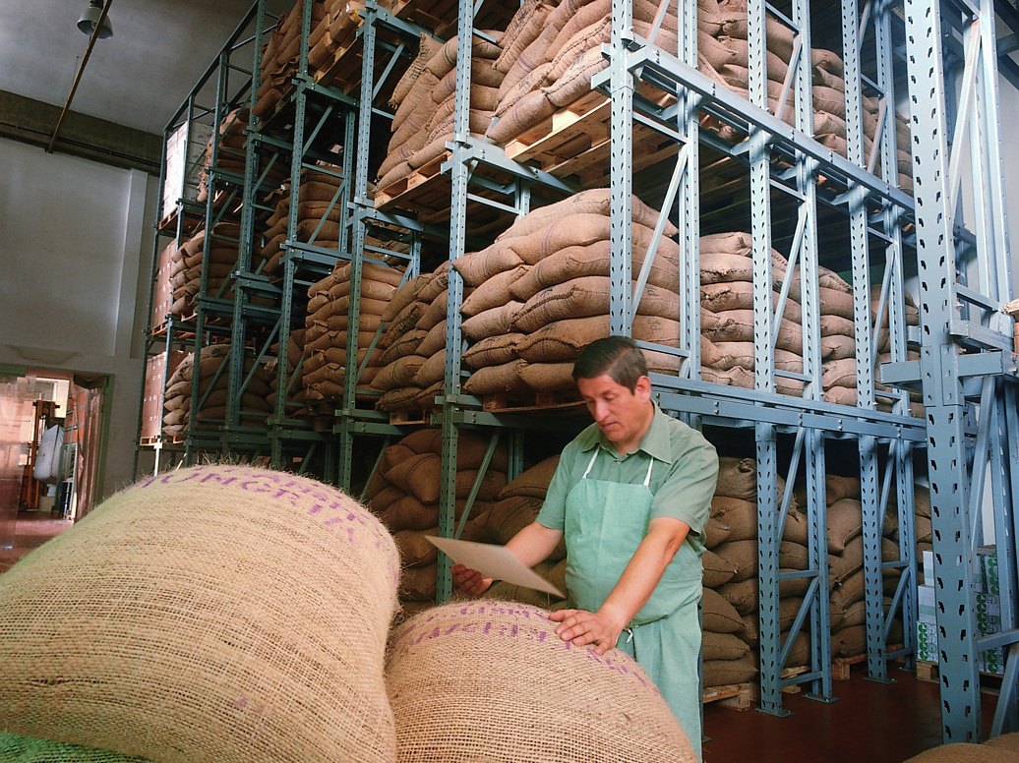
Worksheet 2: Components
When inventorying your existing environment, what do you have, what will you need, and do you have a sense now of where and how you'd like to get it?

Slide 70
Module 4:
Building a Repository Service: Roles and Views

Slide 71
Key Components
Hardware
Software
Content
Controls
Trust
Community

Slide 72
Key Components, Many Views
Hardware
Software
Content
Controls
Trust
Community
Manager
Systems Admin
Creator
End User
Stake-holder

Slide 73
Stakeholders
Hardware
Software
Content
Controls
Trust
Relationships
Stake-holder
Notes:
We are going to start on the right and work our way left.

Slide 74
Getting to Know Stakeholders
The mission-vision-money folks, focused on…
  Benefits of digital stewardship
  Resources commitment
  Opportunity costs
  Risk mitigation
  Partnerships and collaborations
  Quality of service

Slide 75
End User
Hardware
Software
Content
Controls
Trust
Relationships
End User

Slide 76

End Users
Want information quickly, with a minimum of fuss
Willing to use free information and trust it just as much as for-fee information
Are unlikely to know of digital repository initiatives, especially beyond their “communities”
YOU are an End User
Potentially, everyone you know is an End User

Slide 77
What People Want…
They want to…
Work with co-authors
Keep track of different versions of the same document
Work from different computers and locations: Mac and PC
Make their own work available to others
Have easy access to other people's work
Keep up in their fields
Organize their materials according to their own scheme
Control ownership, security, and access
Ensure that documents are persistently viewable or usable
Have someone else take responsibility for digital tools
Be sure not to violate copyright issues
Keep everything related to computers easy and flawless
Not be any busier
Foster and Gibbons, Understanding Faculty
Notes:
Through analysis of the interviews, we developed a list of individual needs centered mainly on authoring and co-authoring, archiving and disseminating their own work, and finding and reading relevant work by other authors. The people we interviewed want most to be able to...
[slide contents]
It is essential that anything in an IR be absolutely safe and secure. Beyond that, the single most important criterion of an IR's value to our faculty members is that other people find, use, and cite the work that they put into it. Even the most enthusiastic supporters of IRs will soon lose interest if this criterion is not met.

Slide 78
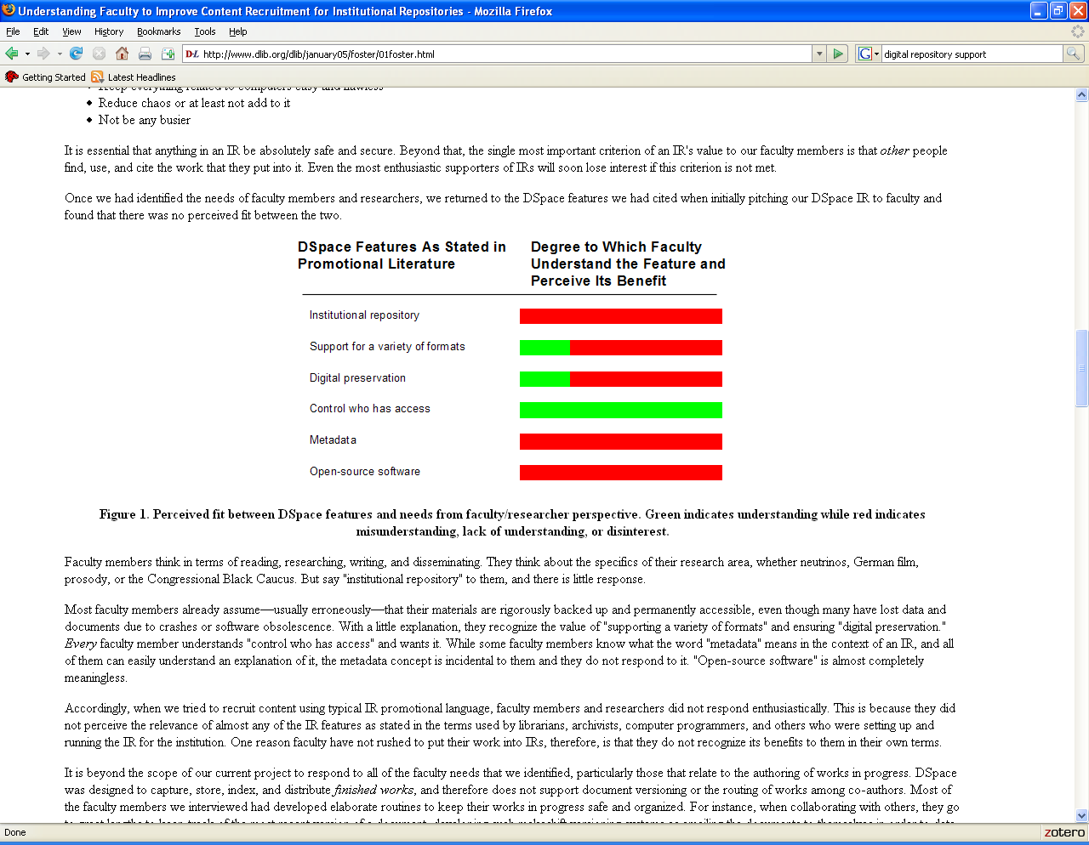
What People “Get”
Foster and Gibbons, Understanding Faculty

Slide 79
Software
How awareness of software functionality manifests in the End User:
Can I find what I need?
Can I use what I find?
Can I keep a copy of what I find?
Do I have to pay?
Will it be there tomorrow?

Slide 80
Content
Simply, they want a select, yet comprehensive body of content, well described, and available
  Preferably for free?
  Preferably right now?
  Preferably at the same place forever?

Slide 81
Creators
Software
Content
Controls
Trust
Relationships
Hardware
Creator

Slide 82

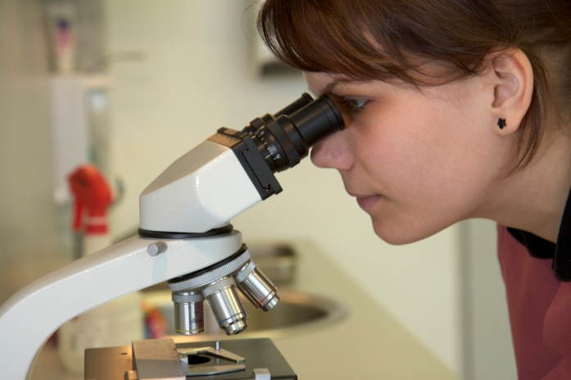

Repository Content Creators / Depositors
Equivalent of “Donors”; may include Archivists
Deposit content, or references to content
Make decisions about use, rights, ownership
Make decisions about “submission” or “native” formats

Slide 83
Content
Content Creators are “Content Big”
They create/contribute to the repository:
  Representations of analog materials
  Born digital content
  Initial descriptive metadata
They may contribute:
  Initial rights and use metadata
  Initial access controls

Slide 84
Trust
Content Creators are “Trust Big”
  Why?
  “Preservation is the creation of digital products worth maintaining over time…”
Conway

Slide 85
Controls
“Gray areas” of Content Deposit
Ownership and right to publish and/or distribute can be confusing to Content Creators
Resources like SHERPA can help

Slide 86
Systems Administrator
Hardware
Software
Content
Controls
Trust
Community
Systems
Admin

Slide 87
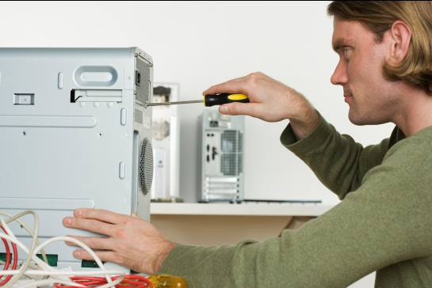
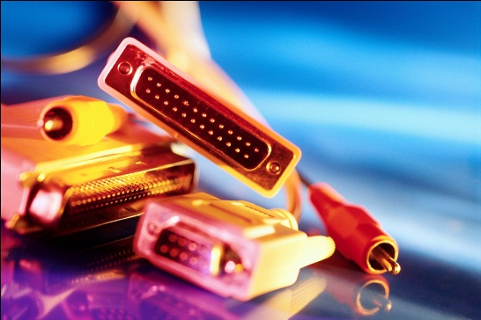

Repository Systems Administrators
Manages hardware and infrastructure
Responsible for security
Coordinates software development and preservation activities at the system level
Resource allocation – equipment, staffing, licensing, etc.

Slide 88
Hardware
Systems Administrators are “Hardware Big”
  Focus on
    Capacity
    Scalability
    Redundancy
    Stability
    Disaster recovery
    Security
    Connectivity
Cost is never out of mind

Slide 89
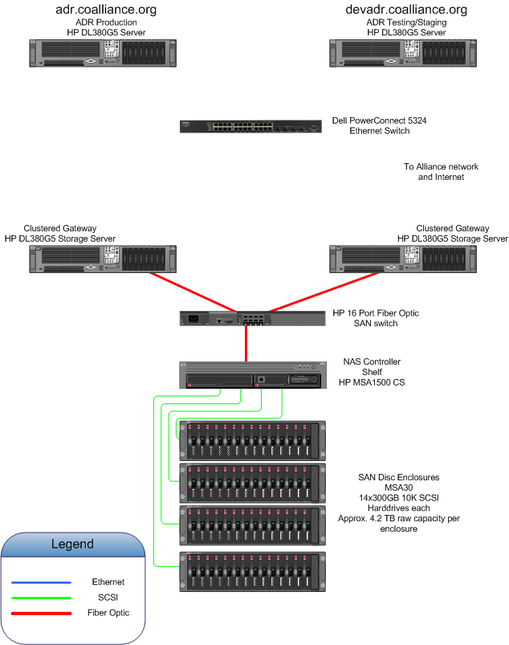
Hardware and Infrastructure
Servers
Disk Array
Connectivity
Back-Up Appliances
Power
Cooling (not much heating)
Notes:
Hardware-wise, we maintain dedicated production and development servers, disk storage, disk- and tape-based back-up systems in a climate controlled facility,

Slide 90
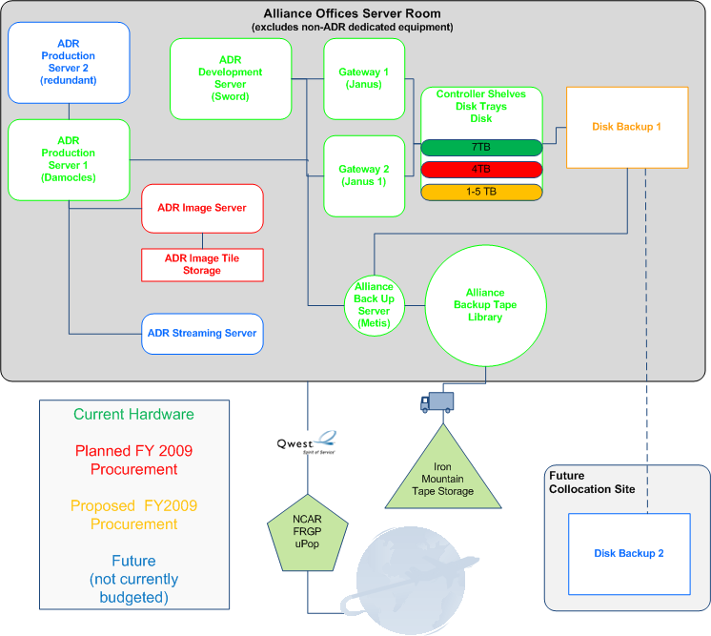
Hardware and Infrastructure Overview
Notes:
with connectivity via Qwest and the Front Range Giga Pop’s uPop service. Before the end of the calendar year, we will relocate or primary hardware to one of our member institution’s to take advantage of redundant power (generators) and cooling, as well as increased building security.

Slide 91
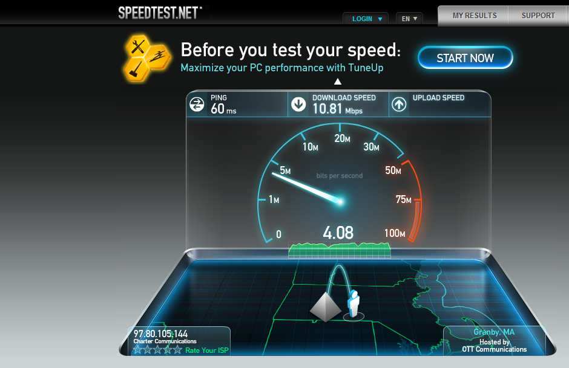
Infrastructure

Slide 92
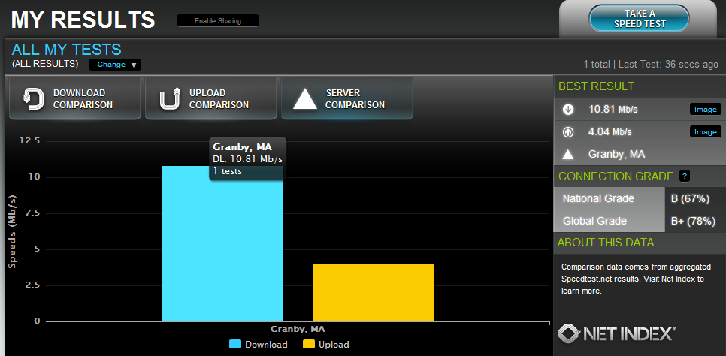
Infrastructure
Infrastructure
Speedtest.net

Slide 93
Hardware and Infrastructure Strategies
Redundancy within systems
Mirrored sites
Disaster recovery planning
  Back-up systems
    Tape
    Disk
Diversify funding sources
Document activities
Disseminate to community and review “peer paths”
Maintain and grow skill sets and knowledge bases

Slide 94

And then there is this to consider…

Slide 95
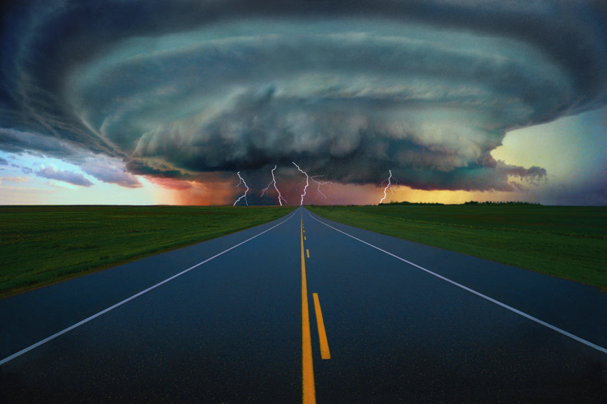
And then there is this to consider…

Slide 96
Software
Systems Admins. are “Software Big”
Translate functionality requests into repository services, by evaluating and using
  Vendor-supplied repository software
    Digital Commons, Digital Archive, Documentum, Cumulus, Artesia, DigiTool…
  Open-source repository software
    DSpace, Fedora, EPrints…

Slide 97
Software
With a variety of middleware and front-end tools to enhance functionality:
XTF, Origami, IPaper, Omeka, Hydra, Islandora, Manakin, Blacklight, …

Slide 98
Software Myth
“If only we had (fill in the blank)* everything would be fine”
* Fedora, DSpace, CONTENTdm, Insight, Greenstone, Keystone, DLXS, Documentum, Cumulus, Islandora, etc…

Slide 99

Software Reality
No one software will
Manage digital objects and metadata
Provide public access
Permit easy re-purposing
Preserve digital assets
Apply and Manage policies
Make Quality choices
Determine Access controls
NO SYSTEM WILL MANAGE ITSELF!
Software should be seen as a tool, not a “solution”
Notes:
Myth and reality
1 or 3

Slide 100
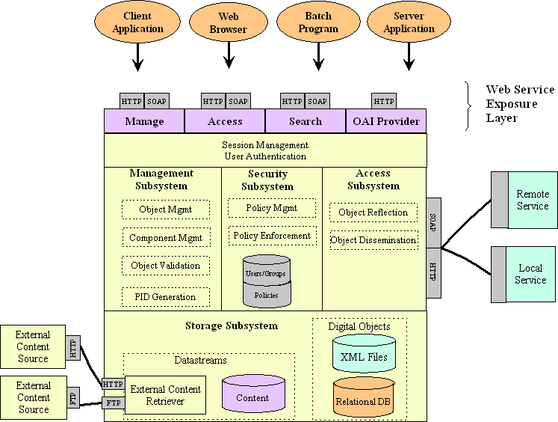
The “Systems View” of a Repository Service
Presentation
Access
Management
Storage
Staples, Thornton, Ross Wayland and Sandra Payette, "The Fedora Project: An Open- source Digital Object Repository System, “D-LIb Magazine”, April 2003. http://www.dlib.org/dlib/april03/staples/04staples.html

Slide 101
Controls
Systems Administrators are “Controls Big”
Enforce policies through use of technology and software
Work with Managers to establish a service level agreement (SLA) which can determine scope of
  Access controls
  Versioning
  Digital object identifiers
  Fixity checks
  Back-ups

Slide 102
Metadata Controls
Systems Administrators use creator, manager, and software generated metadata to programmatically apply and enforce controls

Slide 103
Server Controls
Blocking (and unblocking) search engine crawlers
Limiting access at the “port” or “domain”
Limiting access through firewalls
Maintaining security certificates
Supporting authentication and verification processes

Slide 104
Trust
NISO Framework Principles
Collections
Objects
Metadata
Initiatives
TRAC- ISO 16363
C. Technologies, technical infrastructure, and security.
Some of A. Organizational infrastructure
An awareness of B. Digital object management
ISO 16919 -
Systems Administrators are “Trust Big”
Their near-central role also requires a strong understanding or awareness of everything!

Slide 105
Repository Manager
Hardware
Software
Content
Controls
Trust
Community
Manager

Slide 106
Repository Managers
Stewards entrusted with content, collections and resource management
Frequently (digital) archivists, (digital) librarians, (electronic) records managers, and information managers
Maintain content and metadata in forms that are archival, reusable, and interoperable
Enforce conditions of use, rights, ownership
Guide all other repository community roles in some form or fashion
Guide outreach, marketing collection development activities
Zuccala and Opennheim, Managing and Evaluating DRs

Slide 107
Repository Managers
The main role of the Manager…
“should be to recognise and define the raison-d'être of the repository so that depositors, users and members of the public will be familiar with its existence and purpose…”
Zuccala and Opennheim

Slide 108

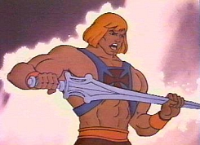
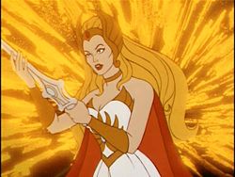
Repository Managers
Not to be too obnoxious,
but these folks could be considered the
“Masters of the
[Repository] Universe!”

Slide 109
Hardware
Managers should know enough about hardware to:
  Make the case for hardware to stakeholders and funders
  Negotiate agreements and contracts with vendors and service providers if necessary.

Slide 110
Software
Managers are “Software Big”
Functionality
  Indexing
  Discovery
  Delivery
  Management

Slide 111
Software
Answering questions like “How do I deposit my stuff?” leads to intersections with software architecture that accommodates Submission Information Packages (SIPs):
  Workflows
  Standards
  Best practices
  Scalability
  System-driven format transformations

Slide 112
Content
  Managers are “Content Big”
  or, more accurately “Actual Content May Vary…”
  You must be familiar with Standards and Best Practices
  Metadata
  Formats
  Quality

Slide 113
Content Standards
  Follows NISO Framework’s Collections and Objects Principles
  May create and structure objects and metadata according to accepted standards and best practices (i.e. METS, Digital Capture Recommendations from the Library of Congress)
  May identify file type candidates for migration to new formats at point of deposit (i.e. MS Word to PDF)

Slide 114
Metadata Standards
  Follows NISO Framework’s Metadata and Objects Principles
  May opt to identify, require and support a normalizing schema (i.e. MODS, Dublin Core)
  Likely to maintain an OAI-Dublin Core compliant metadata record somewhere for each object
  To support harvesting and aggregation of records in OTHER repositories

Slide 115
Digital Object Standards
  Be able to work with creators on SIP object profiles and standards
  Be able to work with Systems Administrators on Archival and Dissemination Information Packages object profiles (AIPs, DIPs)

Slide 116
What ARE you talking about?
  Managers straddle the content creation and the content management and preservation worlds
  They need to be as concerned with capture best practices as they are with digital repository and object design – as both ultimately ensure the long-term preservation and access of digital resources

Slide 117
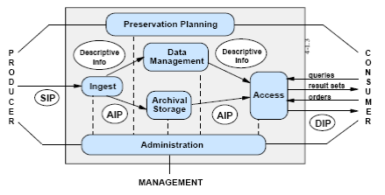
OAIS Conceptual Model

Slide 118
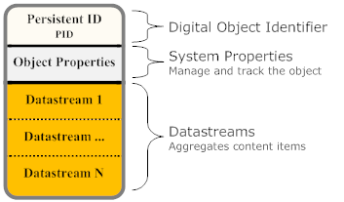
A Digital Object Model
73

Slide 119
Controls
General policies and responsibilities governed by a Policy Document
Specific responsibilities defined in a service agreement or deed of gift
Manage access, rights and usage through embedded information in files, metadata, and software, as instructed by policies and content creators

Slide 120
Community
Managers have relationships with a diverse community:
  Content Creators/ Depositors
  Stakeholders
  Systems Administrators
  End Users
  and, of course, they may BE End Users!

Slide 121
Trust
NISO Framework Principles
ISO 14721 - OAIS
Collections
Objects
Metadata
Initiatives
ISO 16363 - Audit/Cert. TDR
B. Digital object management
Some of A. Organizational infrastructure
An awareness of C. Technologies, technical infrastructure, and security
ISO 16919 – Auditor Reqs.
Their central role requires a strong understanding or awareness of everything!

Slide 122
Trust within the Community
Managers trust…
  Content Creators/ Depositors
  Stakeholders
  Systems Administrators
  End Users
Notes:
Managers trust
Content Creators/ Depositors
To adopt best practices in content creation and description, and ensure they do have the right to deposit
Stakeholders
To continue to support current and future repository services
Systems Administrators
To build and maintain viable systems and infrastructures
End Users
To respect conditions of use, copyright
To provide feedback

Slide 123
Building Trust Outside the Community
Managers often coordinate repository marketing and evaluation activities
Both marketing and evaluation activities can be used to
  Inform users and potential users of range of services and benefits
  Demonstrate to stakeholders scope and application of services
Press kits and embedded tools to support marketing and evaluation, and are meant to be locally adapted
Notes:
Fedora, DSpace, etc. Videos

Slide 124

Worksheet 3: Roles
Many repository services are run by just a handful of people focused on meeting the needs of the masses. At this point, what role or roles do you see yourself having in your local repository service?

Slide 125
Module 5:
Building a Repository Service: Sustainability

Slide 126
Sustainability
“Ensuring that valuable digital assets will be available for future use is not simply a matter of finding sufficient funds.
It is about mobilizing resources—human, technical, and financial—across a spectrum of stakeholders diffuse over both space and time…”
Sustainable Economics for a Digital Planet. URL: http://brtf.sdsc.edu/biblio/BRTF_Final_Report.pdf
Notes:
Sustainability
Sustaining efforts at every level
Laws of conservation
Review of the NISO framework
Initiatives , Collections, and Objects
Five Stages (Anne Kenny)

Slide 127
Principles of GOOD Digital Initiatives
A good digital initiative (a.k.a. project, program)…
  has a substantial design and planning component.
  has an appropriate level of staffing with necessary expertise to achieve its objectives.
  follows best practices for project management.
  has an evaluation component.
  markets itself and broadly disseminates information about the initiative's process and outcomes.
  considers the entire lifecycle of the digital collection and associated services.
A Framework of Guidance for Building Good Digital Collections, NISO.

Slide 128
Taking on a “Digital Mortgage?”
  “Each organization must budget to transfer old files to new formats as software and hardware change and electronic media reach the end of their relatively short life expectancies…also a digital infrastructure including staff, contracts, equipment, and software”
Puglia, Lowry & Troll; Marcum in Vogt. Handbook for Digital Projects:
A Management Tool for Preservation and Access. URL: http://www.nedcc.org/resources/digitalhandbook/dman.pdf
Notes:
Property is property, no matter what it is and where it is stored.
Determining replacement value of born analog AND born digital files
Obtaining coverage
Puglia, Lowry & Troll; Marcum in Vogt. Handbook for Digital Projects:
A Management Tool for Preservation and Access. URL: http://www.nedcc.org/resources/digitalhandbook/dman.pdf
Self-insurance
Property is property
Durable Data, Sustainable Preservation Practices

Slide 129
Insuring Digital Collections
  Three possible strategies
  Actual value
  Replacement value
  Self-Insure
  Start by identifying risks
  Organizational Risks
  Content Risks
  Infrastructure Risks

Slide 130
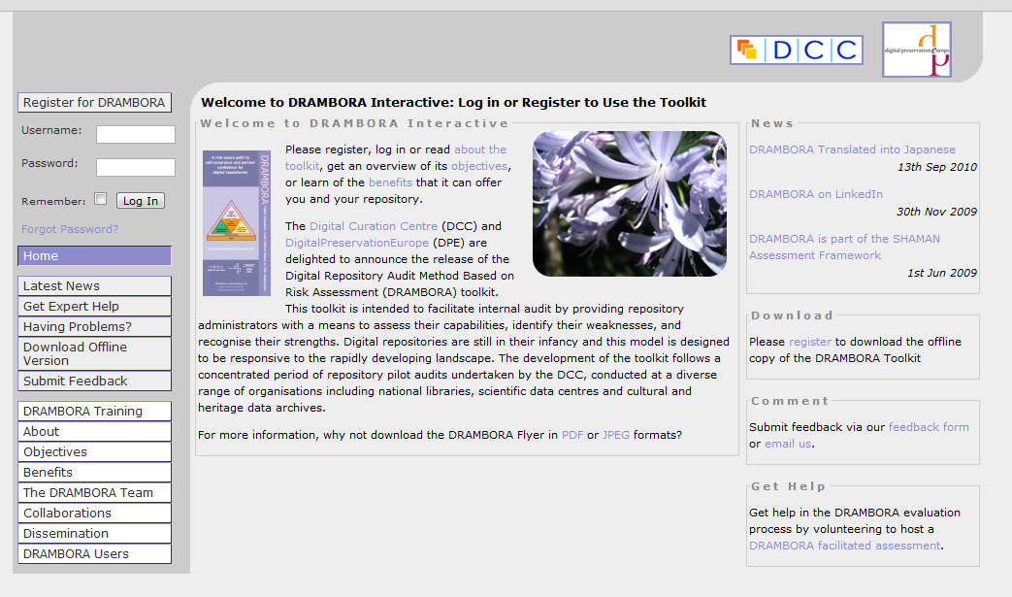
DRAMBORA
Notes:
The digital repository audit method based on risk assessment (DRAMBORA) is a methodology and associated software-based toolkit developed by the Digital Curation Centre and Digital Preservation Europe to support the assessment of digital repositories.

Slide 131
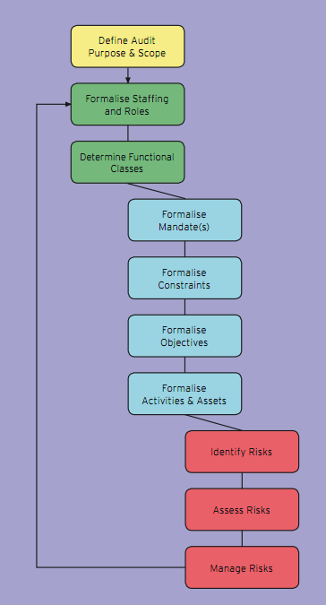
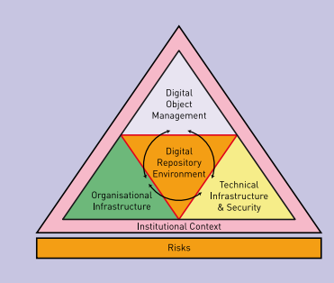
DRAMBORA
Notes:
The DRAMBORA toolkit is intended to facilitate internal audit of digital preservation repositories by providing repository administrators with a means to assess their capabilities, identify their weaknesses, and recognize their strengths.

Slide 132
Defining Digital Preservation
Short Definition
Digital preservation combines policies, strategies and actions that ensure access to digital content over time.
(ALCTS, 2009)
Notes:
Medium Definition
Digital preservation combines policies, strategies and actions to ensure access to content that is born digital or converted to digital form regardless of the challenges of file corruption, media failure and technological change.
The goal of digital preservation is the most accurate rendering possible of authenticated content over time.
Long Definition
Digital preservation combines policies, strategies and actions to ensure the most accurate rendering possible of authenticated content over time, regardless of the challenges of file corruption, media failure and technological change. Digital preservation applies to content that is born digital or converted to digital form.
Digital preservation policies document an organization’s commitment to preserve digital content for future use; specify file formats to be preserved and the level of preservation to be provided; and ensure compliance with standards and best practices for responsible stewardship of digital information
Digital preservation strategies and actions address content creation, integrity and maintenance.
There’s more, but we’ll get there in a bit…
Long Definition (Continued)
Content creation includes:
Clear and complete technical specifications
Production of reliable master files
Sufficient descriptive, administrative and structural metadata to ensure future access
Detailed quality control of processes
Use of persistent identifiers

Slide 133
Examples of Repository Policy Areas
Organizational
  Governance
  Participation
  Community Organization
  Community Termination
  Grant Support
Content and Metadata
  Deposit and Usage
  File Format Support
  Identification
  Ownership
  Metadata
Access, Rights, and Usage
Authentication
Copyright
Preservation and Infrastructure
Preservable formats
Repository Termination
Technical Infrastructure
Notes:
At this level, we develop consortial development priorities, policies, and operations plans, as well as joint marketing materials and strategies. These efforts are then used as models locally.

Slide 134
The Five Organizational Stages of Digital Preservation
The five stages of organizational response to digital preservation are:
Acknowledge
Act
Consolidate
Institutionalize
Externalize
The Five Organizational Stages of Digital Preservation. Kenney, A., McGovern, N.
Notes:
http://quod.lib.umich.edu/cgi/t/text/text-idx?c=spobooks;idno=bbv9812.0001.001;rgn=div1;view=text;cc=spobooks;node=bbv9812.0001.001%3A11.
Acknowledge: Understanding that digital preservation is a local concern;
Act: Initiating digital preservation projects;
Consolidate: Seguing from projects to programs;
Institutionalize: Incorporating the larger environment; and
Externalize: Embracing inter-institutional collaboration and dependency.

Slide 135
Repository Systems and Preservation
Content integrity includes:
  Documentation of all policies, strategies and procedures
  Use of persistent identifiers
  Recorded provenance and change history for all objects
  Verification mechanisms
  Attention to security requirements
  Routine audits

Slide 136
Repository Systems and Preservation
Content maintenance includes:
  A robust computing and networking infrastructure
  Storage and synchronization of files at multiple sites
  Continuous monitoring and management of files
  Programs for refreshing, migration and emulation
  Creation and testing of disaster prevention and recovery plans
  Periodic review and updating of policies and procedures

Slide 137
Repository Service Threats
Media Failure
Hardware Failure
Software Failure
Power Failure
Communication/Network Failure
Organizational Failure

Slide 138
Content
Concerned with growth and scalability
Concerned with obsolescence
Concerned with degradation and durability
Focused on Preservation strategies

Slide 139
Principles of GOOD Digital Objects
A good object
  exists in a format that supports its intended uses
  is “preservable”
  is meaningful and useful outside of its local context
  will be named with a persistent, globally unique identifier that can be resolved to the current address of the object
  can be authenticated
  has associated metadata
A Framework of Guidance for Building Good Digital Collections, NISO.

Slide 140
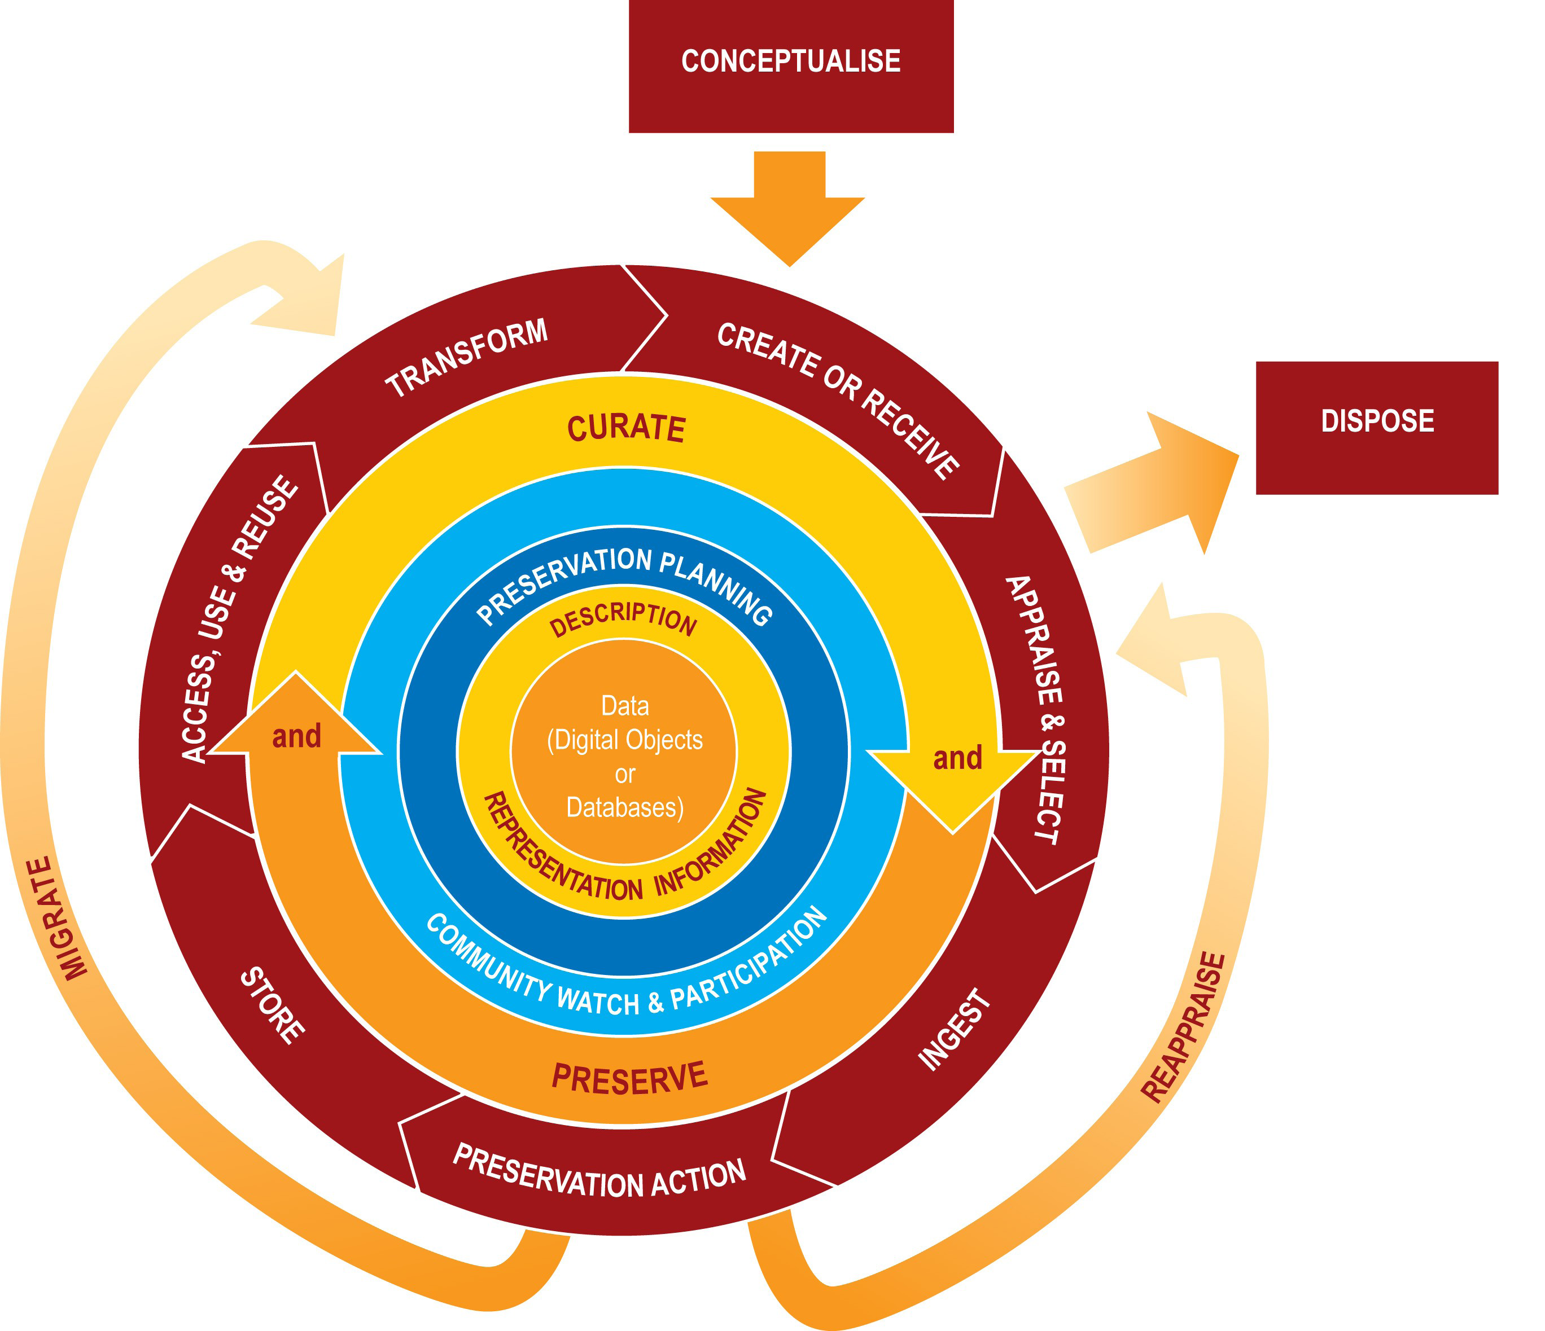
Content and Data Preservation Strategies
Bit-level
  Store
  Refresh
  Migrate
  Preserve the Technology
Full
  Emulation
  Normalization
Lifecycle Management
Notes:
Another webinar
Store
all files in secure, reliable media and locations
and handle according to industry guidelines
Implement periodic and systematic integrity checks
Backup, backup, backup and keep lots of copies in different locations and on different media
Preserve the technology
Refresh
Copy content from one storage medium to another.
Migrate
Transferring digital information from one hardware and software setting to another at a minimum of once every 5 - 10 years.
Emulation
Software that emulates an obsolete platform on new systems
Format Migration
Open and saves a source file in a current/different format (think Word)
Format Normalization
Taking proprietary formats and saving in a more stable format yet retaining essential properties (.rtf instead of .doc)
Can be lossy
Actively manages each stage in the life of the digital object
Takes preservation actions early in the life cycle
Emphasizes creation, selection, documentation, and use.

Slide 141
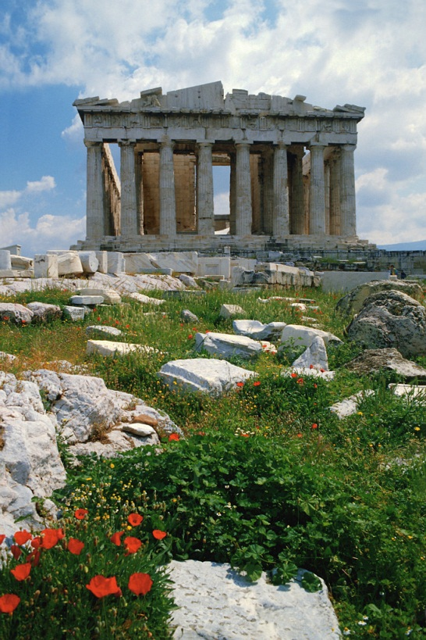
Thoughts…
“Stewardship is easy and inexpensive to claim; it is expensive and difficult to honor, and perhaps it will prove to be all too easy to later abdicate…”
Clifford Lynch

Slide 142

Worksheet 4: Sustaining YOUR Digital Repository

Slide 143
Module 6:
Building a Repository Service: Discovery and Access

Slide 144
Repository Controls
Primarily Users are concerned with
  Open Access
  Copyright
  Conditions of Use
Users are interested in what they can
  Take
  Keep
  Use
  Alter
  Re-distribute

Slide 145
Controls and Social Media
Follow
  Syndication (RSS, Atom)
Aggregators
  local, regional, national
Harvesters
  OAIster, Internet Archive
Culture of participation
  Blogs & Wikis
  Social networking
  Social tagging
Openness
  Sharing
  Syndication

Slide 146
Transformative Technology
The “Untethered Internet”
  Mobile devices and tablets
Mash-ups
Augmented reality
Cloud services
  Streaming delivery

Slide 147
Module 7:
Promoting and Measuring Use

Slide 148
Marketing Repository Services
Develop a multi-platform “brand” using Web and print
Find and engage YOUR End Users
Recruit YOUR advocates
  Enlist Stakeholders, Creators, and End Users in dissemination of marketing “messages”
Identify potential partnerships
Embrace “R&D”
  “Rip-off and Duplicate”

Slide 149
Marketing Repository Services
Web Strategies
  Build “Community Spaces”
    Mostly public, with “members only” areas
  Develop mailing lists and Listservs,
  Wikis, Blogs, and “Fan” Pages
  Tweet, Like, Follow, Connect…
“Print” Strategies
  Flyers, brochures, bookmarks, stickers,
  Annual reports, white papers, and presentations
  Press Releases to a range of media outlets
    Campus newspaper, Friends newsletter, Member magazine

Slide 150
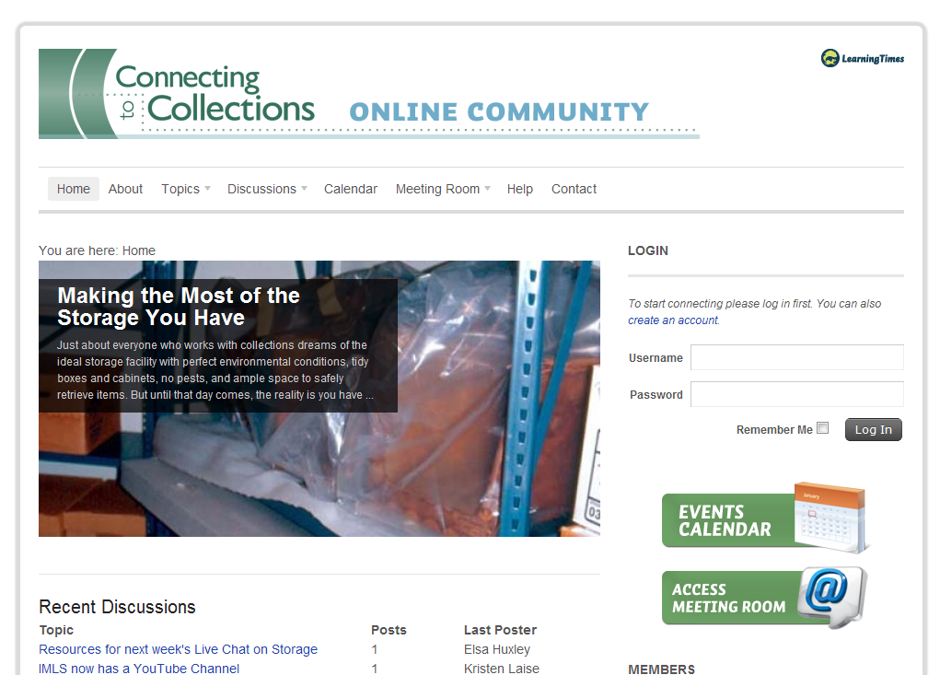
IMLS C2C Online

Slide 151
Evaluation
“[Repositories] must be both useful and usable…”
Make sure you know requirements of funders!
  Include how you will USE findings!
Adopt direct and indirect approaches
Can be coordinated in-house or out-sourced

Slide 152
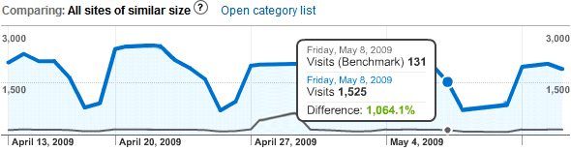
Evaluation
Web Analytics
  File downloads count
  Anonymous user demographics
Surveys
  Online and Print
  Incentives
Focus Groups
  “Early Adopters” are key
Anecdotal evidence
  Might not “help” officially, but it can’t hurt!

Slide 153
EvaluationO
ISO 16363 – Audit and Certification of Trustworthy Digital Repositories
ISO 16919 – Requirements for Bodies Providing Audit and Certification of Candidate Trustworthy Digital Reposiories

Slide 154
Workshop Wrap-Up
That’s All Folks!

Slide 155
Parting Thoughts To Remember…
A digital repository is a service, as much as it is software, hardware, or content.
If you begin a digital repository service, you are committing - at some level - to providing the same type of service and support you provide in your physical institutions.

Slide 156
Parting Thoughts To Remember…
You are not alone!
  YOU
  + Your collections
  + Your colleagues
  + Your users
  + Everyone here today
  + digitalpreservation.gov¹⁰
  ____________________________________
  Success! (or, at least a VERY GOOD start!)

