Slide 1
Exploring the Application of Lessons Leaned from the UNLV’s Linked Data Project to Metadata for Archives
Archives Records: Ensuring Access
Research Libraries Roundtable
August 13, 2014
Silvia Southwick
Metadata Librarian
UNLV Libraries
silvia.southwick@unlv.edu

Slide 2
UNLV’s Linked Open Data Project
Relationships among people identified in transcripts from the digital collection: African American Experience in Las Vegas -- Oral History
Linked Data visualizer RelFinder – open source

Slide 3
How have we started?
Study group in the library
Thorough literature review
Tests of open source technologies – OpenRefine, Mulgara, Virtuoso, visualizers (Relfinder, PivotViewer)
Definition of data model – Europeana Data Model (EDM)
Design an exploratory project
Data model

Slide 4
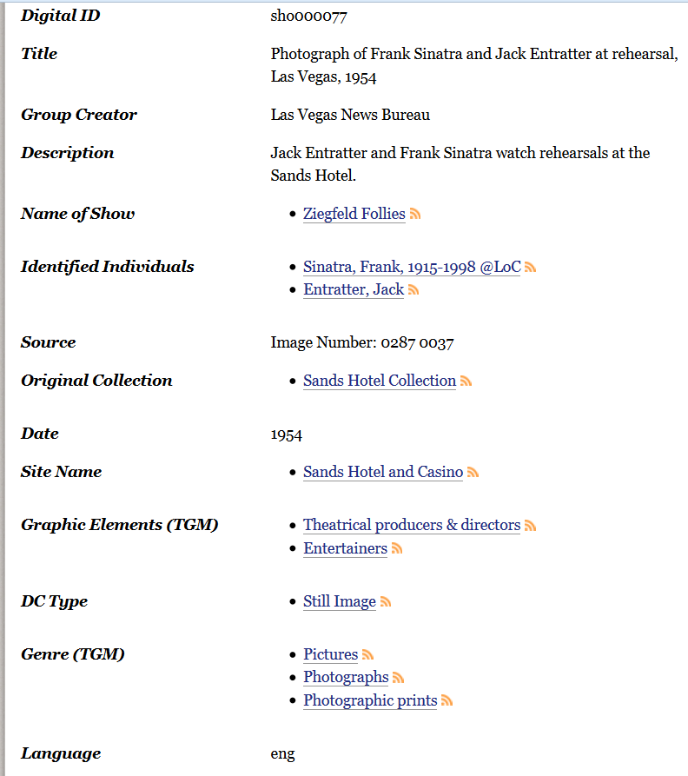

Current digital collection
record

Slide 5
Expressing metadata as triples
subject --- predicate --- object
<this thing> <has creator> <Las Vegas News Bureau>
< this thing > <has genre> <Photographic print>
< this thing> <depicts> <Frank Sinatra>
< this thing> <depicts> <Jack Entratter>
-------------------------------------------------------------------
<Frank Sinatra> <has profession> <entertainer>
<Jack Entratter> <has profession> <theatrical producer>

Slide 6
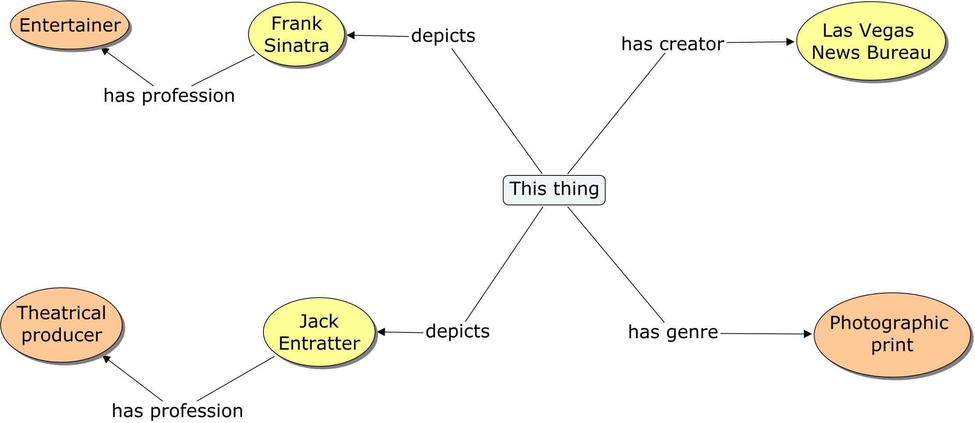
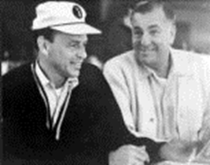
Graph Representation

Slide 7
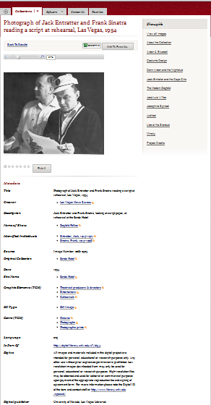
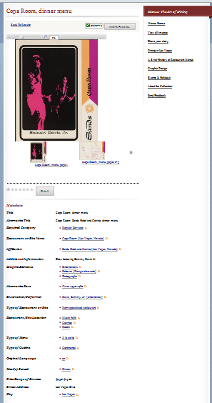
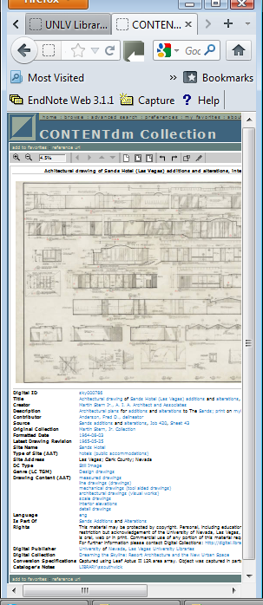
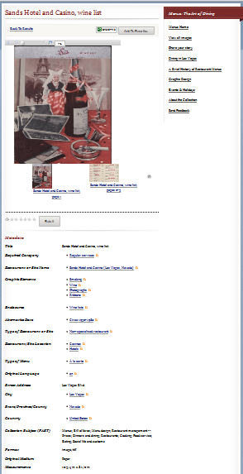
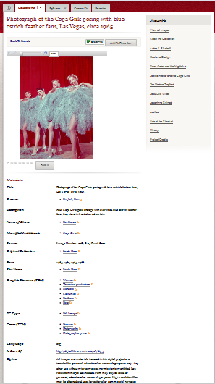
Records from different digital collections
Showgirls
Dreaming the
Skyline
Menus

Slide 8
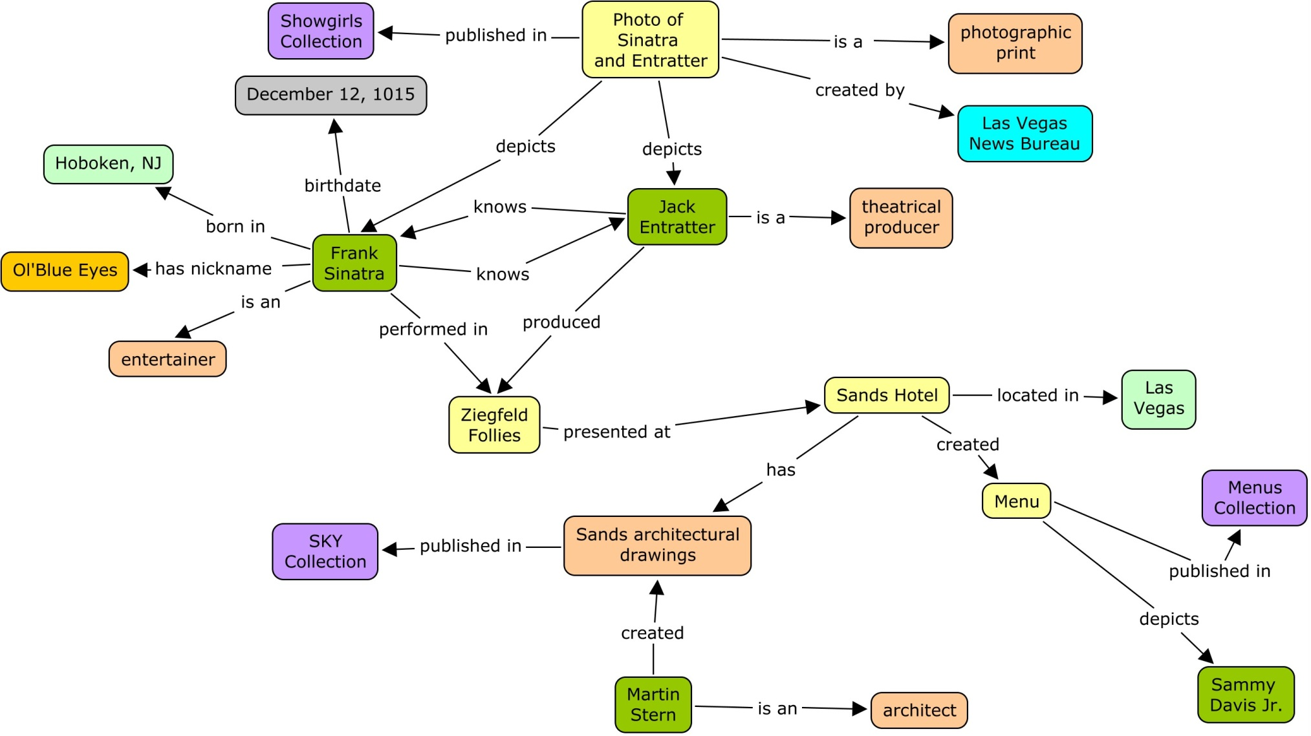
Missing Links

Slide 9
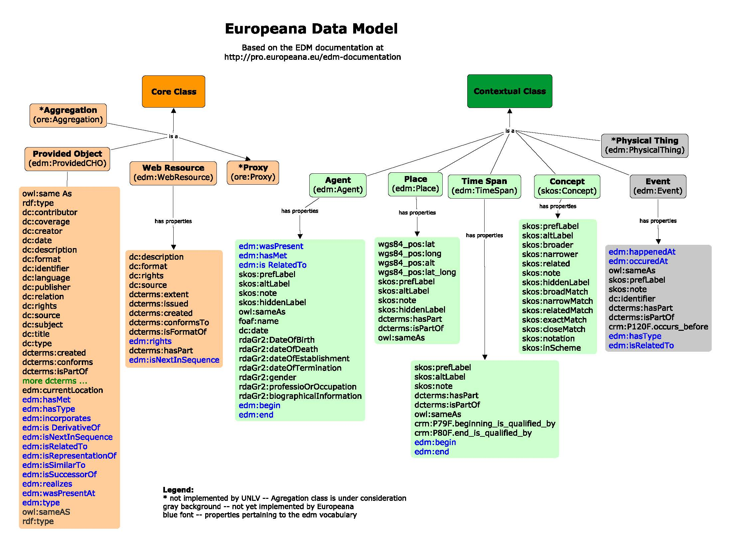

Slide 10
What have we accomplished?
Transformed our digital collections metadata into Linked Data
Used visualizers to demonstrate some of the benefits of Linked Data
Integrated data with other datasets (DBpediapedia, Geonames, Library of Congress authority files and thesaurus.
Displayed data in innovative ways (RDF not proprietary)
Made our data available for re-use (in progress)

Slide 11
How?
Clean data
Export data
Mapping
Define URIs rules
CONTENTdm
Import data
Prepare data
Reconcile
Generate triples
Export RDF
Open Refine
Import data
Publish
Mulgara /
Virtuoso

Slide 12
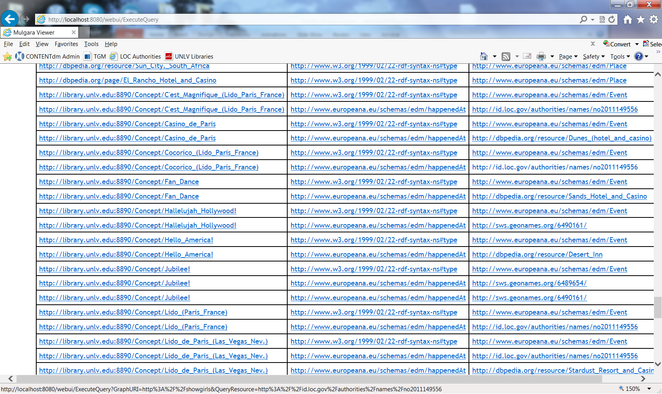

Slide 13
Applying experience to archival data (eac-cpf)
Digital Collections (QDC+)
Data model: EDM
Managing URIs
Technologies:
OpenRefine (Open Source)
– focused on flat data structures
- easy to create mapping
Functions: clean, prepare data and reconcile data and generate Linked Data
Mulgara/Virtuoso/Sesame…. Triple stores
eac-cpf
Data model: eac-cpf ontology
Developed by Silvia Mazzini (Italy)
Managing URIs
Technologies:
Karma (Open Source)
- focused on hierarchical data structures
-mapping is more complex
Functions: clean, prepare data (reconcile?) and generate Linked Data
Mulgara/Virtuosos/Sesame/… triple stores

Slide 14
Digital collections
Special Collections
Clean data
Export data
Mapping
Define URIs rules
CONTENTdm
ArchiveSpace
Import data
Prepare data
Reconcile
Generate triples
Export RDF
Open Refine
Karma
OpenRefine
Import data
Publish
Mulgara /
Virtuoso
Mulgara /
Virtuoso

Slide 15
Thank You!
UNLV’s LOD Project
Blog: http://library.unlv.edu/linked-data

