Slide 1
Third Time’s the Charm?:
The Journey of I&A’s Advocacy Toolkit
RAAC: Mary Rubin & Andrew Noga
I&A: Christine George, Rachel Mandell, & Wendy Hagenmaier
Notes:
Hi my name is Mary Rubin and I’m the incoming Advocacy Subcommittee Chair for the Regional Archival Associations Consortium.
Hi my name is Wendy Hagenmaier and I’m the outgoing Chair of the Issues and Advocacy Roundtable.
[Mary]
We’re here representing a larger team--Andrew Noga, also RAAC Advocacy Subcommittee member; Christine George, Outgoing Vice-Chair of I&A; and Rachel Mandell, I&A Intern.

Slide 2
Created in 2013-2014…
One …
… Long …
… List …
… On …
… One …
… Page …
Notes:
[Wendy]
The idea for an I&A Advocacy Toolkit arose at the Roundtable’s gathering at the SAA Annual Meeting in 2012. As recorded in the minutes, quote: “It was suggested that we...create an advocacy toolkit to help organizations. We also discussed the nature of archival advocacy including steps to take and also to designate a way to document our steps, thinking about what we are doing and what we should be doing.” Throughout 2013 and into 2014, the I&A Steering Committee assembled resources on the definitions of archives and advocacy, the value of archives, specific advocacy efforts, and organizations, agencies, and coalitions related to advocacy in the archives field. It was the origin of a great resource, but left much to be desired in terms of usability--both for toolkit users, who had to scroll down a long list on a long page, and for toolkit creators, who found it cumbersome to edit the Drupal page and add timely advocacy updates.

Slide 3
Updated in 2014-2015…
I&A Steering Committee:
Fixed broken links
Added dates to resource descriptions
Brainstormed moving to Wordpress
Identified a major content gap: resources and information from RAAC
Notes:
[Wendy]
The steering committee realized the toolkit was a resource that had to be sustained and kept relevant over time for it to be successful. So in an effort to establish a model of sustainability, the next year, we reviewed the toolkit and made improvements, attending to link rot, adding metadata, and brainstorming how much more flexible the toolkit would be if it were created in an easily edited platform like Wordpress.
The steering committee members all agreed on one point in particular--the lack of information about, relevant to, and created by regional archival associations presented a huge gap in the toolkit that needed to be remedied. The I&A Chair had established a great relationship between I&A and the Regional Archival Associations Consortium leadership, and the toolkit offered an ideal opportunity for the two groups to join forces on a concrete deliverable.

Slide 4
Third iteration in 2015-2016…
New I&A home on WordPress
Christine G. and Wendy H.
I&A took on an intern
Rachel M. (now incoming Vice-Chair)
Partnered with RAAC
Mary R. & Andrew N.
Notes:
[Mary]
The current I&A leadership, including Wendy & Christine, gave the Advocacy Toolkit a new home on WordPress and made the updates to the toolkit as they were needed. I&A also took on an intern to draft and conduct a survey about the toolkit.
MARKETPLACE
We invite you join us in mini focus groups related to our work on the I&A toolkit. We will be discussing and working through advocacy scenarios to identify gaps or new resources for the toolkit.

Slide 5
Third iteration in 2015-2016… (cont.)
1st: Updated for dead links & grammar
2nd: Survey, Distributed via:
SAA listservs: I&A, A&A
SAA Blogs:
Archives Aware! (CoPA)
SAA I&A Blog
SNAP Blog
SAA In the Loop email
RAAC listserv → Regional listservs
Notes:
[Mary]
Partnering with RAAC, which included Andrew and myself, the toolkit was accessed again - attending to link rot, adding metadata, and brainstorming how to better enable the user’s experience as well as accessing how to tie RAAC’s resources into the toolkit. Wendy helped as well. We utilized Google Docs to make a mock of the toolkit and then we were able to collaborate and discuss the different sections and links on the toolkit. Wendy made the updates. At this time, the toolkit had a page for each section, which accounted for 10 different pages to click through. Our fearless intern Rachel, who has a strong background in social science research, drafted a survey to measure user experience of the toolkit. It invited participants to visit the toolkit and answer 9 questions about demographics, content, and layout. Christine wrote an engaging invitation to participate in the survey, which we distributed to the I&A and A&A lists, the Committee on Public Awareness Archives Aware! Blog, and I&A and SNAP blogs, as well as In the Loop. I distributed the survey to the RAAC listserv, where it went out to regional listservs in a trickle down recruitment effort.

Slide 6
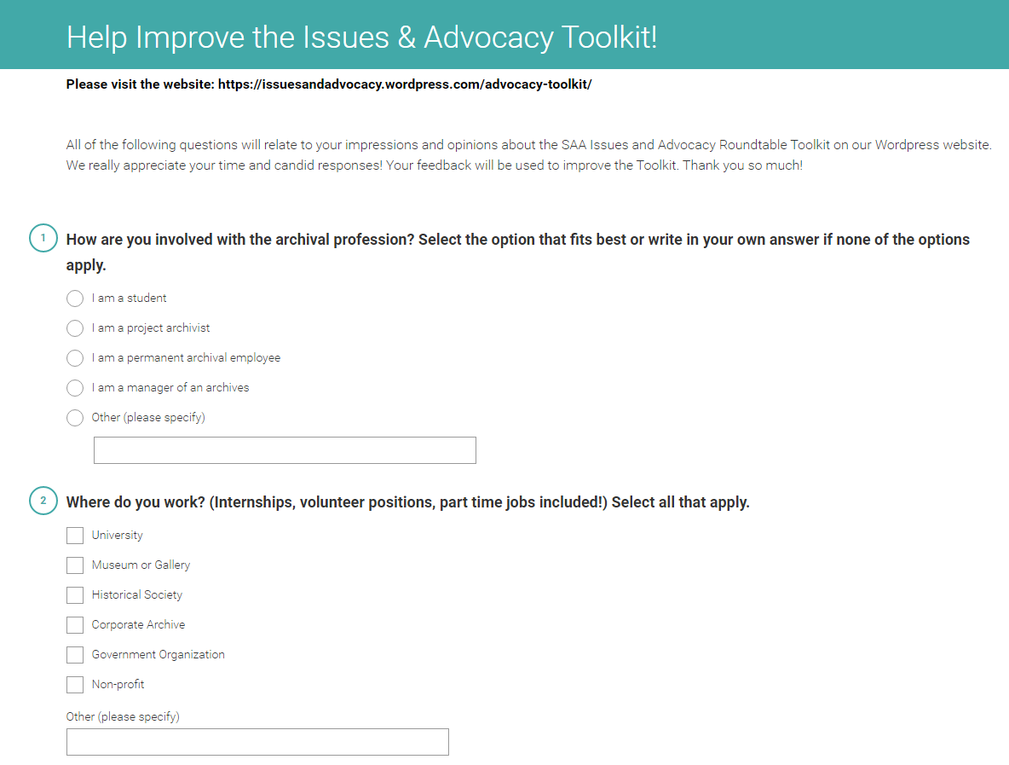
Survey
31 responses
Roles:
55% permanent archival employees
26% managers of archives
13% students
6% other
0% project archivists
Notes:
[Wendy]
The survey asked participants about their advocacy experience, their preferences for navigating the toolkit, how they would improve it, and whether they would participate in a focus group about the toolkit in the future. We received 31 responses.

Slide 7
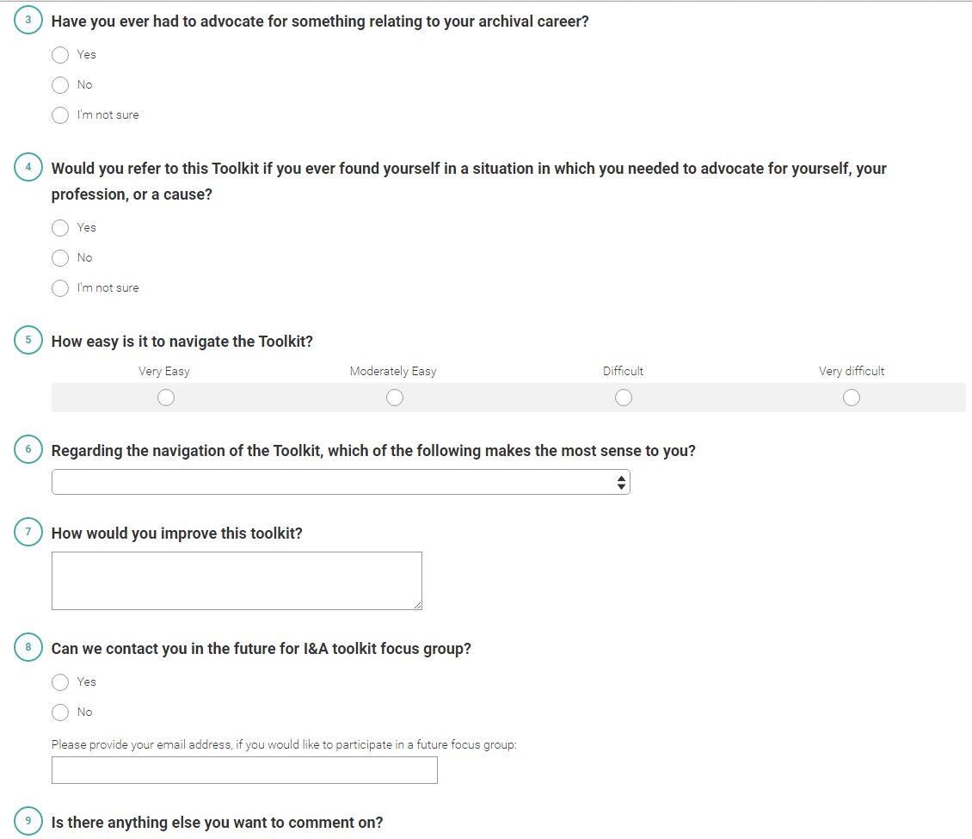
Survey
Institution type:
51% university
19% government
14% nonprofit
8% museum/gallery
5% corporate
3% other
Notes:
[Wendy]
When asked “Have you ever had to advocate for something relating to your archival career?,” 78% of respondents said yes, 16% said no, and 6% said “I’m not sure.”

Slide 8
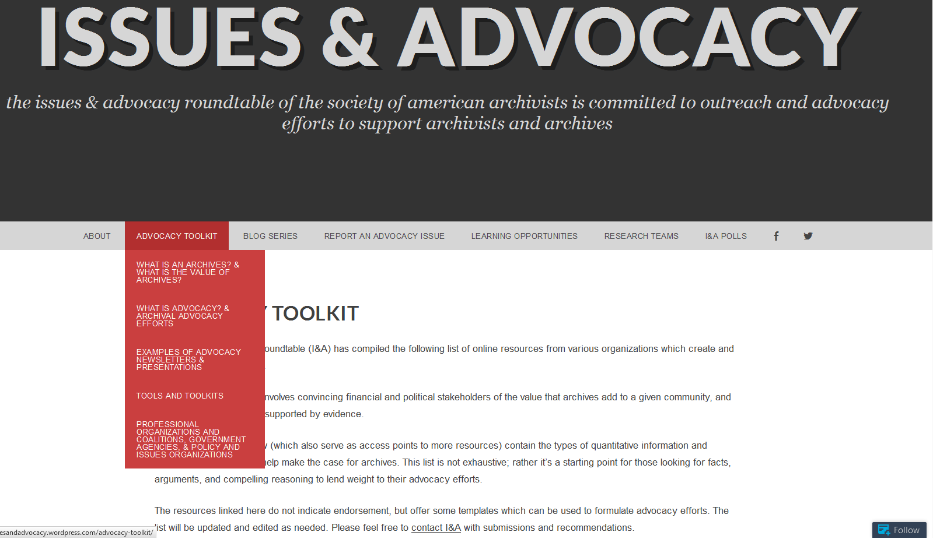
Third iteration in 2015-2016…
Notes:
[Wendy]
This screenshot shows a glimpse of the toolkit after we migrated our web presence to Wordpress. Key Roundtable documentation--minutes, bylaws, our statement of mission, vision, and core values, etc. are maintained on our SAA microsite. But frequently updated content, such as an active series of blog posts, our form archivists can fill out to report advocacy issues, info about our research teams, and of course, our toolkit now live on the I&A Wordpress site. An overwhelming majority of survey respondents said they preferred a series of nested pages for the toolkit, rather than one long page. We changed to a nested model based on their feedback.

Slide 9
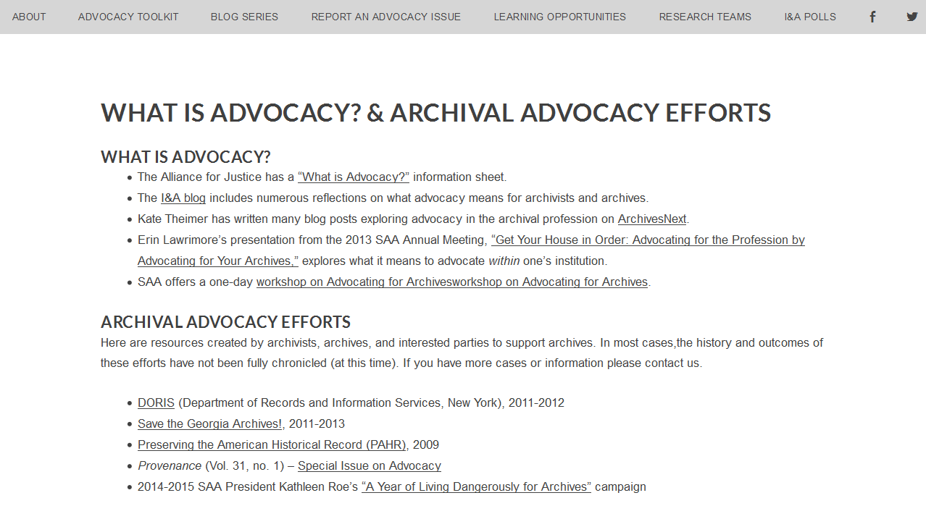
Third iteration in 2015-2016… (cont.)
Notes:
[Mary]
As Wendy mentioned, survey participants were asked about their involvement in a future focus group. Unfortunately, the scheduling that we had for this project did not work out for us to complete those focus groups before SAA. We also hoped to do Google Analytics analysis to access which documents were being used/clicked most frequently as well as seeing how people were getting to the toolkit. I&A’s intern was also time limited and the board for I&A as well as the board for RAAC are turning over during this annual meeting.

Slide 10
Third iteration in 2015-2016… (cont.)
Last:
Adding content
From survey:
“I would like to see more about advocacy within your own institution.”
“Expanded resources.”
“With some contact for people experienced in advocacy and willing to advise colleagues.”
Notes:
[Mary]
So the last endeavor for the 2015-2016 group is to add more content. One suggestion based on the survey was to add a list of contact people with advocacy experience; however, we decided that maintaining the list of people would be cumbersome and instead added links to the internal SAA advocacy groups.
We have hopes that this won’t be the last of a workgroup to develop this toolkit more fully. Rachel, I&A’s intern, is the incoming Vice Chair for I&A. And I am the incoming Advocacy Subcommittee Chair for RAAC. I&A and RAAC will continue to have a great relationship whether or not I&A’s new leadership decides to continue work on the toolkit beyond its normal maintenance.

Slide 11
Third iteration in 2015-2016… (cont.)
Next:
Mini focus groups at RAO Marketplace
Continued maintenance
Content creation
From survey:
“Find the gaps in the linked resources and arrange to have things developed.”
Notes:
[Wendy]
The toolkit is not a serious research project; it’s a practical resource for archivists, a series of simple webpages created by a roundtable. And yet, it offers a compelling example of how best practice research methods can be integrated into the collaborative work of SAA component and allied groups, reinforcing the assessment and metric-driven model of work--and advocacy--that is now required for us to effectively make our case. Mary and I are excited to extend our data gathering by conducting mini focus groups during the RAO Marketplace this Friday, where we will ask participants to respond to a series of advocacy scenarios and in so doing, identify new content that I&A’s and RAAC’s broad membership bases might be able to generate for the toolkit. In the year ahead, we envision the move from data gathering to implementation, mobilizing our members to write or design or code original resources and tools to empower archival advocates.

