Slide 1
The Research Forum @ 10: Observations
Notes:
Good afternoon, I am Dan Noonan the Digital Resources Archivist with The Ohio State University Archives. What began in Chicago in 2007, continues strong a decade later. The Research Forum continues to build bridges between research, innovation and practice in the archival field. Through the presentation of 191 papers and 214 posters, including this current meeting here in Atlanta, the Forum has tackled topics not only in the digital realm, but ones that deal with core archival functions and the role of archives in society. Nancy approached me with the idea that the decade-mark presents an opportunity for review; to make observations about the trends, gaps and opportunities for the future. And in full disclosure I was on vacation biking from Pitt to DC with a bunch of Boy Scouts a few weeks ago when we confirmed my participation, so I spent the past week reviewing the proceeding, data encoding and crunching the numbers for this presentation. It is my interpretation–in hindsight–about the topical categories and the subsequent assignment of classification coding for data analysis, as such all errors in interpretation are mine. Most of what I’ll be showing you is visualizations of that data. So let’s get this party started…

Slide 2
Notes:
Starting with that first meeting in Chicago, 170 institutions have presented on topics ranging from access and description to curation and preservation to advocacy and outreach. Of those institutions, approximately 90% were domestic, while10% were from beyond the borders of the United States. I need to note that my analysis of institutional affiliation does not include data for 2016.
The preponderance of institutional affiliations has been that of colleges and universities (66%), but also includes non-profits, museums, vendors/consultants and even a K-12 educational institution. However, there is a gap that I would point out—and probably my most significant observation—two-thirds of the papers and posters have been presented by individuals associated with colleges and universities special collections and archives, general libraries, educators or graduate students. This compares to the somewhat dated A*Census data, which indicates approximately only 36% of the profession is associated with higher education. Granted, research is part and parcel of what we do in academia, and it is in many cases encouraged and supported to a much greater extent than it is for our counterparts, who are represented in the other one-third of this chart, but in reality are the other 64% of our profession. Now maybe the non-academic archivists are conducting research, as well as developing and implementing innovative practices, but do not have the opportunity to attend the Research Forum?
The challenge—or maybe more optimistically, the opportunity—we have is how to engage the non-academic archival community more broadly in the research, development, innovation and implementation and in the discussion thereof? While the Forum concentrates the discussion on an annual basis, which has the effect of raising the level of importance, is there a means, especially in our increasingly virtual-age, to engage a greater percentage of our profession on a more regular basis? I pose these questions rhetorically for now, but would hope that they engender further discussion today and as we go forth from this Forum.
Now another possible view of this data to consider is this. First we assume that the graduate students and educators are primarily engaged in research within their role at the Forum, and we add them to the Researcher category. Then we presume the college and university special collections, archives and library participants are primary engaged in implementing applied research, we see 32%—68% split respectively amongst researchers and practitioners. That’s a lot of assuming, but if my assumptions are correct (or nearly so), it is encouraging that research is being leveraged at a ratio of 2:1.

Slide 3
Notes:
Now what I do find even more heartening than the idea that 170 institutions have been represented, is that 390 people have had the opportunity to either present a paper, poster or both over the past decade. As can be seen in this chart, the vast majority of participants have only contributed once. Yes, there have been some of the “usual suspects” who have presented multiple times (you know who you are Mr. Lee, Ms. Smith, Ms. Tsutsui). I, personally, have been an occasional attendee, but am a first time presenter. While some may view this abundance of presenters and institutions as demonstrating a lack of continuity or opportunity to view the progress of research projects over time, it does more importantly demonstrates a commitment to diversity of concepts and projects. This has been a strength of the Forum.

Slide 4
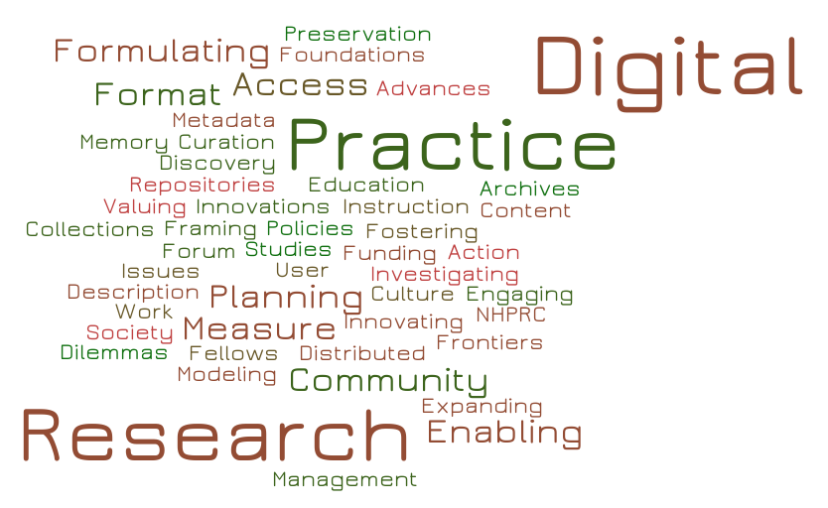
Notes:
Outside of the initial meeting, which focused on fostering and engaging in research—as well as providing a platform for NHPRC Research Fellows to report on projects they were engaged with—there has not been an intentional effort to specify an over-arching theme for the annual Forum, nor session segments therein. The themes have emerged organically from the submissions themselves. Even this year’s Forum call for participation which noted, “Topics that address the 10th Anniversary of the Research Forum are especially welcome this year.” resulted in only two out the eight thematic segments in the day, Funding, Research, and the Forum and Building on the Forum—the latter of which this presentation is part of. From 2011 through 2013 there appears to have been no attempt to even articulate thematic segments throughout the Forum. Additionally, segment themes have only been reused twice, both in 2009 and 2010—Collection Management Tools and Practice and Formulating Community Practice.
The number of thematic segments throughout the day-long Forum has increased from the initial three in 2007 to a high-point of ten in 2014 and 2015. Inherently this means the sessions are shorter, allowing for a diversity of projects, topics and voices to be heard from in a day. Moreover, unlike the conceptually similar Coalition for Networked Information (CNI) semi-annual meetings, presentations do not compete with one another, nor is participation and attendance limited to partner institutions. This is another key strength of the Forum!
On average there have been 26 paper presentations and 31 poster presentations at each Forum—this year being the high-water mark for papers (34) and 2010 for posters (39). It should be noted that there is overlap in paper and poster presentations on an annual basis, where the presenter does both on the same topic; as well as overlap in consecutive years, where a poster precedes a paper on the same topic.

Slide 5
Notes:
In reviewing all of the papers and posters presented at the Forum, I was able to discern nineteen different categories that are addressed as can be seen in this chart. While these categories could be further refined—or some might suggest collapsing and aggregating them at a higher level—I feel they provide an appropriate view of the topics covered by the Forum over the past decade. Further, I did not limit the number of categories within which to classify a particular paper or poster as they often crossed categories. It being the Research Forum and living in the digital age in the 21st century, the usual suspects of curation and preservation, “big data’, digital forensics and processing, digitization and metadata were well represented among the topic presented. However, what is striking—and this is my last major take-away from the data—is that the clear majority of presentations dealt with issues of description of and access to collections and the administration and management of archives and archival projects.
First keep in mind that I cross-categorized many presentations, so one that dealt with say digital forensics, may also have dealt with access and description or an aspect of archival management. But more importantly, it is the basic archival principles and functions that underpin what we do regardless of whether we are addressing analog or digital assets—or as I prefer to consider them non-technology and technology dependent. Research in the areas of our basic principles and functions should always be ongoing; we should never presume that these are fixed in stone and cannot evolve. Nor should we lose sight of them as we adapt to preserving our documentary heritage in ever-changing formats. The Research Forum is a valuable opportunity for an exchange of evolving information, guidelines, standards and practices.

Slide 6

Conclusions
Diverse number of participants, institutions and institutional types…
…but should look at encouraging greater participation beyond academia.
Themes have developed organically.
Topics that not only reflect the times, but are rooted in basic archival principles and functions.
Notes:
In conclusion, the Research Forum has been successful in attracting a significant number of participants from a diverse set of backgrounds and institutions. If it can improve in one area, it would be that of building upon that diversity, and actively encouraging, facilitating and/or enabling more non-academic-related participation. I should note that one aspect of “participation” which I did not examine was that of the attendees or audience. It would be interesting to see how those statistics compare to that of the presenters.
The Forum is successful in that due to the currency of the topics presented, which have not been forced by pre-ordained categories. The topics range from the exotic, such as alternative media types and “big data” to the mundane (but fundamental) topics of access and description and archival management. Further, each presentation gets its spot in the sunshine, and is not forced to compete with another session. Congratulations on your first decade! And here’s to your second! Thank you!

Slide 7
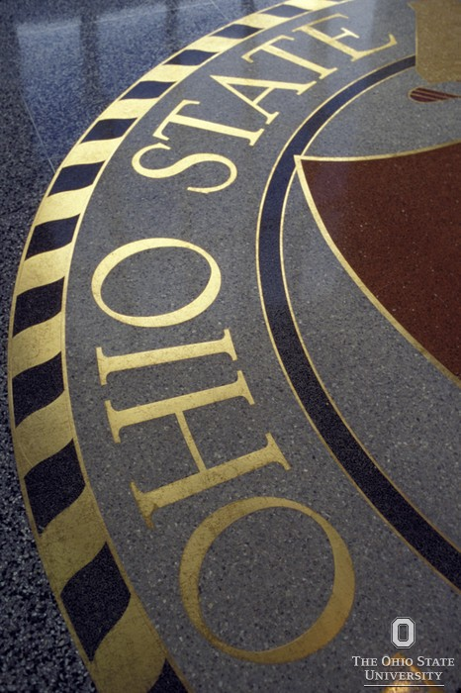
Contact Info
Dan Noonan
noonan.37@osu.edu
614.247.2425
320B 18th Avenue Library
175 18th Avenue
Columbus, OH 43210
www.go.osu.edu/records
www.go.osu.edu/archives
@DannyNoonan1962

