Slide 1
Report on Digital Preservation and Cloud Services

Slide 2
Why share this with others?
MHS situation is a rough proxy for that of many archives and other cultural repositories
Instrumental's report is comprehensive, thorough, with many useful comparison points
Authors are unaware of any similar research having been reported before this
Has the capacity to serve as a white paper that can benefit the digital preservation community

Slide 3
MHS Problem
Escalating digital content within collections
100 TB current state
30 TB projected annual growth
Insufficient storage environment
More redundancy needed
Preservation strategy still in its infancy
Cost is a big issue

Slide 5
The question
How might cloud storage contribute to a sustainable preservation strategy?
vs. simply increasing existing storage architecture
How do we research the question?
Seek qualified consultant
Instrumental, Inc., St. Paul, MN
http://www.instrumental.com

Slide 7
Instrumental’s skills and experience
Performance Analysis:
Requirements and specification development
System and storage benchmarking and capacity planning
Modeling and simulation services
Product evaluations
Architecture & Design:
System and storage architecture design, integration, and deployment
Integration, Management & Consulting:
Technology recommendations
Proposal assistance
Implementation
Demanding client base
Library of Congress
GSA
Dept. of Defense
Generations of experience in high performance computing
Roots in Control Data, UIBM, and Cray Research

Slide 8
Points of analysis
Average daily, weekly and monthly retrieval rates (both file counts and data volume)? Most of the cloud storage providers charge not only for archive but retrieval.
Peak daily, weekly and monthly retrieval rates (both file counts and data volume)? Some of the cloud storage providers have higher peak rates.
What is the timeframe required for a retrieval?
Authentication model requirements i.e. who can put data into the archive, who can replace files, who can remove files and who can access files? Do different users have different roles? How many users and does user access need to be tracked?
What is the incoming and outgoing bandwidth to MHS? This is critical to understand to determine the maximum potential data access.
Will MHS accept LTFS on LTO5+ for large data volume restoration? This is likely much less expensive for large amounts of data needed at MHS.
What is the technical expertise of the MHS employees overseeing the digital archive? Some cloud storage providers can be more turnkey while others require highly technical staff to operate.
What are the plans for future growth?

Slide 9
Storage Type Reliability and Integrity
The hard error rate, which defines how many bits of data can be read before a read fails, for enterprise tape storage is at least 2 orders of magnitude better than that for even enterprise disk storage as shown in the table below.

Slide 10
Considerations & risks
Data ownership, rights, and obligations
Reliability and integrity
Disaster recovery
Retention and portability
Availability
Breaches and security
Scalability

Slide 11
Questions to ask a cloud service
What is the underlying storage technology which determines the overall reliability of the archive? The hard error rates of disk and tape are not going to change.
Given the available service providers and the fact that new providers are coming to market monthly, what customer bases are the cloud providers actually attempting to serve? Adding a framework for data integrity on top of a cloud provider attempting to serve a different market will not be likely to meet overall requirements. Cloud storage providers are often marketing to application developers which may or may not meet the needs for MHS. MHS needs data integrity and security on a per file basis. MHS should look for providers that are targeting long-term preservation of sensitive and/or historical files.
What are the security policies, procedures and certifications in place? Adding security features to a cloud provider with an inherently insecure environment will probably not meet the MHS legal requirements.
What is the data validation and integrity framework? MHS needs to have a framework in which integrity can be validated both inside and outside of the MHS cloud archive. MHS must be able to periodically check the integrity of stored data against original copies in addition to using vendor-provided checksums in the cloud environment to ensure integrity of the data after transfer (see the detailed explanation below).

Slide 12
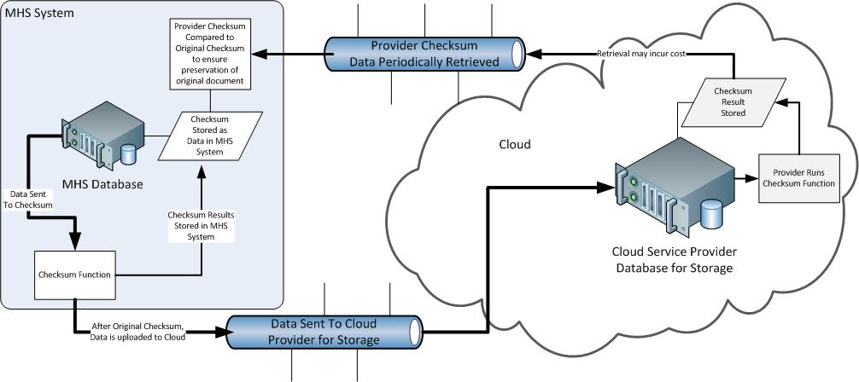
Proposed Data Integrity Validation Procedure

Slide 13
Provider / Service | Data Integrity | Reliability | Scalability | Retention and Portability | Availability | Data Ownership | Preservation Functionality | Total 3-Yr. Costs
Amazon S3 | Limited checksums | Average | Almost unlimited | Not easy to move | Average | Similar to others | None | Medium
Amazon Glacier | Limited checksums | Multiple tape copies | Almost unlimited | Not easy to move | Lower since on tape | Similar to others | None | Low
Google Cloud Storage | No checksums | Average | Almost unlimited | Not easy to move | None in contract | Contract concerns | None | Medium
Tessella's Preservica | Checksums and CRC | Multiple cloud copies | Same as S3 | Multiple providers | Multiple cloud copies | Similar to others | Developed for this | ?
VISI ReliaCloud | Limited checksums | Average | Cannot support MHS | Somewhat limited | Average | Similar to others | Some claimed | High
SDSC Cloud Storage | Automatic verification | Average but no tapes | Almost unlimited | Claimed to be easy | Concerns about disks | Similar to others | None | Medium
DuraSpace DuraCloud | User run checksums | Multiple cloud copies | Same as S3 | Multiple providers | Same as S3 | Similar to others | Some claimed | Medium
IBM SmartCloud | Limited checksums | Average | Unknown | Unknown | None in contract | Similar to others | None | ?
FujiFilm Permivault | Custom plans | On-site and cloud | Almost unlimited | Somewhat limited | On-site copy | Similar to others | Limited | Low
FujiFilm Permivault Client | Custom plans | Cloud only | Almost unlimited | Somewhat limited | Average | Similar to others | Limited | Low
Code 42 CrashPlan Pro | Limited checksums | Average | More limited than S3 | Somewhat limited | Average | Similar to others | None | Low

Slide 14
General recommendations to MHS
Hybrid solution to data preservation makes the most sense
Cloud storage can provide an important element of redundancy
Enterprise hardware-based solution needed for files characterized by critical needs, ownership or rights issues, other problematic elements
Accepting a hybrid solutions helps us understand our enterprise hardware and funding needs

