Slide 1
“A hard drive! Box it and put it on the shelf, Elizabeth.” First steps in digital forensics in a very small archives
A Research Project supported by the Ian McLean Wards Memorial Trust
Notes:
Hello, I’m Elizabeth Charlton, Province Archivist for the Society of Mary in New Zealand, better known as the Marist Fathers and Brothers. This congregation brought Roman Catholicism to New Zealand in 1838. As the 2014 recipient of a scholarship from the Ian McLean Wards Memorial Trust, I have been able to undertake this applied project in digital forensics in a very small archives. In the NZ context, very small archives usually have one staff member and operate on less than $15000 US/year.
This project has been of a personal nature in that it was conducted outside of work, though my employer has and does support my absences for training. I have had no direct supervision. I reported regularly to the Trust.
So how did my proposal come about?
Experiences of the last decade – with theory and obsolescence of hardware and software … had attuned me to the precariousness of the digital world.
I had an external hard drive for back-up indicating signs of failure, so I was able to successfully move and retain all my files.
My information studies had records management as a major focus. This emphasised the records continuum model created by Frank Upward at Monash University, Australia and the 4 characteristics of authenticity, reliability, integrity and usability specified in the records management standard, ISO 15489.
Another paper required us to make a video. My video camera requires firewire to download footage and my current laptop doesn’t have one. The video editing software I was used to (and had) wouldn’t run on Windows 7. Luckily, I still had a laptop with Windows XP and a firewire port.
I subscribed to several Listserv and did a lot of follow-up reading from postings…
THEN

Slide 2
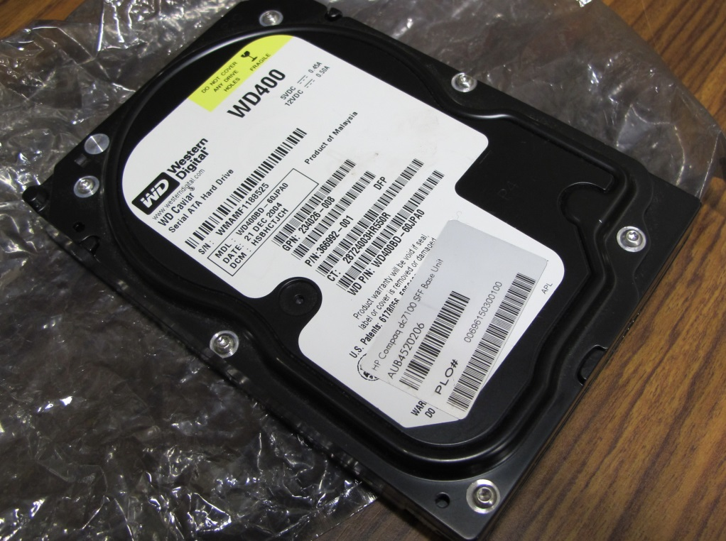
It started with a…
Notes:
What do we do with this? The hard drive arrived from Fiji in 2013 AND was simply put on a shelf. The elderly Marist brother who was then in charge of the archives said to me, “You can look at it in 10 years or so!”
I was volunteering in the Marist Archives at the time and very early into my studies. I had the feeling that just leaving the drive on the shelf was not proper management but I didn’t know what was.

Slide 3
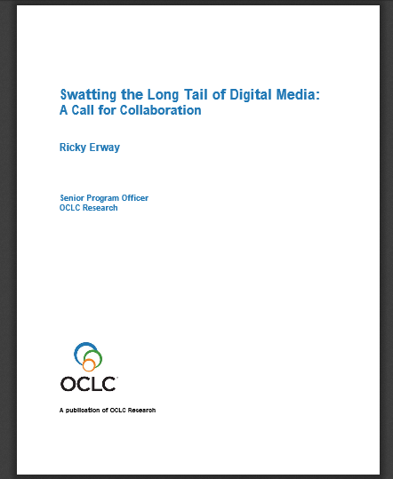
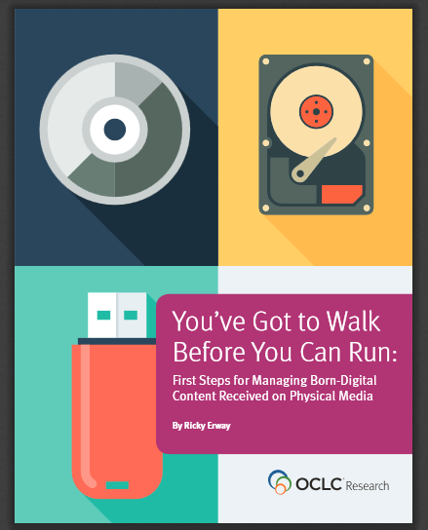
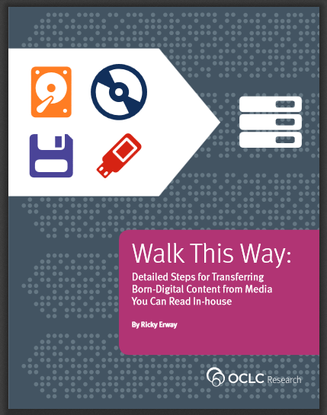
And…
http://www.oclc.org/research/themes/research-collections/borndigital.html
Notes:
I found from one the listservs that OCLC had produced in their Demystifying Born Digital Reports series, three manuals that provide a way forward.

Slide 4
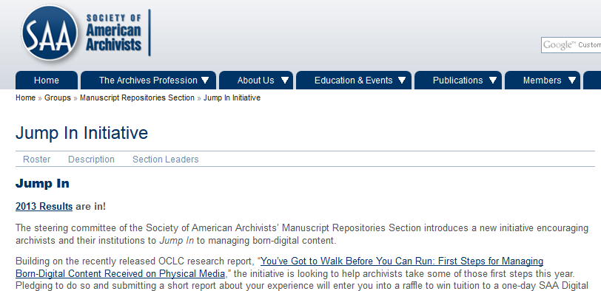
And…
http://www2.archivists.org/groups/manuscript-repositories-section/jump-in-initiative-2013-results
Notes:
The Manuscripts Section had started the Jump In Initiative using the first OCLC report.

Slide 5
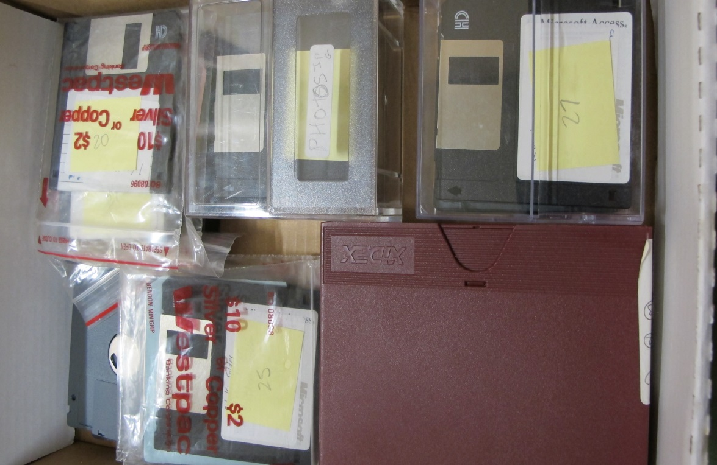
First Result - Now what?
Notes:
So I gave it a go… This was starting small by creating an inventory of the legacy media in one’s collections. It at least meant that I found out what we had and gave an indication of the volume of storage that would be required if everything were to be retained and could be accessed.

Slide 6
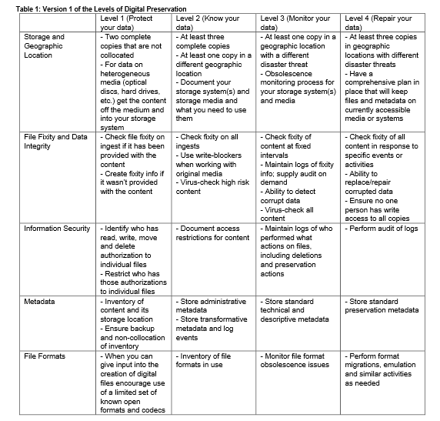
Could this help?
http://www.digitalpreservation.gov/ndsa/working_groups/documents/NDSA_Levels_Archiving_2013.pdf
Notes:
In 2014, I organised a professional visit to the Library of Congress to learn more about the levels of digital preservation.

Slide 7
How about this?
http://blogs.loc.gov/digitalpreservation/2014/05/digital-archiving-making-it-personal-at-the-public-library/
Notes:
During the meeting I was introduced to the model of hardware shared within a community at a pubic library. Admittedly this was for video, but the seed was planted as to whether something similar could work for floppies or hard drives that archives receive.

Slide 8
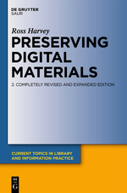
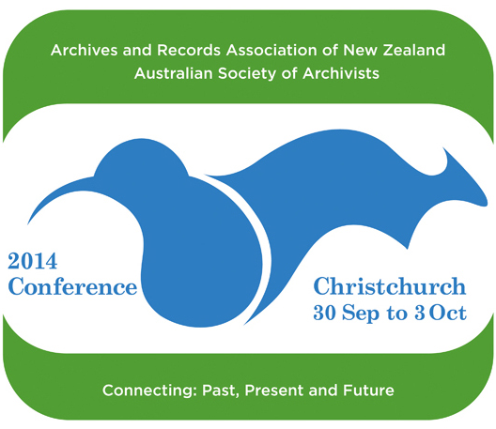
Even more food for thought…
All Bits Considered: Caring for Collections when Bitstreams Matter
Cal Lee, Wellington, New Zealand
http://www.archivists.org.au/learning-publications/2014-conference
http://www.nzqa.govt.nz/
http://www.degruyter.com/view/product/129095
Notes:
A few months later Cal Lee from UNC Chapel Hill came to NZ and introduced BitCurator.
At the joint ARANZ/ASA Conference in Christchurch two digital analysts from Archives NZ spoke on “Legacy Digital and Outreach @ArchivesNZ”. This outreach catered specifically for government departments. In particular, Mick Crouch mentioned that it is important not to wait for a finished solution for digital preservation, but to deal with what we have now; using the tools we have now.
Apart from one master’s paper in digital curation, no training was offered in NZ in digital preservation, until last year when the first DPOE course was run with about 30 attendees. There is no guidance regarding digital archives pitched towards the Community Archive sector.
In fact, within the broader information management and services profession, managing digital material had been identified as a skill gap as indicated in the needs analysis conducted in 2014 for the NZ Qualifications Authority’s mandatory review of qualifications for Information Management and Services (Cossham, 2014).
In the 2011 second edition of Ross Harvey's book Preserving digital materials, On p.213 he writes,
Discussion about digital preservation has too frequently been couched in terms that apply only to large well-resourced institutions, with little regard for the requirements of smaller organizations and of individuals.
Harvey goes on to discuss the issue of scalability of solutions and ends by urging for the creation of guidelines for small institutions;
These institutions urgently need guidance in the form of precise and concise directions that can be readily implemented, perhaps as workflows applicable to day-to-day operations. (2011, p.214)
I didn’t see that any solutions were forthcoming in NZ, so to work out what to do, I would have to do it myself and then start sharing with the wider community. This gave me the impetus to apply for the scholarship.

Slide 9
Quite simply – what do I do and how do I do it?
Equipment
Legacy media and formats
Appraisal and retention of material
Out of scope
Arrangement and Description
Access
Long-term storage systems
Notes:
So that it how I came to set the project’s parameters.
By working it out for me and consequently for those in very small institutions
Can we manage legacy media? What do we need to be aware of if we’re going to take up this challenge?
If we don’t know what’s on the legacy media, how can we appraise without making irreversible changes?
If the material is of value, how do we remove it without making irreversible changes?
What could be an equipment set-up that could be shared among smaller institutions?
Institutional needs differ and so approaches differ. I wanted to create something that is workable for small institutions that do not have regular IT support and staff with little digital knowledge.

Slide 10
Method – Action Research
Achieve understanding and change at the same time
Arises from a specific problem arising out of professional practice
Problem-focused in approach
Practical in intended outcomes
Directly relevant to participants
Results in improving practice
Notes:
As a former teacher I was used to the principles of action research, that is
Action research is the proposed method of study, as it is appropriate “when you wish to achieve understanding and change at the same time” (Dick, 2002). According to Wallace (1998), action research “… nearly always arises from some specific problem or issue arising out of our professional practice… It is very problem-focused in its approach and very practical in its intended outcomes” (p. 15); the research is directly relevant to the participants and results in improving practice (McNiff & Whitehead, 2010).

Slide 11
Initial Research Framework
1. The selection of the equipment (hardware and software) required to access and process the digital information for preservation.
2. The testing of the preservation process
3. The creation of the workshop materials documenting the preservation process
Notes:
To answer the questions I initially framed my research in three stages;
The purpose of the first stage was to ensure that the equipment selected was the most up-to-date available at that point in time; this reflects Mick Crouch’s advice mentioned earlier. The second stage’s focus was deepening my understanding of the processes involved in digital preservation, while the last stage was to embed the improvement into my own practice - the best way to learn is to teach - by creating the materials for and facilitating a practical workshop for interested parties who also want to better their understanding of this domain.

Slide 12
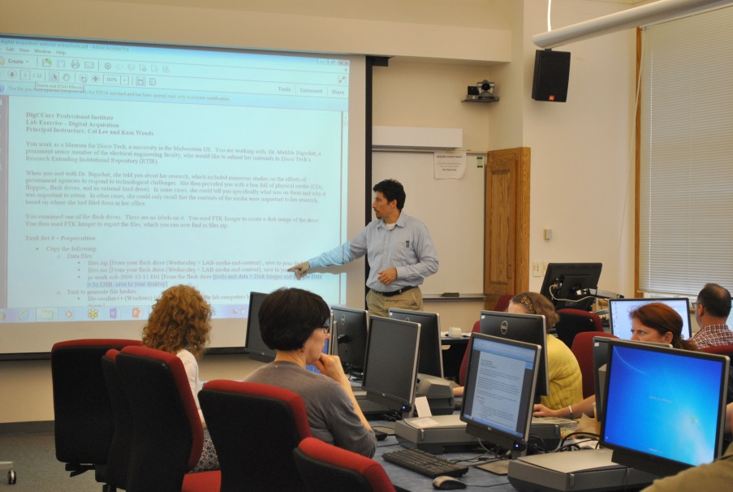
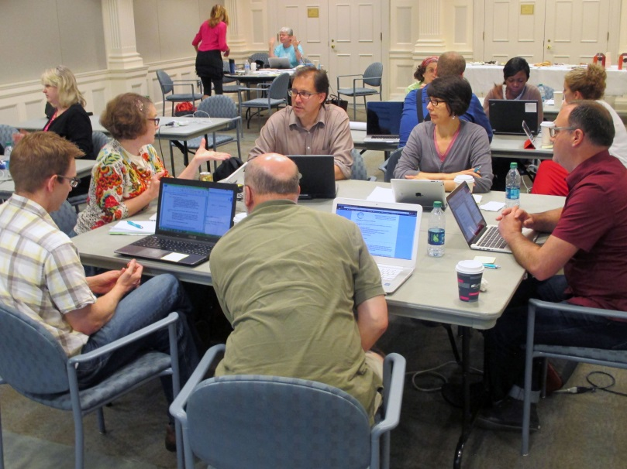
DigCCurr Professional Institute: Curation Practices for the Digital Object Lifecycle
https://www.flickr.com/photos/uncsils/sets/72157652034661453
Notes:
A key aspect to action research is its iterative nature, in that it both entails a process of planning, acting and evaluating against the project goals and allows for flexibility in adjusting project parameters.
After visiting Archives NZ and NatLib, I realised that working with digital objects was not so advanced in NZ as I had originally thought. The two institutions share some digital forensic equipment such as a Kryoflux. So I widened my discussions to include the digital archivists at Georgia Tech, Georgia State and Emory Universities, the Library of Congress and the Smithsonian Institution Archives as well as attending DigCCurr Professional Institute.

Slide 13
Sole Archivists’ Group Wellington: Media Survey
Notes:
Furthermore upon surveying members of a long-standing informal group of lone arrangers and meeting with a few members to gain more in-depth information about their practices, I realised that there was a lack of awareness amongst colleagues not just about legacy media but also more general computer skills.
These aspects meant that addressing points 1& 3 of my initial research framework would entail more focus than the scholarship funding would cover.
I conducted an informal survey with the Sole Archivists’ Group
Very small sample, N=5
3.5” floppy disks – an issue here is availability of drives to read disks and that more than one drive may be required to read them.
CDs / DVDs – Drives are starting to disappear from laptops. If copying, can lose naming convention (max 8 characters)
Flash drives - Not long-term. One in the group said, file put on in 2011 already corrupted
Separated computer and external hard drives for the purpose of purchasing equipment

Slide 14
Results
Notes:
I achieved the aim of action research that is - understanding and change at the same time.
After returning from DigCCurr, I purchased hardware suitable for use as a sharable digital forensics station. This was followed by hands-on training in the Digital Forensics: Advanced class at Annual Meeting last year.

Slide 15
Results
https://practicaltechnologyforarchives.org/issue6_charlton/
Notes:
Using that newly gained knowledge, I tested “guinea pig” legacy media and wrote an article documenting the process.

Slide 16
Results
Imaged and appraised the floppies at work
Transferable skills
Workflows for legacy and modern acquisitions
A retention and disposal schedule now on work plan
Notes:
I then repeated the process at work; practising on my own floppies assisted me in estimating how much time it would take to image and complete an initial processing. With the quantity of digital material I have awaiting processing, I believe that this volume is manageable and can be integrated in my workload without compromising other tasks. The benefits of appraisal in managing my institution’s legacy material made the cost of learning advanced skills worthwhile. These skills are transferable in that the processes prepared me to work also with modern acquisitions.
I drafted workflows and created instruction sheets for individual processing steps using the selected equipment. I will talk at the Lone Arrangers Roundtable tomorrow about my workflows.
Reporting back to my administration has led to a growing awareness of the appropriate management of information over time. A retention and disposal schedule for analogue and digital records is now in the planning stages.

Slide 17
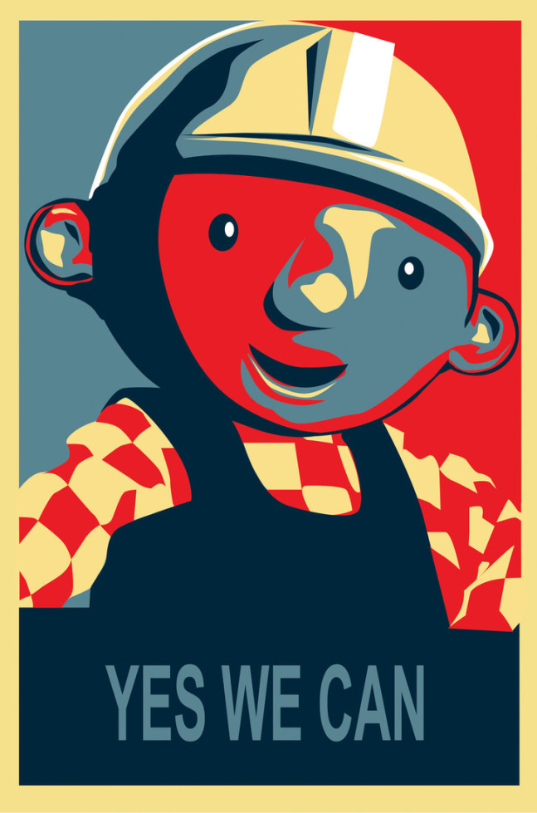
http://mattcantdraw.deviantart.com/art/Yes-We-Can-257260055
Notes:
I proved that it is possible to implement digital forensic practices in a lone arranger environment.

Slide 18
Results
Communicating about digital curation issues
Meetings at Archives NZ
Some of my suggestions have been implemented.
Wrote an Official Information Act 1982 request for information from Archives NZ
Wrote to members of parliament and had a meeting with my member
Presented at ARANZ Conference 2015
Spoke at BitCurator Users’ Forum 2016
Two talks in NZ coming up
Lone Arrangers lightning talk tomorrow
Notes:
Attendance at DigCCurr Professional Institute where participants are encouraged to make a 6-month action plan made me amend my goals in particular to add communicating about digital curation in NZ.
When I found that results of work conducted at Archives NZ was to be found on personal blogs, I felt that I had to conduct some advocacy for Lone Arrangers grappling with digital preservation.

Slide 19
Findings
The hobbyist is the beginning of the digital preservation journey. While becoming rarer, hobbyists are altruists, driven by an awareness of loss that no-one in their organisation has understood. They are individuals in their organisations, undertaking work that is not within their job descriptions. They have recognized that information is, or has been lost and are trying to do “something”, anything, about it for the good of future generations. Generally, they have no official resources and have neither the tools nor skills to be successful.
https://digitalpreservationchallenges.files.wordpress.com/2012/09/mckinney.pdf
Notes:
One big issue in NZ is the lack of awareness from those in the major institutions of how limited the non-government archival sector is in terms of repository staffing and resourcing.
Peter McKinney from the National Library of New Zealand lead a workshop at iPres 2012 in which he presented a challenge to the digital preservation community through an epochal framework; (https://digitalpreservationchallenges.files.wordpress.com/2012/09/mckinney.pdf)
I disagree with Peter that hobbyists are becoming rarer. Digital preservation is still well off the radar in most lone arranger institutions (and many larger ones) in NZ. As a lone arranger, there is no-one else to take on the challenge, so I am proud to be a hobbyist because at least something is being done with the material in my institution – and as Nancy McGovern poses “What is good enough in your situation?” In fact I am an early-adopter of digital forensics for archives in NZ and am dealing with what we have now; using the tools we have now.

Slide 20
Findings
Challenges for lone arrangers in their management of born-digital archives:
Acquisition of technical knowledge
Isolation
Budgetary constraints
Time constraints
Notes:
My journey through defining what is achievable for me and my institution has highlighted challenges for lone arrangers in their management of born-digital archives. While some of these challenges are not unique to lone arranger environments, they become more salient within this context.
Due to the nature of their positions, lone arrangers work mainly in isolation unless they are part of a wider community of practice. Overcoming this isolation requires management support for professional development opportunities and time to apply what has been learnt. Furthermore, management also needs to be made aware of the complexities of digital preservation and make provision for its implementation. Acquiring requisite technical knowledge is a barrier to taking action in the born-digital sphere. Lone arrangers are confronted by all the aspects of archival administration, so it can be challenging to prioritise the learning of new skills especially when those skills are applicable to only a small proportion of the work load.

Slide 21
Implementation Challenges
Storage
Affordability
Communicating requirements to IT
Community of Practice
Non-sharing of knowledge?
Leadership
Support and advice
Where is the training in NZ?
Where is the discussion in NZ?
Planning?
Notes:
Implementation Challenges fall into two categories
- Storage
- Community of practice
When I started out on this journey, I was very focussed on getting the material off older physical media through the creation of disk images, but as my reading and discussions advanced, I started wondering about where exactly I was going to store them. In addition the topic of calculating storage capacity requirements comes up infrequently. Finding affordable storage solutions that follow at least some of the principles of good digital preservation (eg more than one copy; monitoring for fixity) has not been easy. Communicating digital preservation requirements to IT professionals in an environment where a focus on digital preservation is the exception not the rule is in fact my next challenge as I prepare for a server upgrade.
The other challenge is establishing a community of practice for digital preservation in NZ. I have found it surprising that there are no nationwide conversations or questions about what do we do? However, a survey of cultural heritage institutions conducted a couple of months ago by the National Library in NZ indicates that few institutions are taking action in the domain – there was a 24% response rate to the survey.
21.4% of the respondents are transferring born-digital archival content from physical media
50% of those transferring sometimes create disk images
3.4% use writeblockers
5.2% use digital forensic software such as BitCurator or FTK Imager
So it is clear that I will be continuing in my role as cheerleader of a digital forensics in the archives for a while longer yet.

Slide 22
Thank you for your attendance today
A DigCCurr tradition: Durham Bulls Minor League Baseball Game
Elizabeth Charlton
babette@ihug.co.nz
Notes:
Thank you

