Slide 1
Agenda’s for Preservation Research
Micah Altman
MIT Libraries
Prepared for SAA Research Forum
Atlanta
August 2016

Slide 2
What’s New? (at the Forum)

Slide 3
 | Impressionistic Themes
2007 | fostering & engaging research
2008 | content planning; formats; repositories; user studies
2009 | collection management; community practice
2010 | archival practice; distributed preservation; collection management
2011 | trust
2012 | use and control
2013 | archival ethics
2014 | metadata, culture & society, modeling practice, education
2015 | collections, discovery, description

Slide 4
 | Tools
2007 | digital libraries; data grids; XML/xsl ...
2008 | data repositories; data grids; format characterization
2009 | open source accessioning tools; data grids;
2010 | Preservation networks; trusted digital repositories (tdr); preservation workflows
2011 | cloud storage; format characterization; data grid, format characterization
2012 | Archive workflow tools, linked data,tdr, digital forensics;
2013 | certification, linked data, tdr; forensics; workflow; format registry
2014 | Workflow tools, linked data; forensics; cloud storage; semantic technologies; format registry; information visualization, virtual computing environments
2015 | Workflow tools, linked data, TDR; semantic technologies

Slide 5
Some Current Agendas

Slide 6
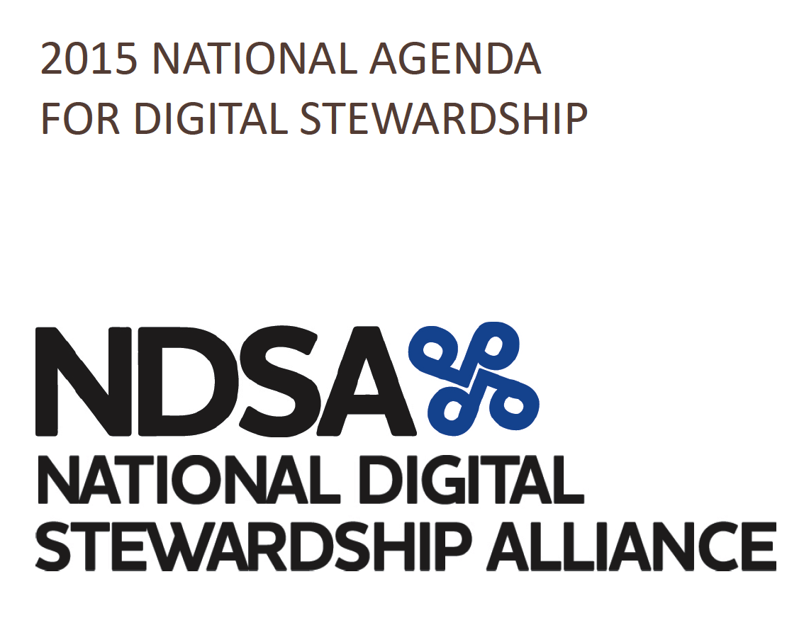
An Agenda for Digital Preservation Research
Build the evidence base systematically -- experiments, testbeds, probability samples
Better integrate research & practice
Stewardship at scale
Multi-institutional collaboration
Methods for big data and collections
Value and portfolio models
Applied research
Cost models at scale
Policy research on trust frameworks
Information equivalence & significant properties
Environmental sustainability
http://ndsa.org/national-agenda/

Slide 7
Difficult Problems & Wicked Challenges …
Difficult Challenges:
Competition from Alternative Avenues
Rethinking Roles and Skills
Personalizing Interactions
Wicked Challenges:
Embracing the Need for Radical Change
Managing Knowledge Obsolescence
http://www.nmc.org/publication/nmc-horizon-report-2015-library-edition/

Slide 8
Future Agendas?

Slide 9
Changing Economics of Long-Term Access
Digitization dramatically reduces marginal costs of:
Access, Replication, Computation, Alteration
→ no single organization can steward all the Information upon which it relies
Applied research for information commons:
Reputation creation and management
Organizational coordination and monitoring
Portfolio management and models
Risk models and diversification
Altman M, Avery M. Information wants someone else to pay for it: laws of information economics and scholarly publishing. Information Services and Use . 2015;35(1-2):57-70.
http://content.iospress.com/articles/information-services-and-use/isu775

Slide 10
Supporting Diversity in the Information Architecture of Archiving
Re-presentation
Community ontologies
Local knowledge
Embodied perspective
Multiple ways of discovering and understanding
Accessible
Weinberger D. Too big to know. Basic Books. 2011.
Morales M, Knowles EC, Bourg C. Diversity, social justice, and the future of libraries. Libraries and the Academy. 2014;14(3):439-51.

Slide 11
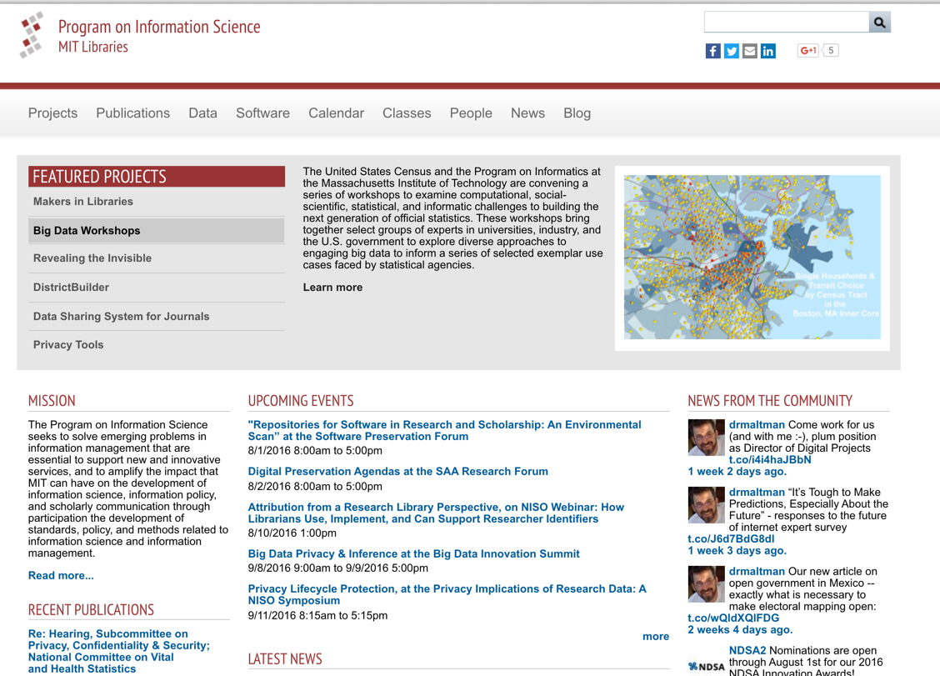
Questions?
Web:
Informatics.mit.edu
Email:
escience@mit.edu

