Slide 1
Versioning in Digital Archives: A Workflow
Laura Alagna
University of Chicago Library
lalagna@uchicago.edu
SAA Metadata and Digital Object Roundtable Annual Meeting
Washington, DC • 13 August 2014

Slide 2
Some context
The University of Chicago Library Digital Repository (LDR) is:
A dark archive
Designed to be permanent; provide long term storage and preservation
PREMIS compliant
20+ TB of data
MDOR Annual Meeting, 13 August 2014

Slide 3
The issues
Scenario: you receive updated versions of digital objects already in your (permanent, long term) Digital Repository
How are digital objects in permanent storage replaced?
What happens to the obsolete versions?
How can you communicate the changes that have occurred?
MDOR Annual Meeting, 13 August 2014

Slide 4
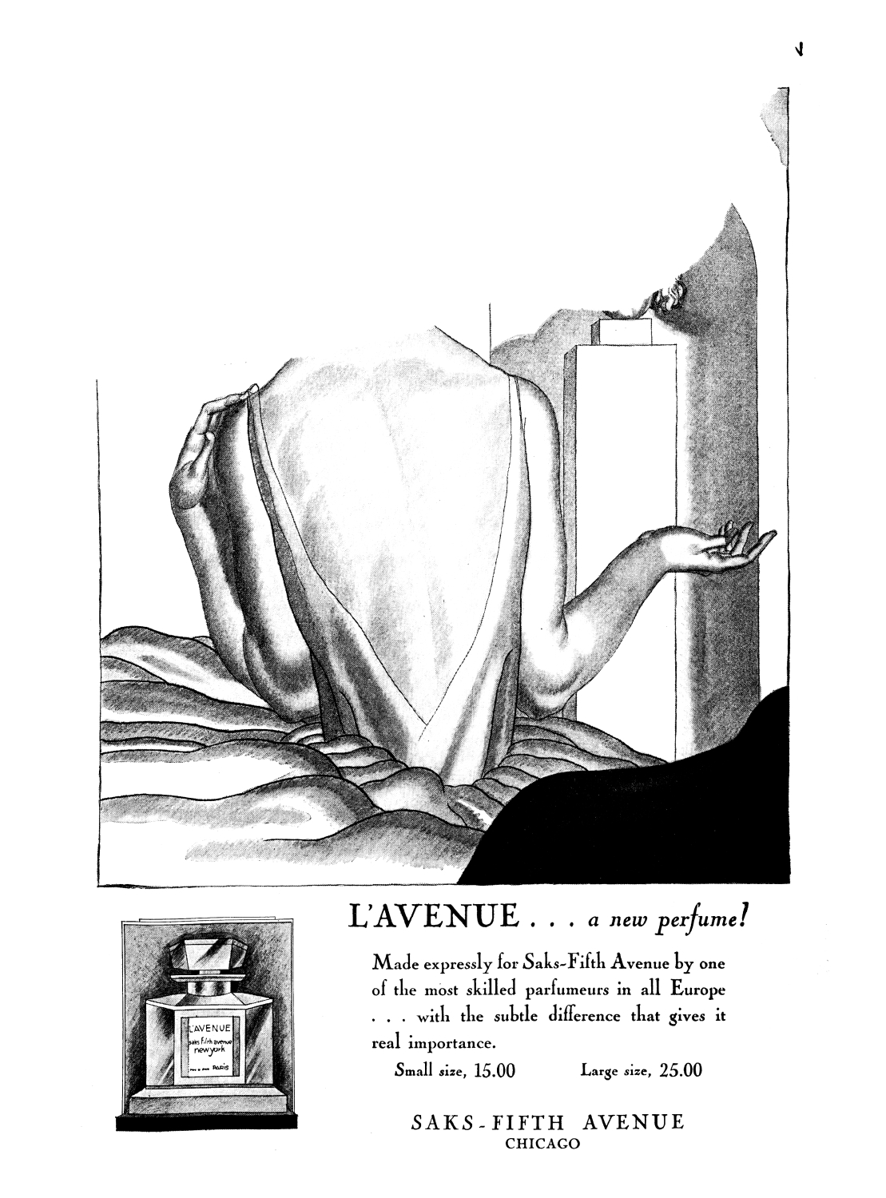
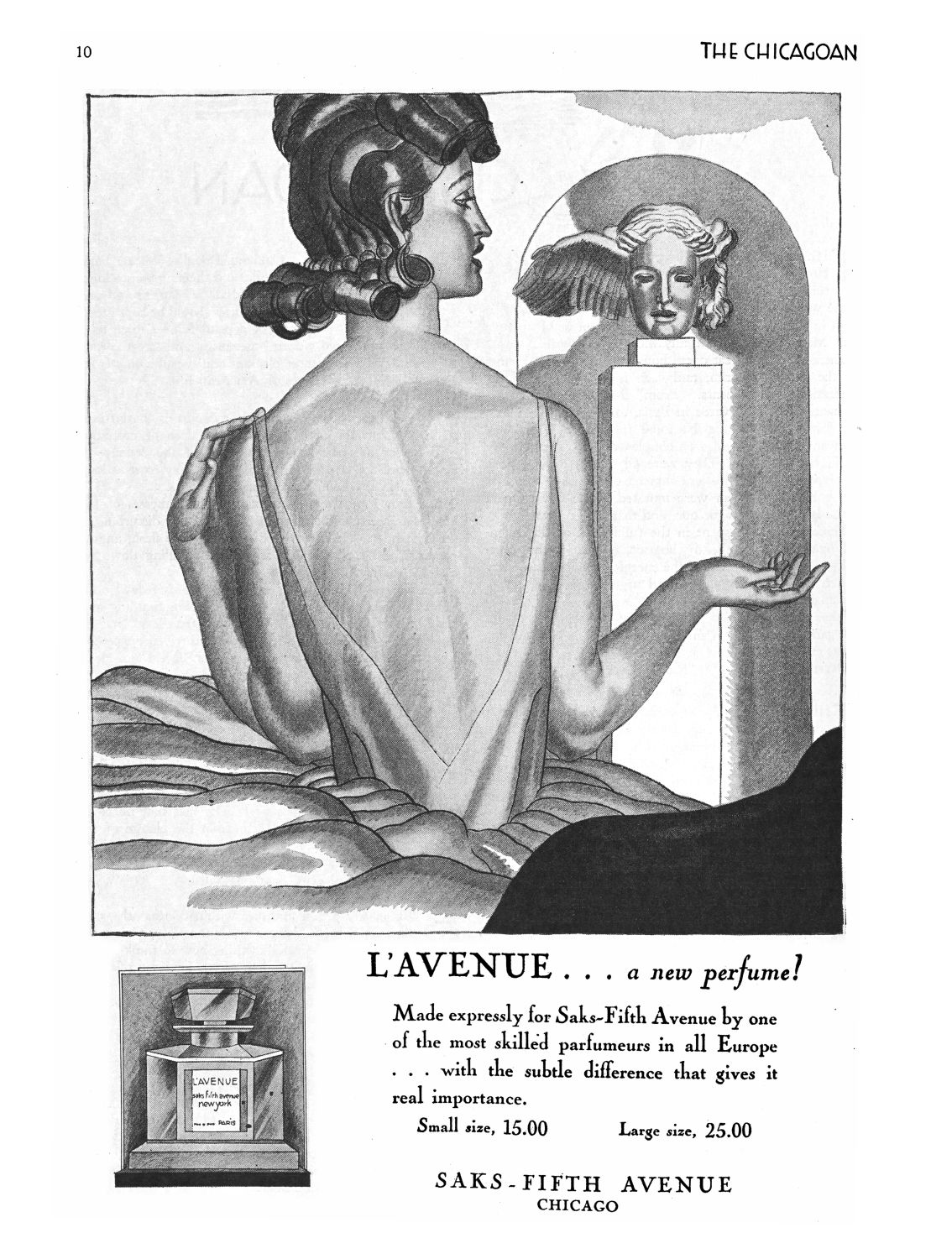
An example
The Chicagoan, vol. 8 issue 3
www.chicagoan.lib.uchicago.edu
Our copy
New York Public Library copy →
MDOR Annual Meeting, 13 August 2014

Slide 5
Our workflow
1. Create a mirrored directory in repository_old
2. Compose a .txt containing all relevant information on the versioning event
3. Move the obsolete version files to the repository_old directory
6. Update other associated metadata (if applicable)
5. Copy the new version files to the repository directory
4. Copy the .txt back to the main repository directory
MDOR Annual Meeting, 13 August 2014

Slide 6
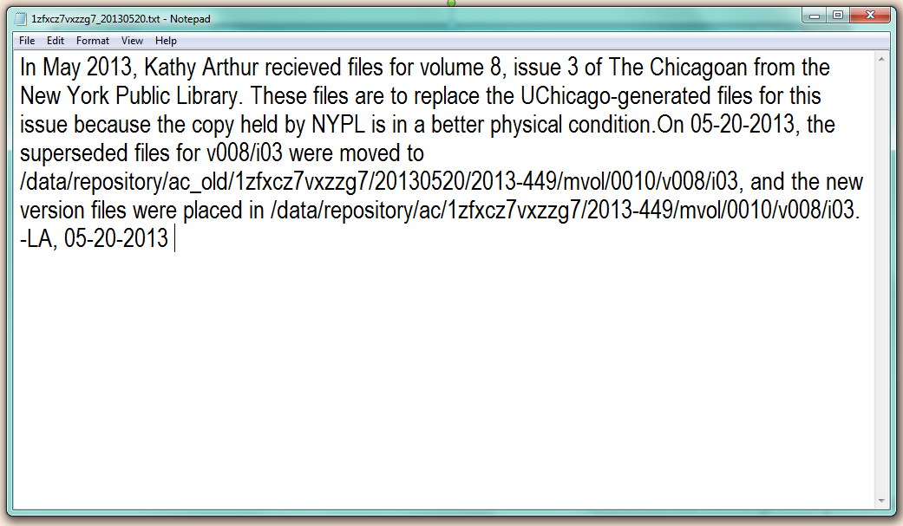
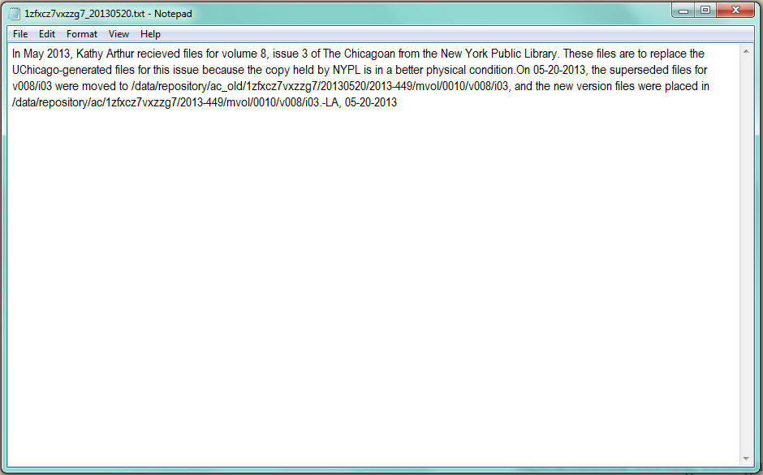
Metadata example
MDOR Annual Meeting, 13 August 2014

Slide 7
Our workflow
1. Create a mirrored directory in repository_old
2. Compose a .txt containing all relevant information on the versioning event
3. Move the obsolete version files to the repository_old directory
6. Update other associated metadata (if applicable)
5. Copy the new version files to the repository directory
4. Copy the .txt back to the main repository directory
MDOR Annual Meeting, 13 August 2014

