Slide 1
Architectural Records Roundtable
Society of American Archivists
Atlanta Annual Meeting
Wednesday, August 3
4-5:30pm

Slide 2
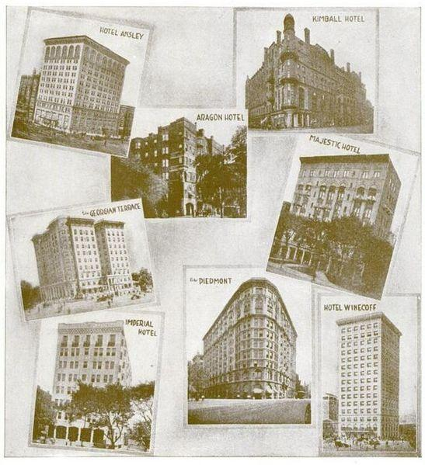
Agenda
Welcome and Introductions
Business Meeting
Election Results
Website Update
Presentations
Zach Vowell and Jessica Meyerson Software Preservation Network
CAD/BIM taskforce update and breakout session
Atlanta Hotels Architecture, 1916. Image from Wikipedia, Creative Commons.

Slide 3
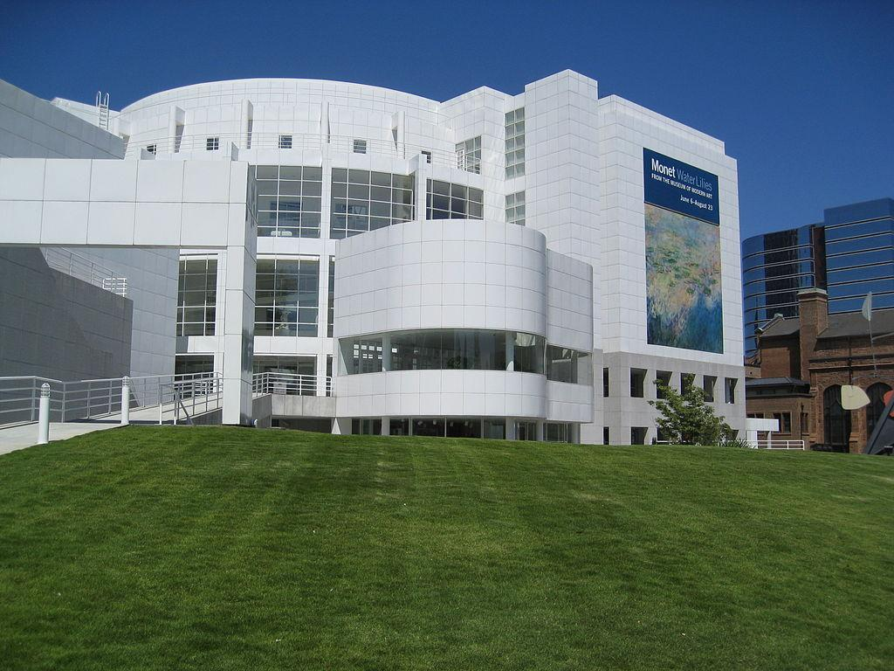
Election Results
Samantha Winn Incoming Co-Chair (2016-2018) Collections Archivist Virginia Tech
Tricia Gilson Incoming Steering Committee Member (2016-2019) Archivist and Curator Columbus Indiana Architectural Archives
Courtney Chartier Council Liaison (2016-2019) Head of Research Services, Stuart A. Rose Manuscript, Archives & Rare Book Library, Emory University
High Museum of Art (1983), Designed by Richard Meier. Image from Wikipedia, Creative Commons.

Slide 4
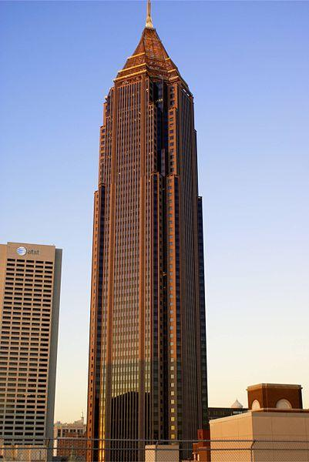
Google Site Update
https://sites.google.com/site/architecturalrecordsroundtable/home
Bank of America Plaza (Atlanta, 1991). Designed by Kevin Roche John Dinkeloo and Associates. Image from Wikipedia, Creative Commons.

Slide 5
Presentations
Software Preservation Network
Zach Vowell and Jessica Meyerson

Slide 6
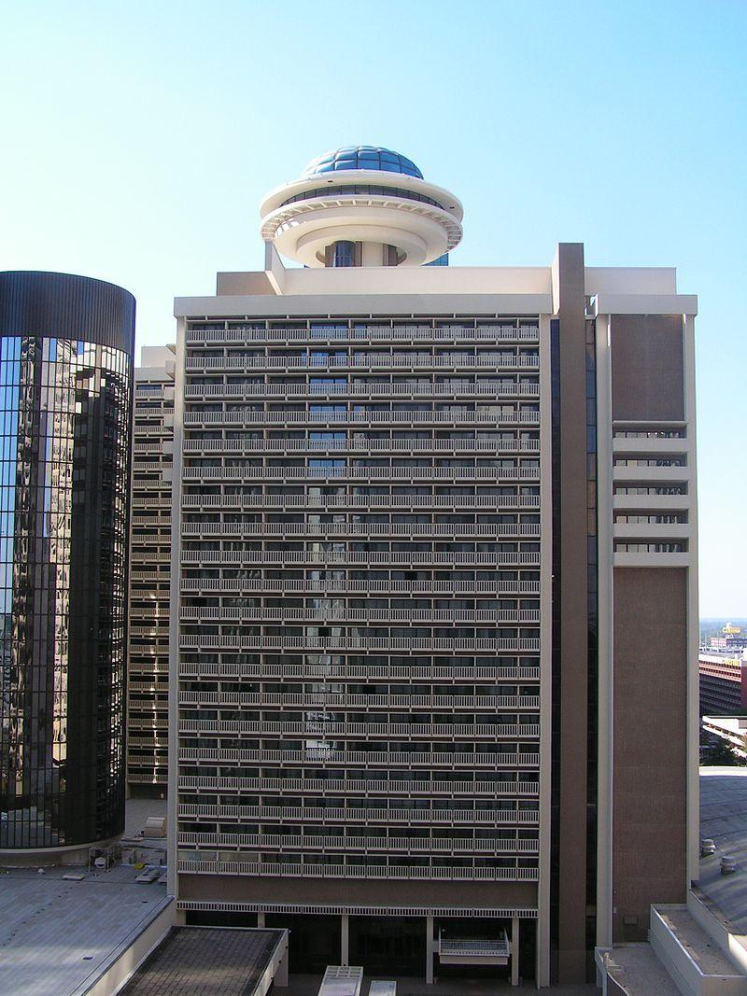
CAD/BIM Taskforce
Survey results
Hyatt Regency Atlanta (1967), Designed by John C. Portman. Image from Wikipedia, Creative Commons.

Slide 7
Digital Design Records: 2016 Survey Results
CAD/BIM Taskforce

Slide 8
Demographics
Experience with Born-Digital 46% 5 years or less 37% 0-1 years 37% 2-3 years 54% 5+ years 25% 5-10 years 74% 10+ years
106 Responses
Job Title 42% Archivist 57% “Other” 22% Architect 22% CAD/BIM in title
Institution Type 28% Firms 55% Institutions/Schools 3% Government Entity

Slide 9
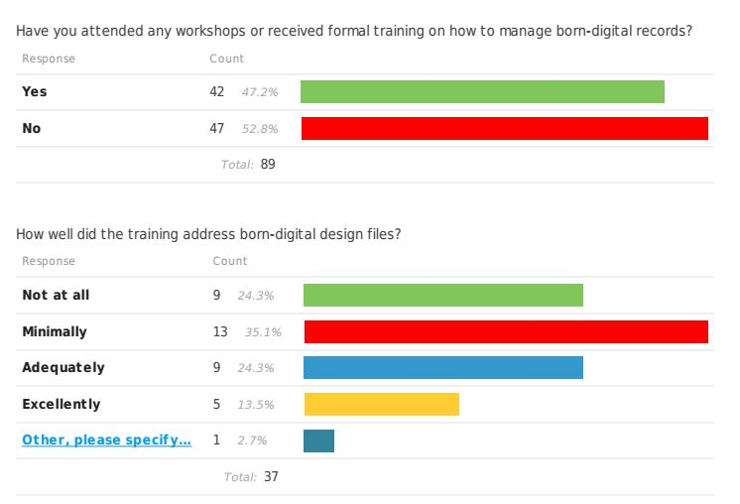
Education
~50/50 received training
Opportunity for ARR to engage with Digital Preservation training

Slide 10
Preservation
Significant holdings of records pre-dating 2000
What is the “Critical Knowledge” we need about these files?

Slide 11
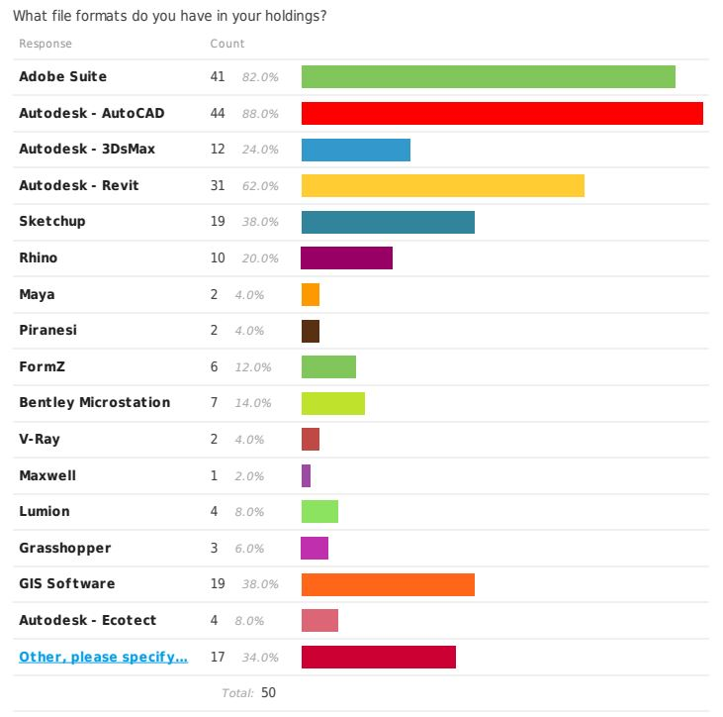
Preservation
Adobe & Autodesk are the dominant file types and software in respondents holdings.
Still, there is a remarkable variety of file formats being accessioned by collecting institutions. Strategies for preservation and access need to account for this heterogeneity.

Slide 12
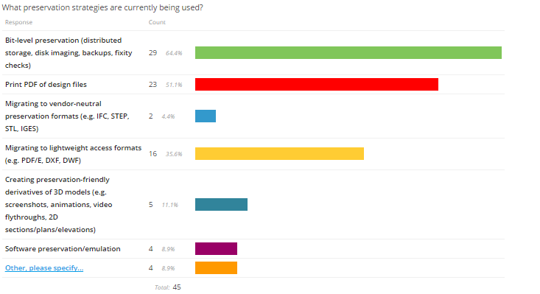
Preservation Strategies
What does bit-level preservation look like?
Follow-up question: Are migration and documentation strategies being implemented uniformly across holdings, or as one-off (e.g. grant funded or otherwise special) projects?

Slide 13
Preservation Strategies
What preservation strategies would you like to implement in the next few years? (23 responses)
Improve bit-level preservation; e.g. storage, backups, server security (8)
Migration to vendor-neutral and/or standard formats (6)
Software preservation/emulation (5)
Build recognition of issue/research/make a plan (4)
Improve naming conventions and documentation (3)
Depends on what donors are willing to do (1)
Encourage backwards compatibility with new software (1)
“I don’t think I could keep up with more digital preservation strategies” (1)

Slide 14
Preservation Strategies
What obstacles are preventing your institution from doing so? (27 responses)
Time/staffing (11)
Funding (6)
Administrative support (5)
IT support (5)
Staff knowledge (3)
Volume of acquisitions/processing backlog (2)
Haven’t yet received CAD/BIM records (2)
Buy-in from records creators (1)
Difficulty of acquiring/licensing legacy software (1)

Slide 15
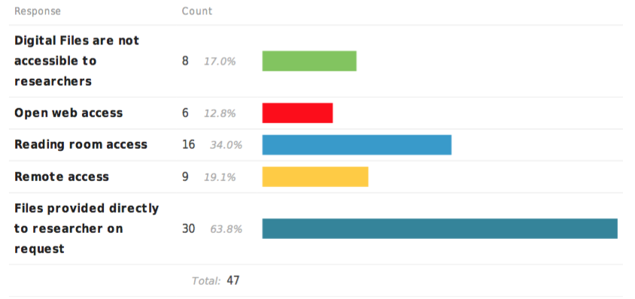
Access
How are we supporting researchers?
What limitations and/or benefits come with these various access levels?

Slide 16
Copyright
Why/how are people not concerned about copyright stipulations?
How are collections being used so that copyright may not be a concern?
Legal issues related to donations of software?

Slide 17
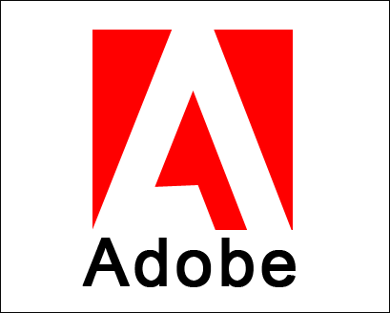
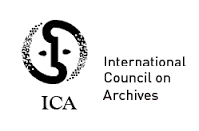
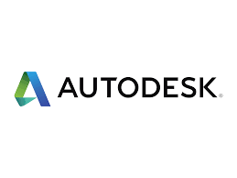
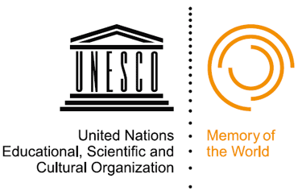
Partnerships
Industry
Archival (Pain Point Partnerships)

Slide 18
Next Steps
Deeper dive into usage of these records
Outreach to entities offering training on born-digital records
Strengthen, potentially formalize, partnerships

Slide 19
Survey Discussion
What is the general sentiment and vibe of our respondents?
What are their major concerns?
What trends are in the data?
Are these things we need to share with the larger community?
Where do we need to be focused?
Which software are most prevalent in our holdings?
From what years?
What are some areas we can provide quick support?
Preservation practices that are consistent?
What kind of checklists or protocols we can share to help facilitate better donor agreements and context collection?

Slide 20
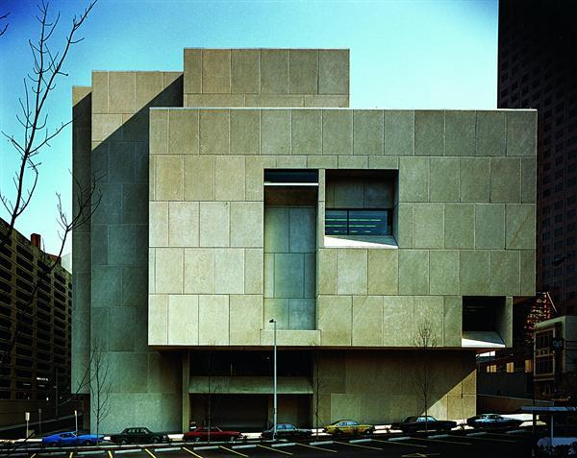
Final Thoughts
How do we see digital records as different from physical?
How do we see researchers using digital records, and what will archivists need to do to support them?
Atlanta-Fulton Central Public Library (1980), designed by Marcel Breuer. Image from Wikipedia, Creative Commons.

